Slide 1

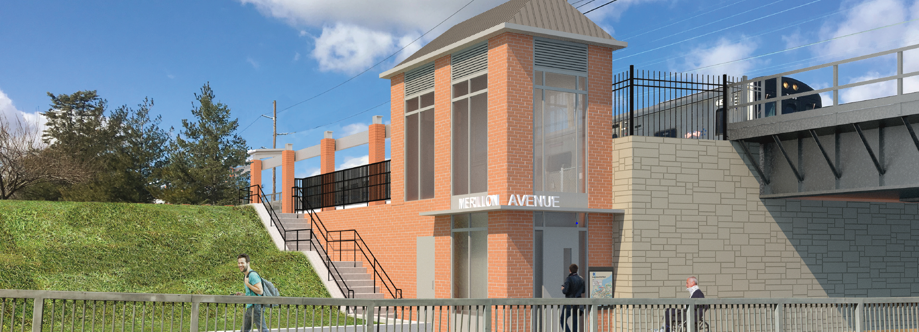


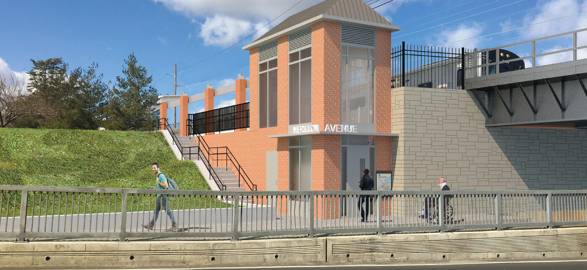
Village of Garden City Board of Trustees
October 4, 2018

Slide 2
Introductions
Andy Kraus - Outreach
Travis Brennan - Outreach
Bob Hamill - Construction
Lukasz Zawojek - Construction
Leslie Mesnick – Project Management

Slide 3

We Are the Design-Build Team
LEAD CONTRACTOR FIRMS
3
3

Slide 4


LIRR Expansion Project Components
New Hyde Park Rd.
Meadowbrook Pkwy
Tanners Pond Rd./
Denton Ave.
Plainfield Ave.
Nassau Blvd.
Glen Cove Rd.
S. Tyson Ave.
Covert Ave.
Cherry Lane
Urban Ave.
S. 12th St.
Willis Ave.
School St.
Main St.
Floral Park
Station
New Hyde
Park Station
Merillon
Avenue Station
Mineola
Station
Carle Place
Station
Westbury
Station
Hicksville
Station
9.8-mile Main Line segment from Floral Park to Hicksville
4

Slide 5
Pre-Construction Activities to Date in Garden City
Traffic studies and work zone management
Structure and road inspections
Noise measurement and monitoring
Surface surveying
Subsurface surveying
Rodent control in right-of-way
Access gate installation
Community outreach, meetings etc.
5

Slide 6
Construction Look-Ahead: Major Activities Timeline
April 2019-June 2020: Merillon Station
June 2019-Sept 2019: Nassau Blvd Bridge
Aug 2019-July 2020: New Hyde Pk Rd Crossing
Aug 2020-Dec 2021: New Hyde Pk Station
Dec 2020-April 2021: Denton-Tanners Bridge
6

Slide 7
Community Input and Issues
Traffic Management and Control
Grade Crossing, Stations and Bridges
Retaining and Sound Attenuation Walls
Tree and Vegetation Removal
Construction Access and Staging
7

Slide 8
Traffic Management and Control
Coordinating with Village government, emergency services, school districts and others to develop appropriate detour routing for road closures.
Preparing separate WZTC plans for each phase of each project component
Plan is flexible to address special situations, changing conditions
Special attention to schools, truck traffic, short cuts, etc.
8

Slide 9
Grade Crossing, Station and Bridge Improvements
Coordinated approach to minimize disruption
NH Park Road, Denton and Nassau Bridges remain open during construction
Stations remains open, train service/parking maintained/replaced
Bridge clearance built to NYS minimum 14 feet (plus 1 ¼ feet at Tanner, plus 2 ½ feet at Nassau)
9

Slide 10
Retaining & Sound Attenuation Walls
Throughout corridor, sound attenuation walls will be at least 8’ from ground level or 4’ top of rail
Sound and visual barrier built where none exists now
Studies show most noise is from bottom of train
Noise testing, monitoring and control to remain within agreed upon limits
10

Slide 11
Tree and Vegetation Removal
Vegetation and trees within LIRR property will be removed to allow for construction and as part of regular ROW maintenance
Arborists are evaluating which trees are affected and may be removed adjacent to ROW
Contract includes tree replacement requirements
11

Slide 12
Construction Staging and Access
Direct ROW access limits impacts by accelerating completion of work
Access points help reduce construction traffic on local roads
Allows project to be confined in ROW vs village-private property
Access gates along ROW localize work zones, needed for safety and emergency response
Remote worker parking with shuttle
12

Slide 13
Construction Staging and Access: Tullamore Park & The Cow
Proposed temporary use for staging & storage of equipment/materials
Ballfield on N side of Tullamore, ingress/egress on Main Ave only
Direct access to ROW north of Main Ave and end of Kilburn Rd
Fenced in, secure, maintained
Fields fully restored at project’s expense
Compensation to VGC for community improvements
By agreement with VGC and with clear terms
13

Slide 14




How to Contact Us
24/7 Community Hotline
(516) 203 – 4955
Email
CommunityOutreach@3rdTC.com
Community Information Center
114 Old Country Road
Mineola, NY 11501
By appointment only
Website
www.LIRRExpansion.com
www.AModernLI.com
14

