Slide 1
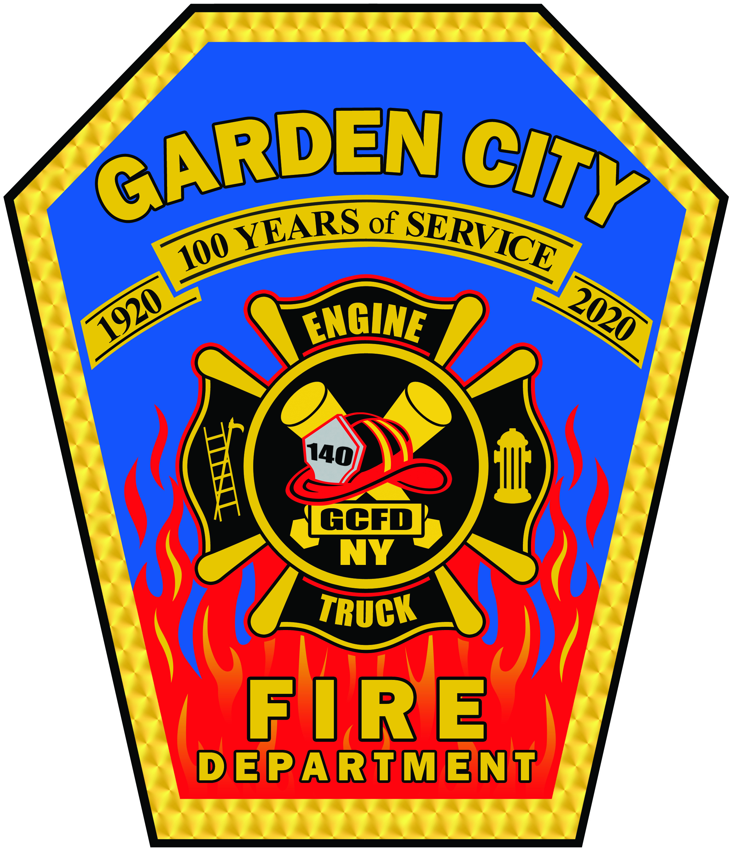
Garden City Fire Department Overview & Strategic Infrastructure Needs
Chief James R. Taunton
November 2025

Slide 2
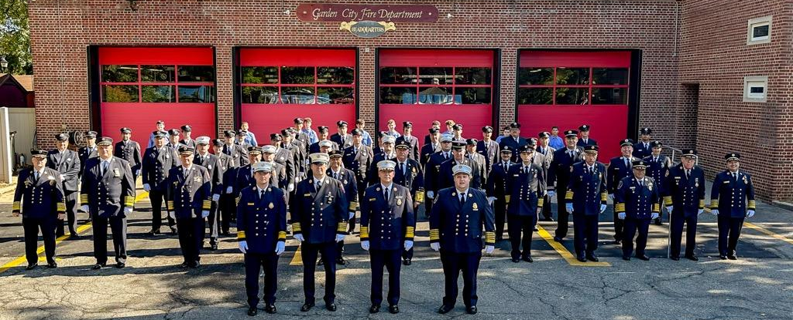
Who We Are
100% volunteer fire department since 2018
Serving 23,000+ residents
Over 100 years of continuous service
99 active members
Three fire stations covering 5 square miles

Slide 3
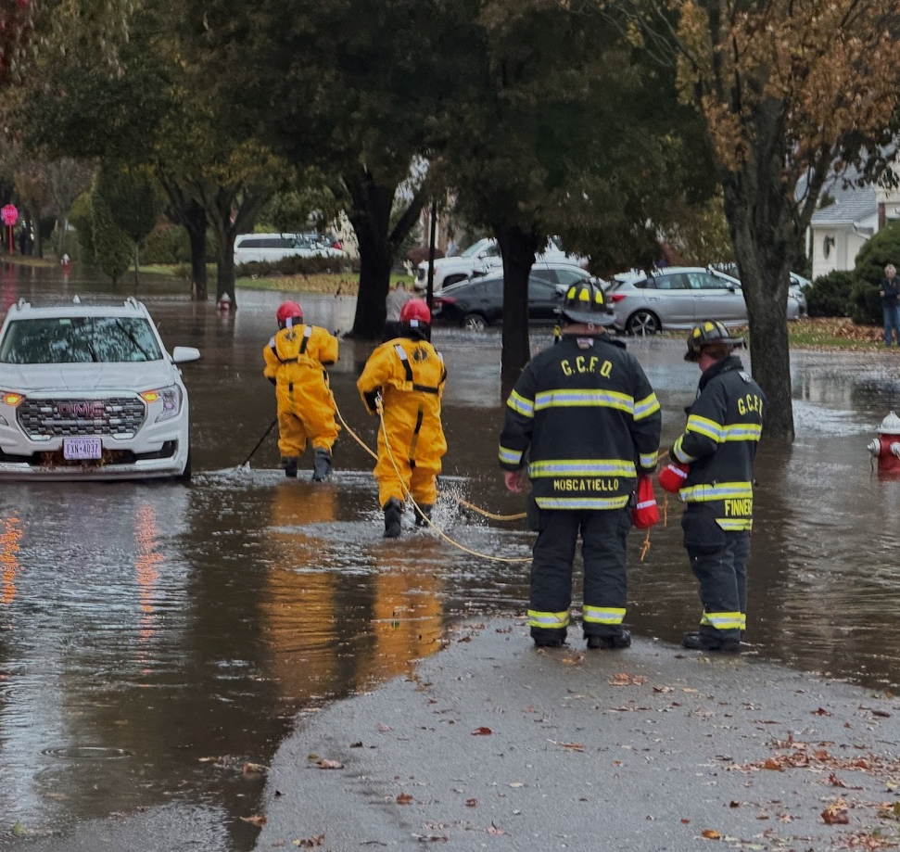
What We Do
Structure fires, smoke conditions
Fire and Carbon Monoxide alarms
Vehicle extrication & rescues
Storm responses; wires, trees, transformers, floods
Public education & fire prevention
Mutual aid support to surrounding departments

Slide 4
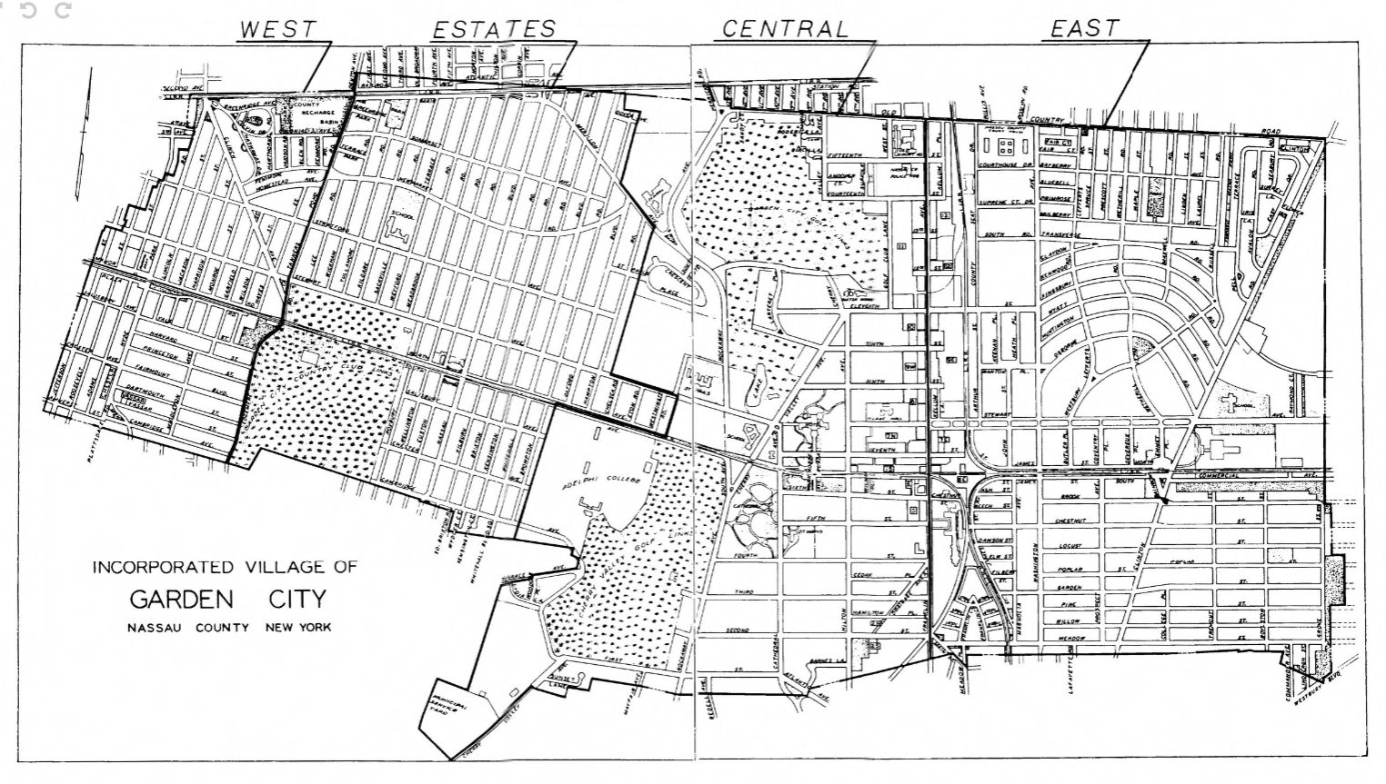

Fire Stations

Slide 5
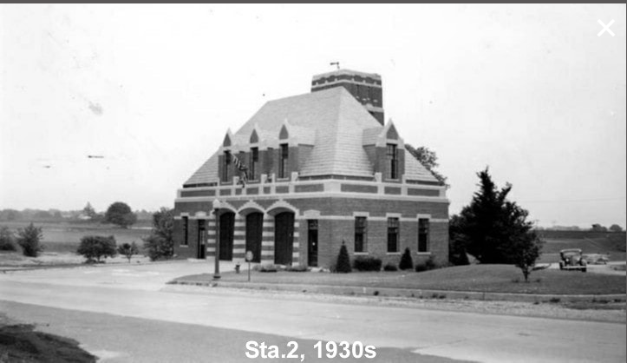
Timeline of Station 2
2017–2018: Initial studies
2021: Full abatement and modified response
2022–2024: Multiple redesigns reviewed
2024: October Workshop with Trustees—updated to 3 options
Nearly a decade without a final decision

Slide 6

Fire Station 2 – Project Options
Option 1: Full renovation + second floor + extension
Modernizes entire building
Adds space for any apparatus, including a ladder truck
Best long-term safety & operational solution
Option 2: First floor renovation + extension
Fixes main operational needs
Extension allows full apparatus accommodation
Most cost-effective option that still meets FD needs
Option 3: First floor renovation only
No extension
Short-term improvement, does not meet long-term needs

Slide 7
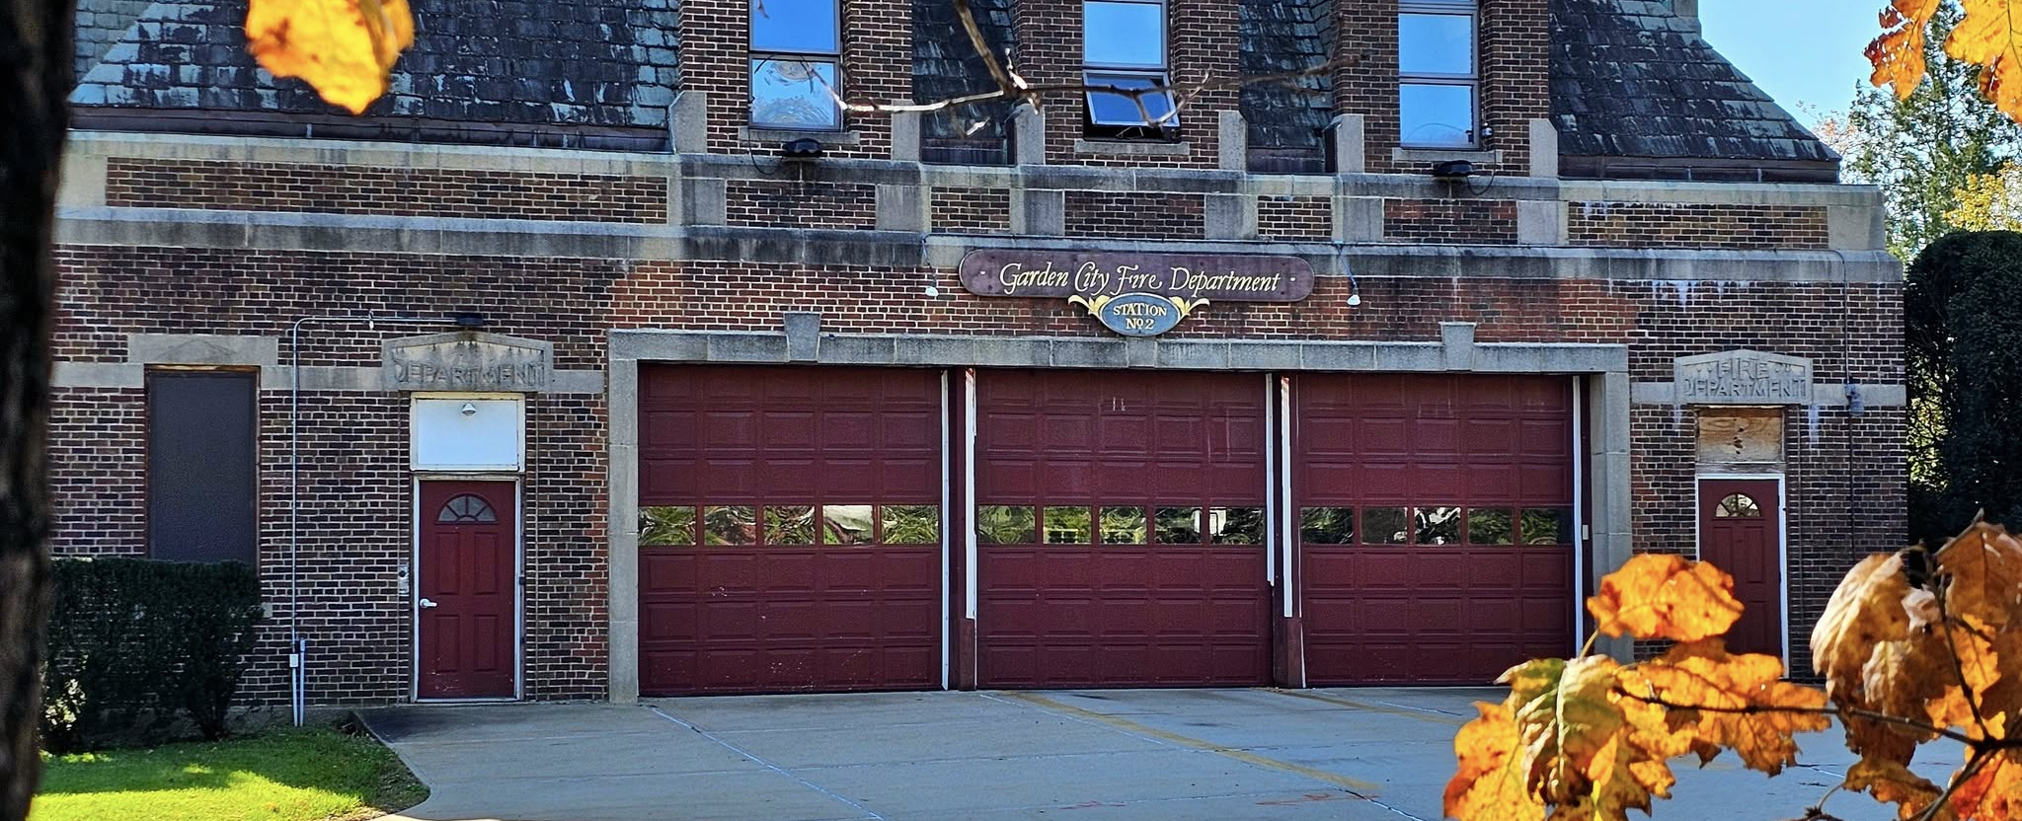
Importance of Station 2 (Edgemere Road)
Furthest west station covering our 5 mile village
Response only since 2021 due to abatement*
Critical for Nassau Blvd, schools, and west district
Increased response time without it
Enables a rapid response to West-End emergencies

Slide 8
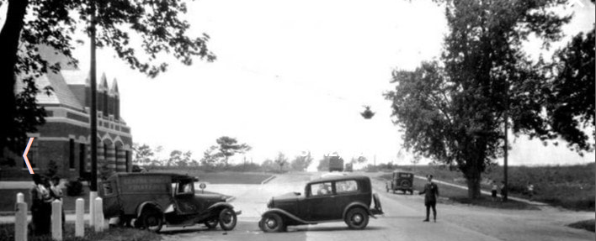
Modern St. 2 Requirements: Protecting Lives, Property, and Community
Properly sized apparatus bays
Gear storage separated from truck exhaust
Improved electrical, HVAC, plumbing
Radio infrastructure room
Safe environment
50-year forward planning

Slide 9
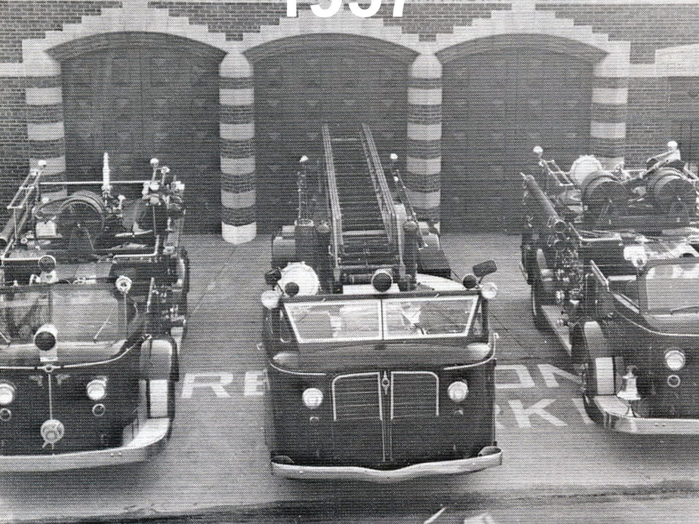
Apparatus Size vs Existing Bays

Slide 10
GCFD Apparatus Overview
Apparatus | Height | Body Width | Mirror–Mirror | Length
141 -HQ | 10'8" | 8'5" | 10' | 32'4"
142*-St. 2 | 9'6" | 8' | 9'7" | 28'5"
143- St. 3 | 10'0" | 8' | 9'7" | 32'5"
144-HQ | 11'4" | 9'8" | 9'8" | 40'4"
146-HQ | 10'7" | 8'4" | 10' | 39'4"
147-HQ | 11'4" | 8'4" | 10' | 43'2"
149*-St. 3 | 9"1" | 8' | 9'7" | 28'
“*” Indicates the apparatus can fit within the current Station 2
Bay Doors | Station 3 | Headquarters | Station 2
Width | 22' | 10.5' | 10'
Height | 11.8' | 11.9' | 10'

Slide 11
Typical U.S. Fire Truck Dimensions
Apparatus Type | Width (Body Only) | Width w/ Mirrors | Height | Length
Engine / Pumper | 8–8.5 ft | 9.5–10 ft | 10–11.5 ft | 28–35 ft
Ladder Truck (Mid-mount) | 8–8.5 ft | 9.5–10 ft | 10.5–12.5 ft | 45–50 ft
Rear-Mount Aerial / Tower Ladder | 8–8.5 ft | 9.5–10 ft | 11–12.75 ft | 47–52 ft
Tiller (Tractor-Drawn) | 8–8.5 ft | 9.5–10 ft | 11–12.5 ft | 55–63 ft
Heavy Rescue / Squad | 8–8.5 ft | 9.5–10 ft | 10–12 ft | 30–40 ft
Mini Pumper / Light Rescue | 7.5–8 ft | 8.5–9.5 ft | 8.5–9.5 ft | 20–26 ft
Source: FAMA

Slide 12
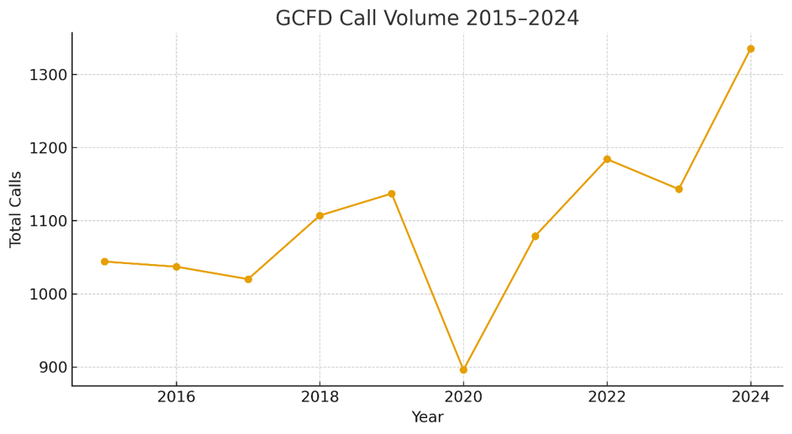

Slide 13
ISO Rating Overview
ISO evaluates apparatus, stations, water supply, training
Garden City FD ISO rating of 3 (scale 1 (best) to 10 (worst))
Goal is to improve rating
50% of score is based on apparatus, response to fires and availability of firefighters and other factors.

Slide 14
Financial & Long-Term Planning
Build
Build once for 50-year needs
Avoid
Avoid expensive future retrofits
Align
Align with NFPA and regional standards
Protect
Protect taxpayer investment

Slide 15
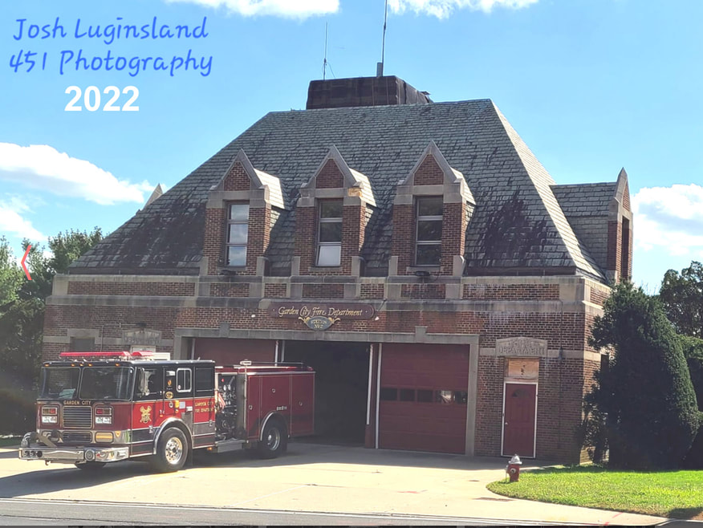
Why “Option 2” is the best for the firefighters and residents
Meet NFPA clearance standards
Allow modern & future apparatus
Support clean cab & decon layouts
Improve firefighter safety
Operational efficiency on response

Slide 16
References & Source Documentation
Fire Apparatus Manufacturers’ Association (FAMA) Emergency Vehicle Size & Weight Guidelines (TC009-1), 2017 Industry standard for apparatus length, width, height, turning radii, and bay size planning. (www.fama.org)
FAMA Fire Service Resources – Apparatus Size & Regulation Guidance Compilation of national apparatus dimensions and facility requirements. (www.fama.org/fire-service-resources-list)
National Fire Protection Association (NFPA) 1901 Standard for Automotive Fire Apparatus Defines apparatus construction, safety requirements, and dimensional standards.
NFPA 1500 – Fire Department Occupational Safety Standard Specifies minimum working clearances (3 ft on all sides) and bay environment safety guidelines.
NFPA 1900 Series (1901/1906/1911)
FireRescue1 Industry Article (2016) “10 NFPA Fire Truck Updates You Need to Know” – overview of modern apparatus growth trends.

