Slide 1
Village of Garden City
Water Department EAB Update
November 2025

Slide 2
Project Update
Well 9 (Edgemere) AOP Treatment project
Water Main Replacement at the DPW Yard and Pool area
Old Water Woks Building Renovations
Cedar Valley Sewer Lift Station Replacement
Hydrant Replacement Water Main Upgrade Project
Village Hall water and fire service replacement project

Slide 3
Steps the Village Continues to take to Assist Residents:
Free lead testing for all residential homes
Road Opening permit fees are waived for Lead Service Line Replacements
Identification program mandated by EPA
In home inspection assistance
Web page to upload residents service line material type
EPA required deadline is now yearly.
Lead services must be replaced by 2037

Slide 4
III. Summary of Inventory
Total Number of Service Lines in the Distribution System |  |  |  |  | 6960
Total Number of Identified Service Lines |  |  |  |  | 3422
Total Number of Lead Service Lines |  |  |  |  | 1190
Total Number of GSLRR |  |  |  |  | 60
Total Number of Non-LSL |  |  |  |  | 2172
Total Number of Unknown Service Lines |  |  |  |  | 3534

Slide 7
The UV Advanced Oxidation Process
UV AOP requires UV light and an oxidant, such as hydrogen peroxide or chlorine. The process occurs in the UV chamber instantaneously with oxidizing radicals attacking and decomposing contaminants, so they are no longer harmful.

Slide 8
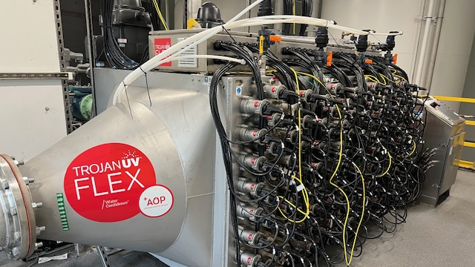

Slide 9
Granular Activated Carbon
GAC treatment typically involves pumping contaminated water or soil vapor through a column or tank filled with GAC. As contaminated material flows through the GAC, the contaminants sorb to the outer and inner surfaces of the granules. The water or vapor exiting the container is cleaner.

Slide 10
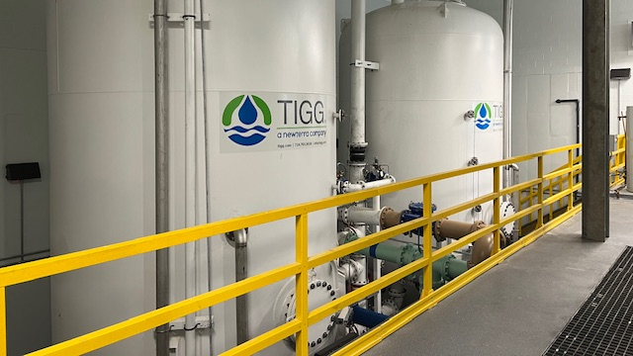

Slide 11
Packed Tower Air Stripper (AST)
Typically uses a counter-flow design with a cylindrical tower containing a specially designed packing media that provides a large surface area for air/water contact. Contaminated water flows down through the packing while air flows upward. VOCs or other contaminants are transferred from the contaminated water stream to the air stream, which then flows out through the top of the tower. Clean water flows out at the bottom of the tower.

Slide 12
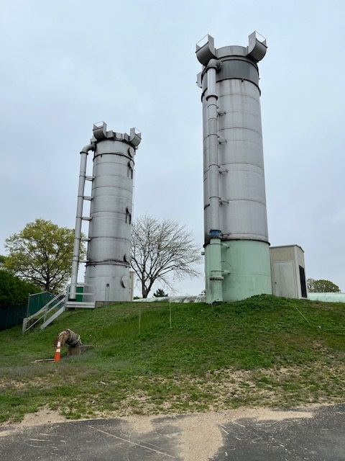

Slide 13
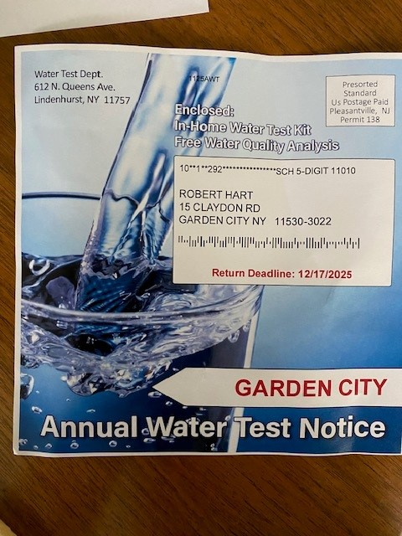

Slide 14
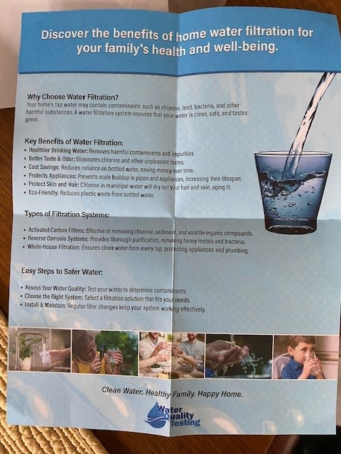

Slide 15
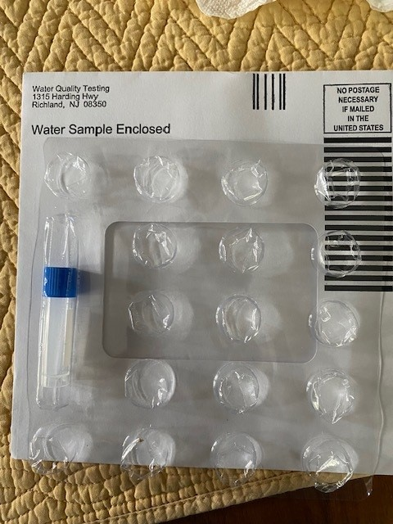

Slide 16
Questions??
Thank you,
Environmental Advisory Board
Stan Carey, Water Superintendent

