Slide 1



It’s Your Doody!
Pet Waste Problem in Garden City
Silver Project by Girl Scout Troop 1187
Jovana Marin
Dana Sievers
Manya Goyal
Juliet Conway
Notes:
LEAVE BLANK

Slide 2
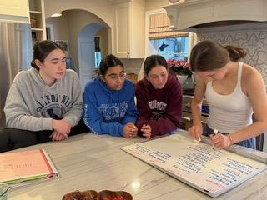
Problem at a Glance
Residents have been complaining about pet waste in GC on social media
One resident said she spotted 4 bags of waste at the park
Many others have been complaining that a storm drain is being used as a garbage can
We have seen dog poop in local parks, schoolyards and streets
Unattended pet waste can lead to harmful diseases such as E.Coli, giardia, and salmonella
Notes:
Problem - Jovana

Slide 3
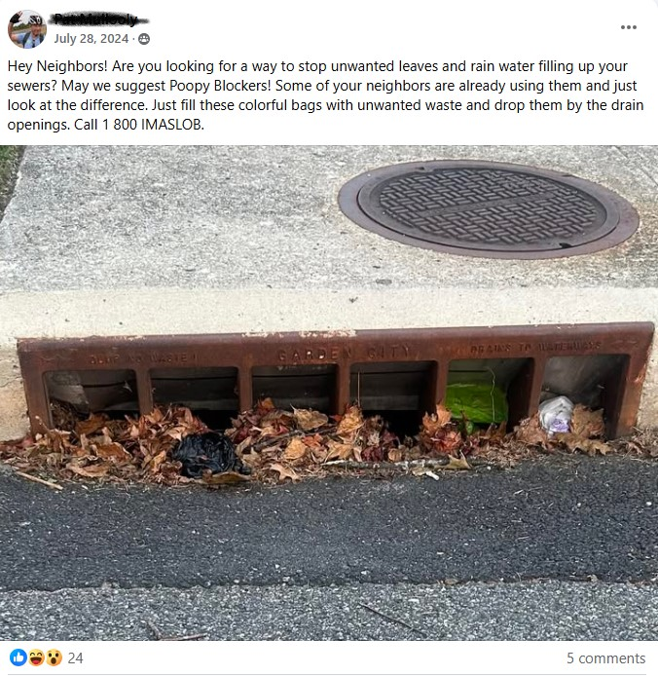
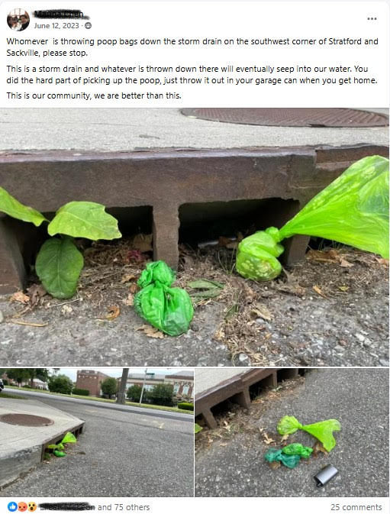
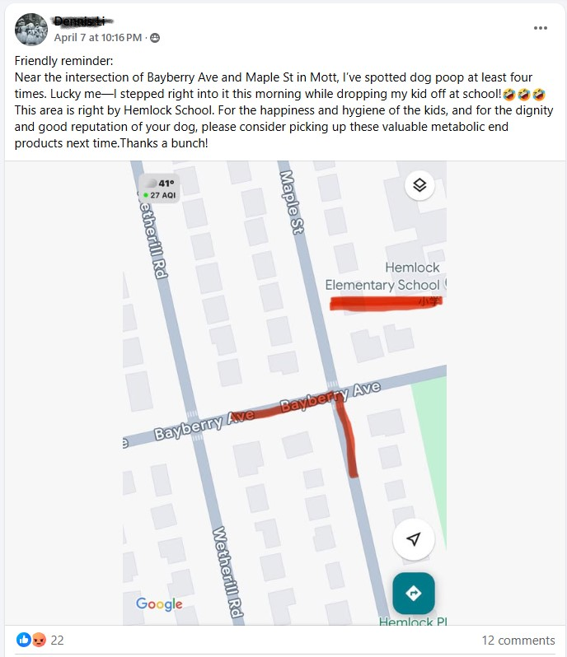
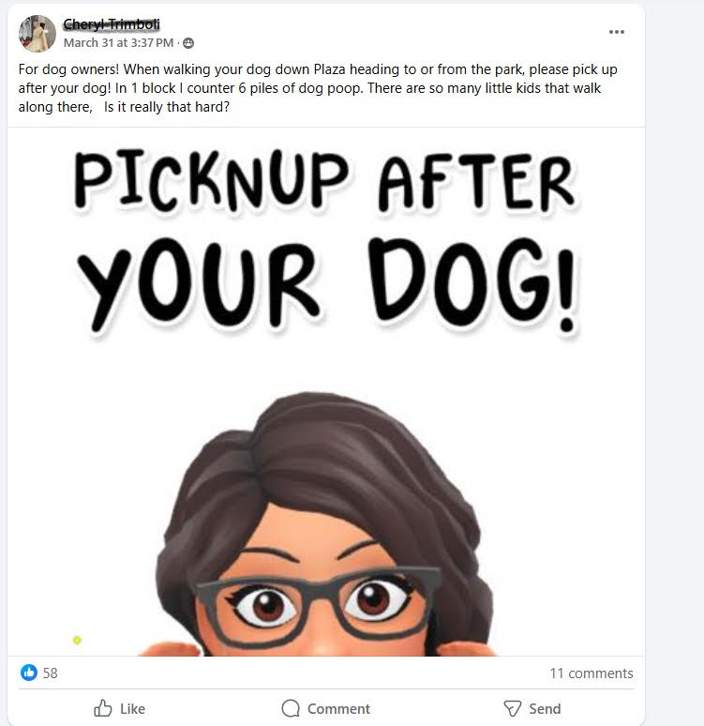
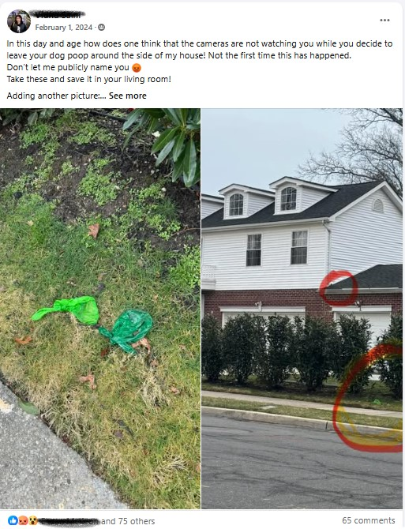
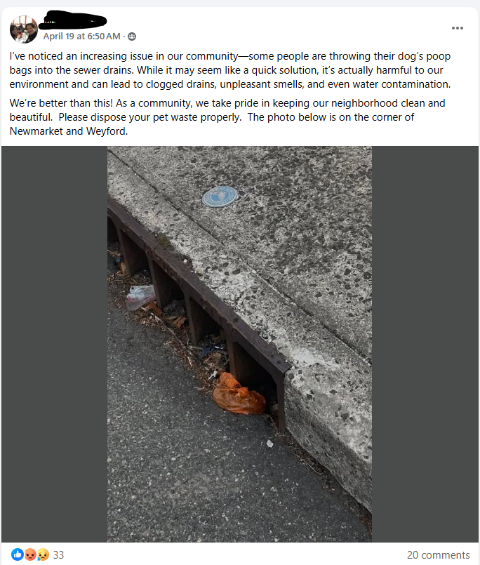
Problem: Pictures Shared on Social Media
Notes:
Problem - Jovana

Slide 4
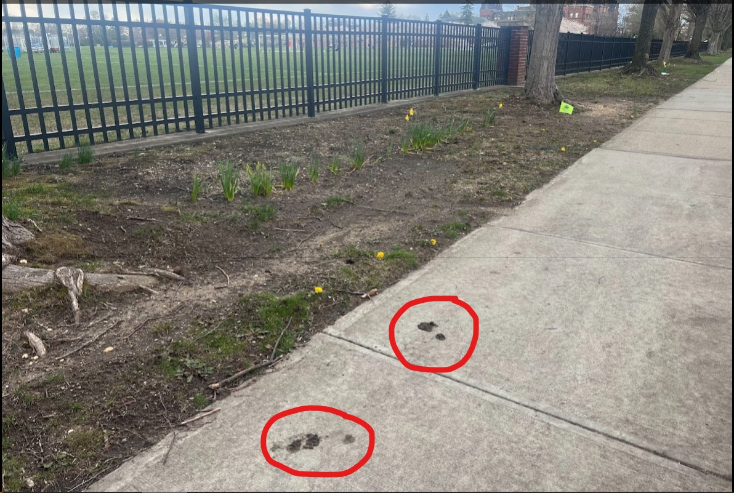
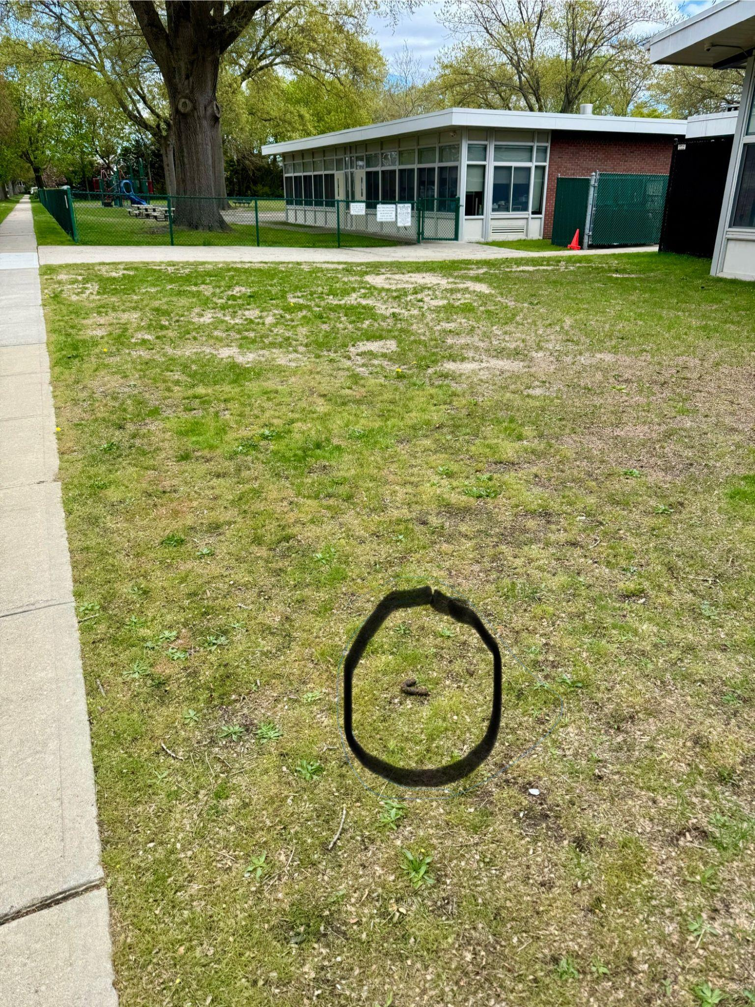
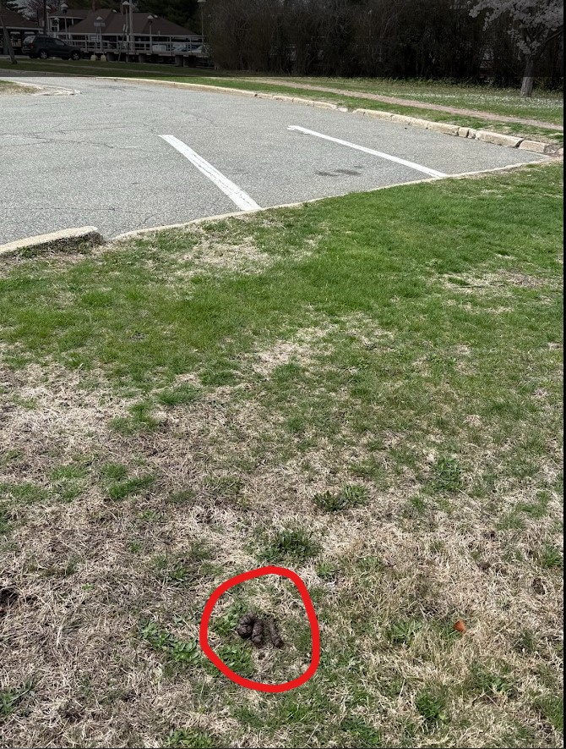

Problem: Pictures Taken by Our Team
St. Paul’s Field
Garden City Train Station
Locust School
Notes:
Jovana

Slide 5
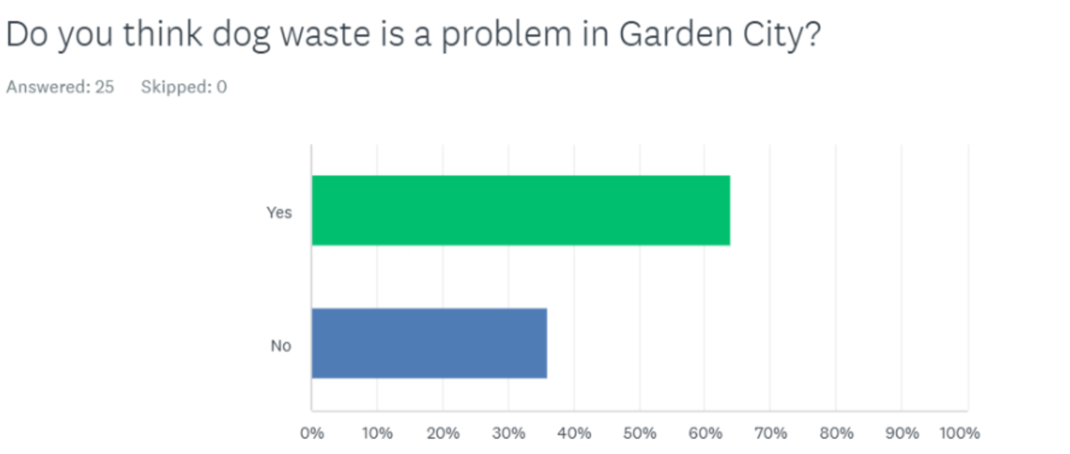
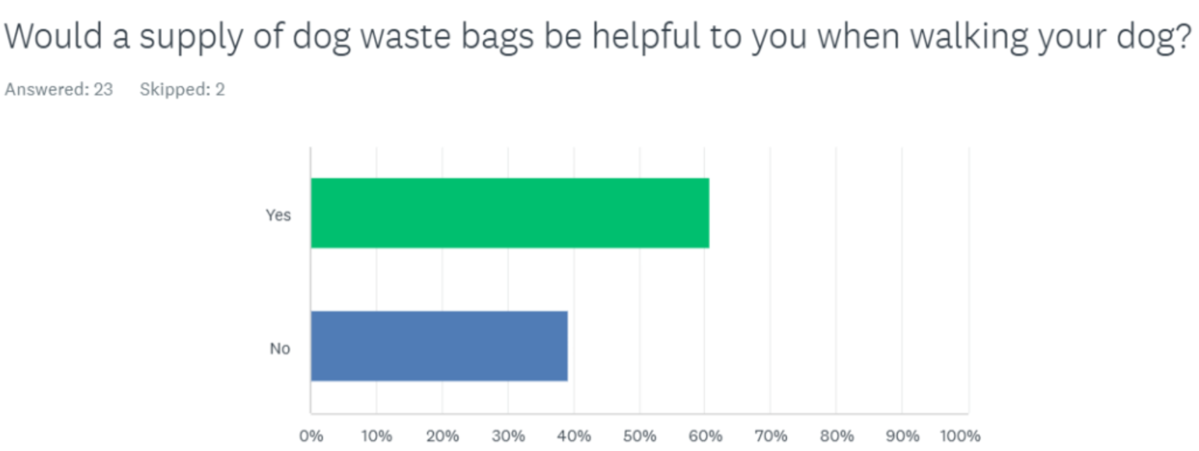
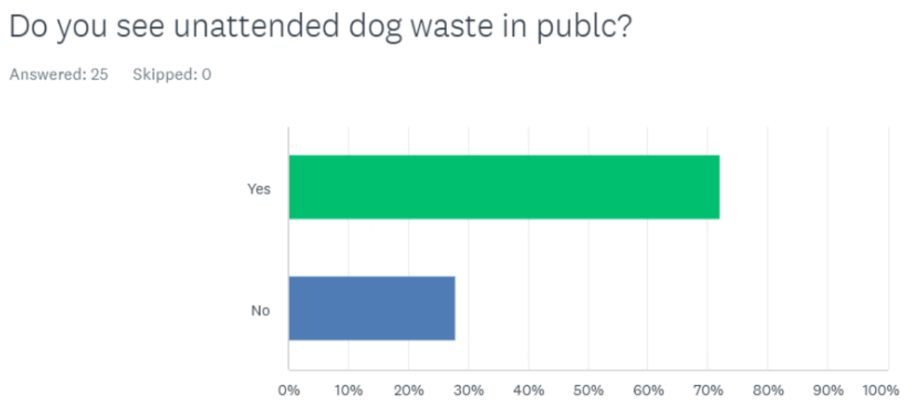
Research: Survey Results
64% of residents agreed that dog waste is a problem in GC
61% of residents agreed that a supply of dog waste bags would be helpful
71% of people see unattended dog waste in public
Notes:
Research: Dana

Slide 6
What Other Towns Have Done
1st Step: Most towns had to recognize the problem in their community and brainstormed solutions like pet waste stations, public education, developing and enforcing local pet waste laws.
2nd Step: Put it in writing, getting involved in town governments and show that this is a real issue being addressed, passing local “Pooper Scooper” laws.
Town of Hempstead - 311 program. The Department of Sanitation (DSNY) enforces the Pooper Scooper law. Property owners remain responsible for maintaining the cleanliness of their property.
3rd Step: Taking Action Advertising the new laws using clear and informative signs and enforcing laws through fines.
Notes:
Research: Dana
Say what enforcement means

Slide 7
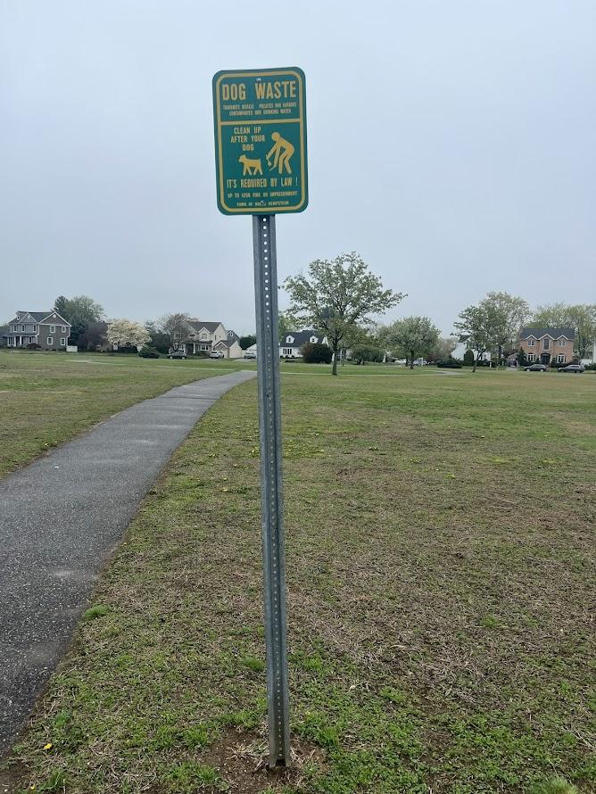
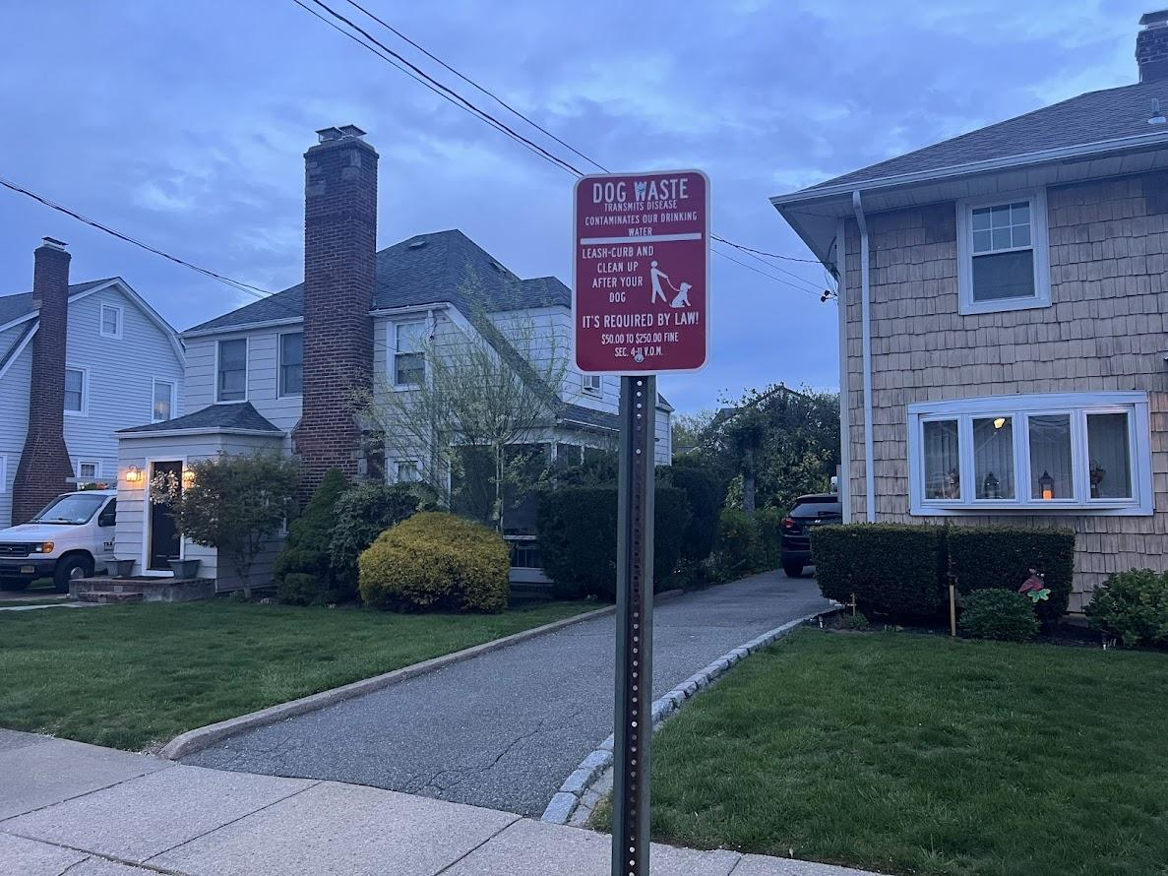
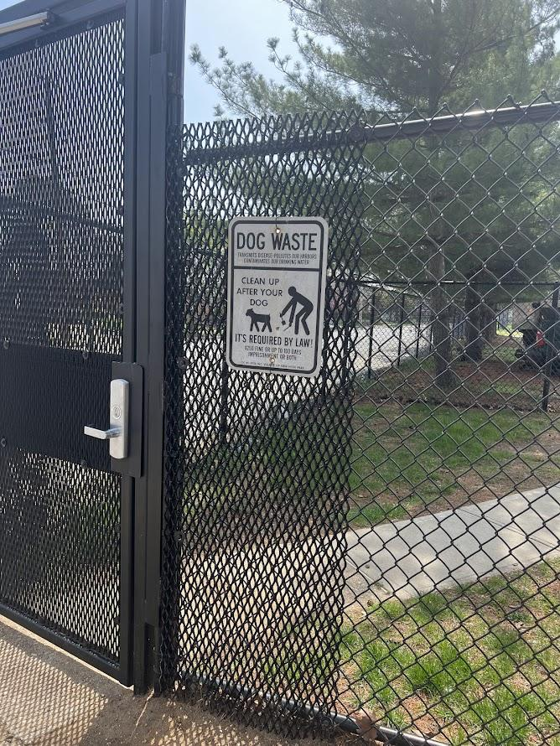
What Other Towns Have Done
Herricks
(North Hempstead)
Mineola
New Hyde Park
Notes:
Research: Dana
The towns have installed signs in [parks reminding and enforcing residents to clean up

Slide 8
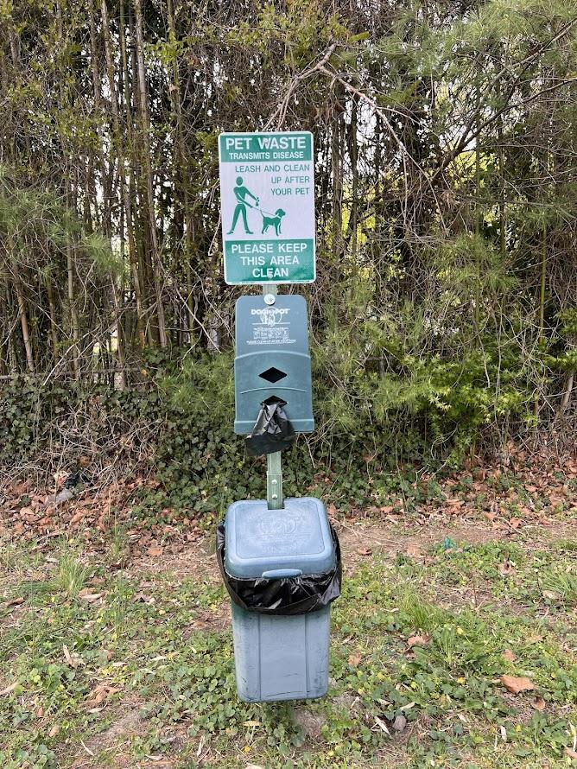
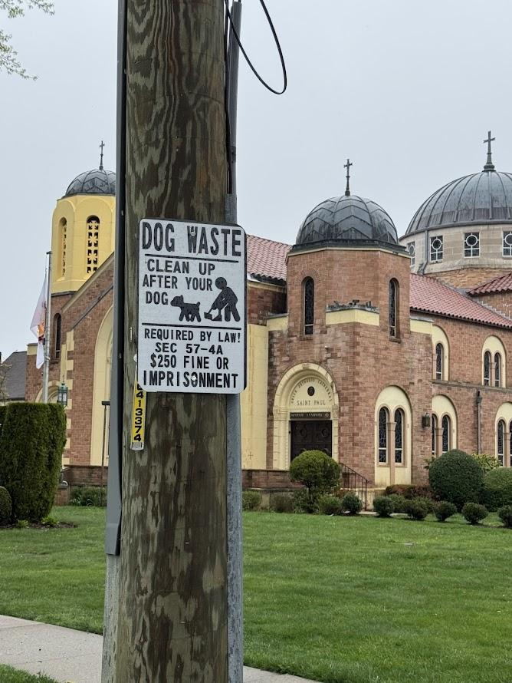
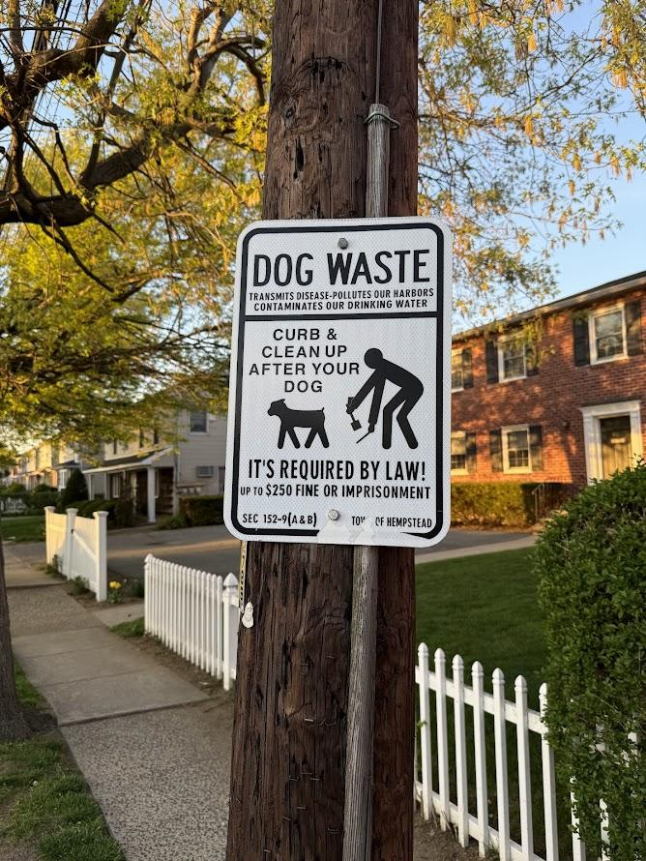
What Other Towns Have Done
On Cathedral Avenue, just past the Garden City border, these signs are every 50 feet on both sides of the road.
Village of Lake Success
Cathedral Gardens
Garden City South (across La Bottega)
Notes:
Research: Dana

Slide 9
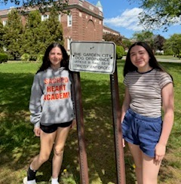
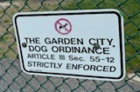
What Our Town Currently Has
Garden City has 3 article points that cover how to manage dog waste:
Village Code § 55-12:
Illegal to allow your dog to urinate or defecate on:
- Sidewalks, parks, public areas, or private property without permission
- Places where people walk, play, or gather
Village Code § 55-13: Proper Disposal
Waste is immediately picked up and disposed of in a sanitary way
Village Code § 55-14: Enforcement
Violations can result in appearance tickets
- Issued by police or Village Animal Wardens Similar to a parking ticket — but for pet waste
Notes:
Research Dana
double day Court is not private area but to make sure to keep their space clean

Slide 10
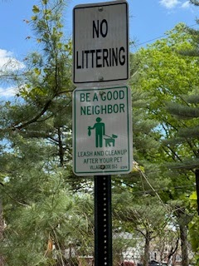
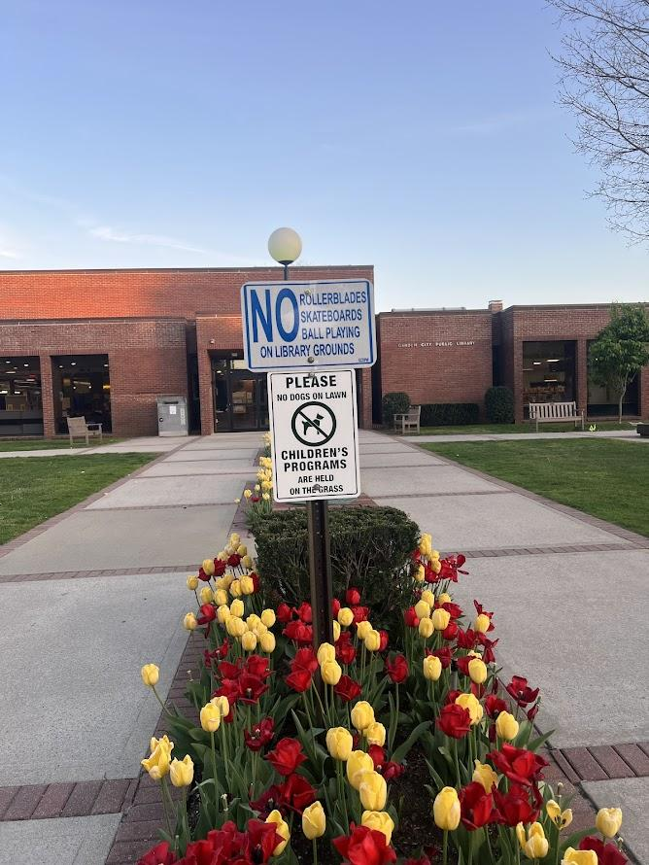
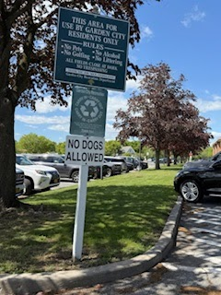
What Our Town Currently Has
Manor Rd
near Edgemere Park
Garden City Library
St. Pauls Parking lot
Notes:
Research Dana
Dog parks
Stratford
Tullamore

Slide 11
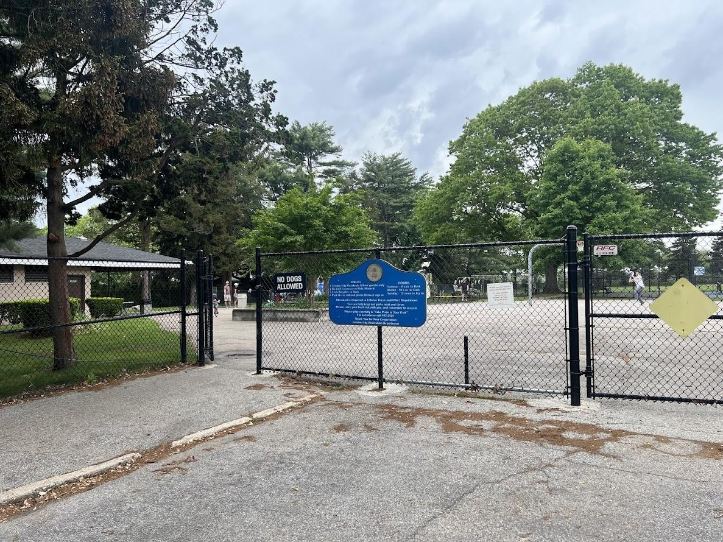
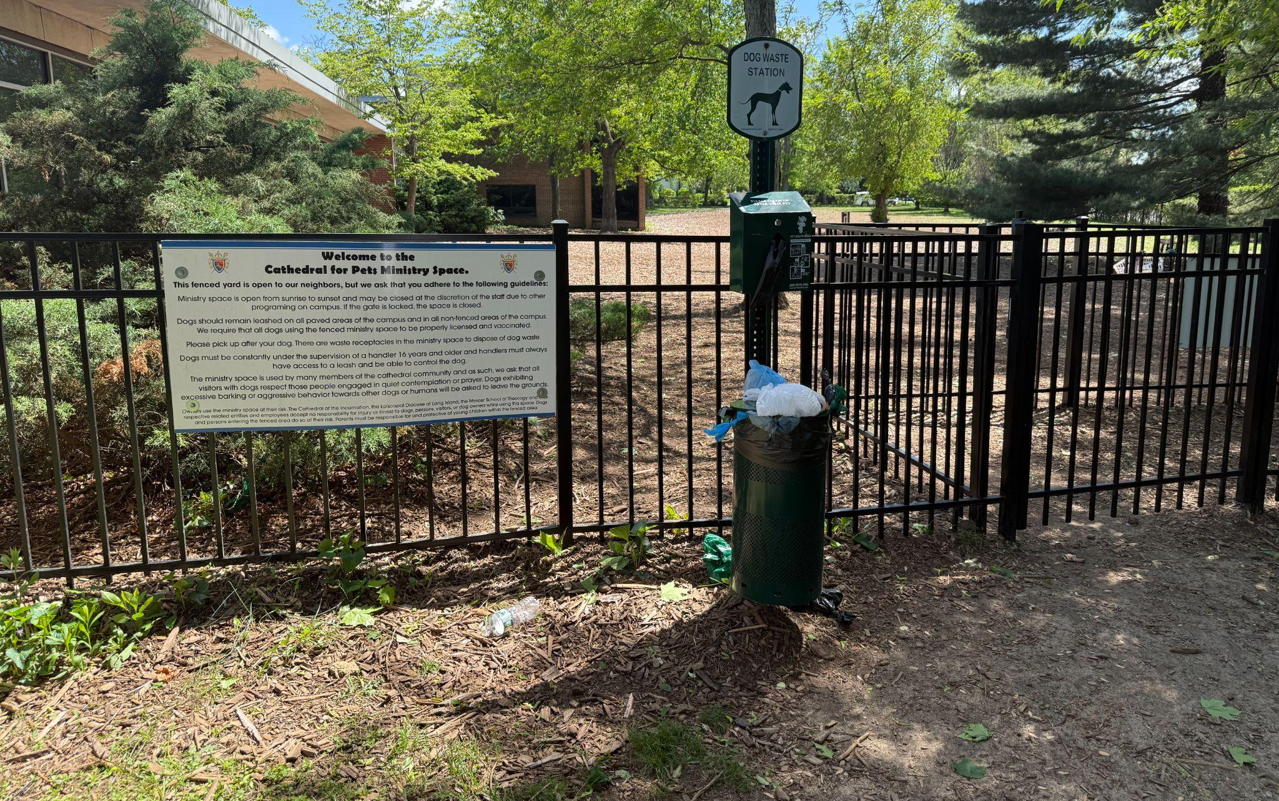
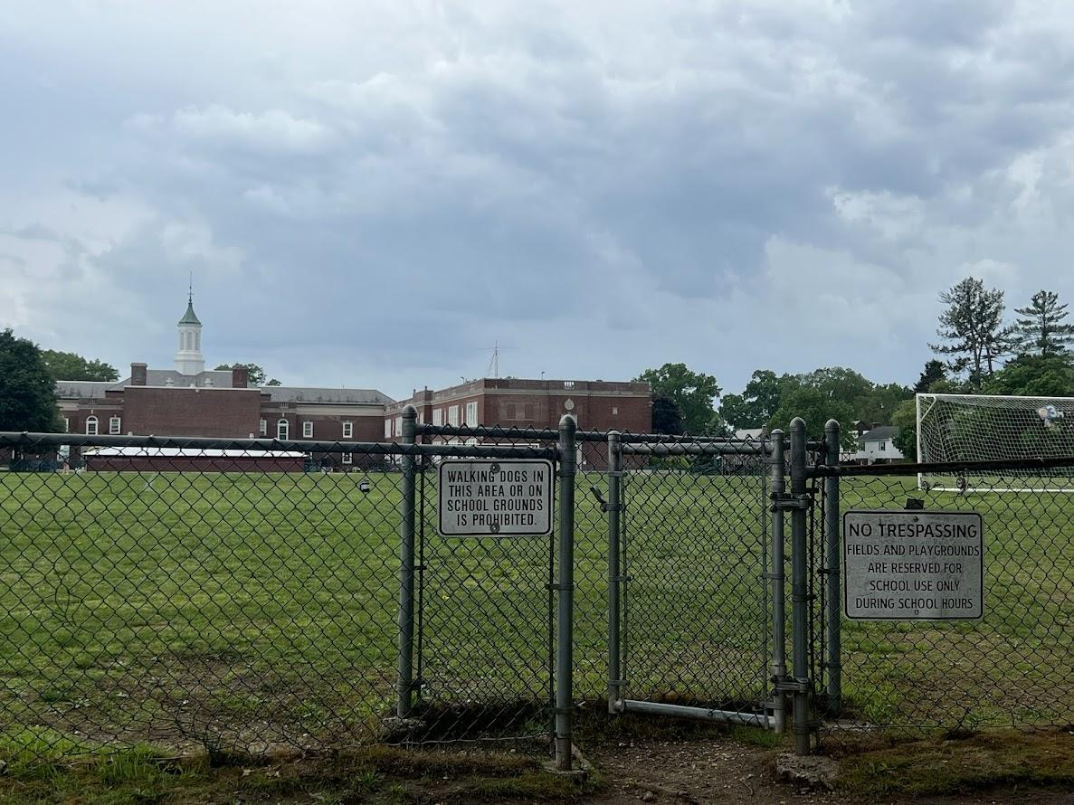
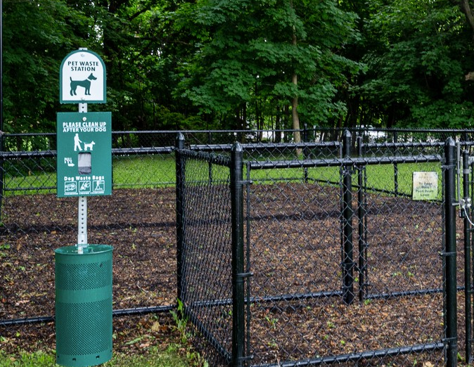
What Our Town Currently Has
Tullamore Park
Cathedral of the Incarnation Dog Park
Stratford School
Double Day Court Condominium
Notes:
Research Dana
Dog parks
Stratford
Tullamore
Our team observed signs outside of every park
But they are just limited to parks and not on the streets
But waste we’ve observed is mainly on the streets or sidewalk
The dog waste we see on the streets isn’t being picked up. Signs and waste cans are only in the parks

Slide 12

What our Village needs to do
TROOP 1187: EAB:
Propose Pilot Program at EAB Meeting
Create Awareness via GC News/Social Media
Share Google Feedback Form
Organize pop-up events at community gatherings
Enact Pooper Scooper Law
Install signs indicating the fine (as seen in neighboring towns)
The Silver Award requires us as girls scouts to recognize an issue in the community (pet waste) and come up with a solution (pet stations). An additional part of our solution is reaching out to members within our community who have the power to take these necessary steps to creating a long lasting solution. Our stations are just the first step! We hope that with these slides and with our overall project our town can take the steps that other towns have taken and write appropriate laws and enforce these laws with signs and fines.
Notes:
Action - Manya
For our Girl Scout Silver Award, we identified pet waste as a community issue and proposed installing pet waste stations as a solution. Additionally, we are reaching out to local leaders to encourage long-term changes, such as creating and enforcing laws with signs and fines. Our pet stations are just the beginning-we hope our project inspires the town to adopt lasting solutions like other communities have done.

Slide 13


What is Pooper Scooper Law?
The New York State Public Health Law 1310 ( Pooper Scooper Law) states that it shall be the duty of every dog owner to remove any of their pet’s feces from any public area or face a fine of up to $250.
Creating awareness of this law in Garden City is a reminder for pet owners to clean up their pet’s waste.
Notes:
Law - Manya

Slide 14
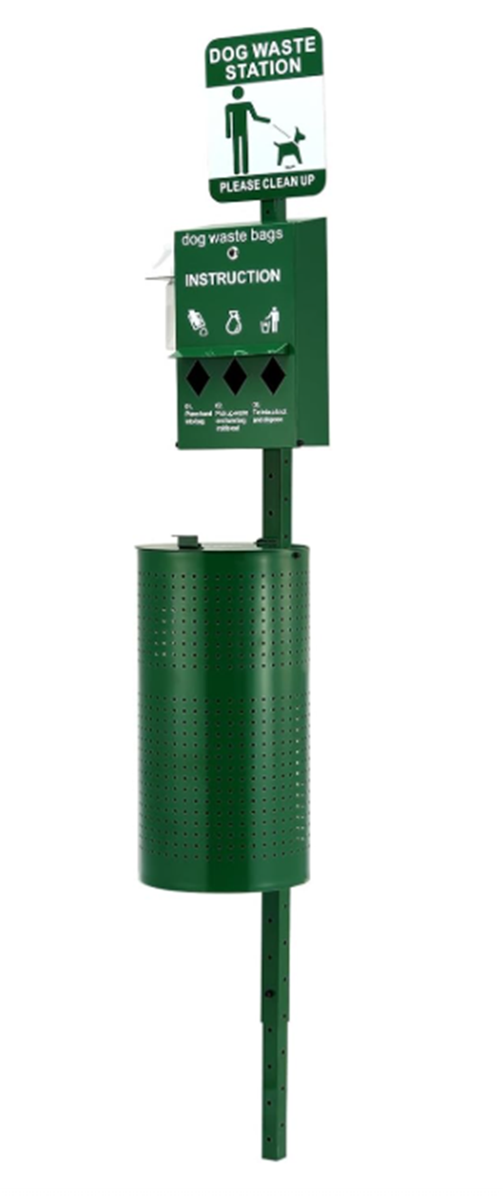
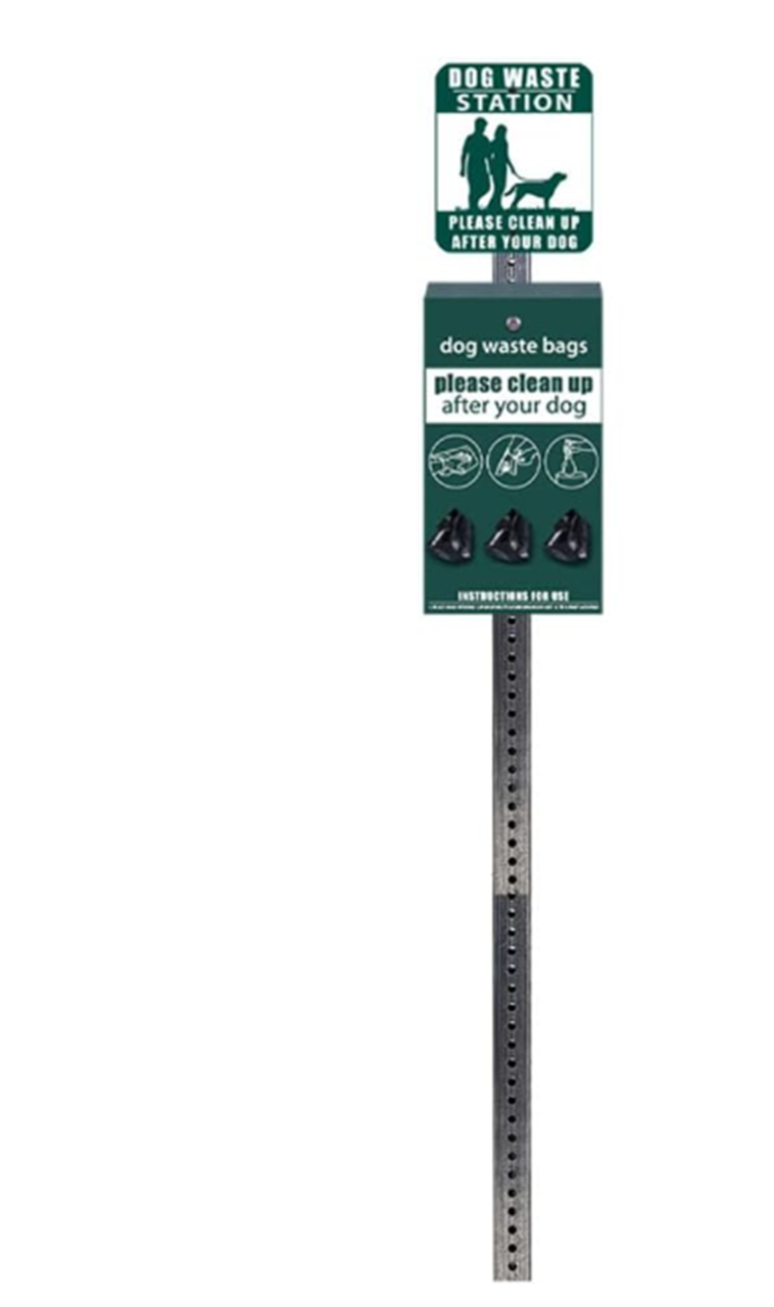
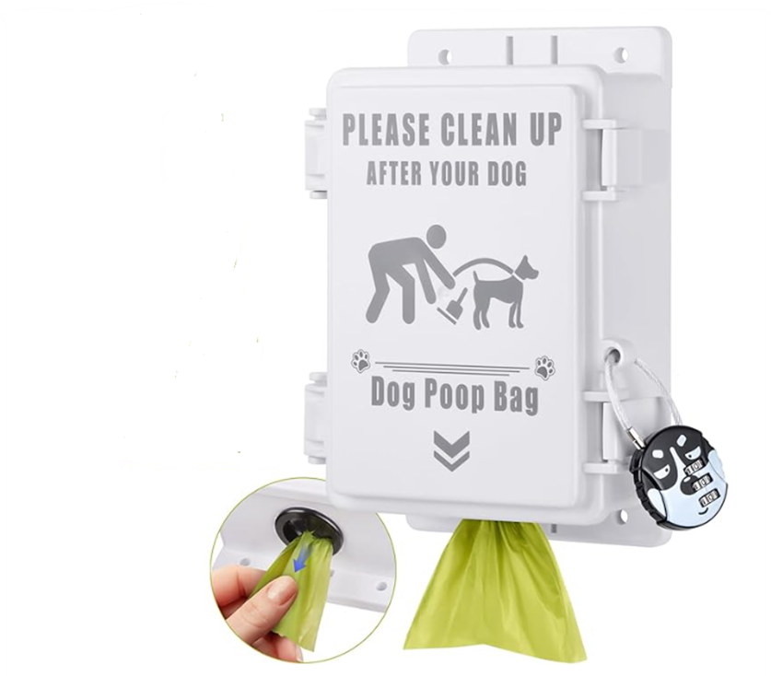
Pilot Program to Install Waste Bag Dispensers
Option A
Option A is a dog waste bag dispenser on a stake with trash can attached.
Option B is a dog waste bag dispenser on a stake.
Option C is a dog waste bag dispenser mountable on a wall or a pole.
Why did we choose option C?
We chose option C because it is very easy to install for our pilot program and it is the cheapest.
Option B
Option C
Notes:
Solution - Manya
Program timeline: May 21 (upon EAB’s approval) through Aug

Slide 15
Cost
Option A - Standalone bag dispenser with attached garbage can $225
Option B - Standalone bag dispenser without garbage can $150
Option C - Bag dispenser that clips on each garbage $26
Dog waste bags (Per 100) $9
Options with all locations and dog waste bags:
Option A - $936 (all 4 Pilot Locations + waste bags)
Option B - $636 (all 4 Pilot Locations + waste bags)
Option C - $140 (all 4 Pilot Locations + waste bags)
Notes:
Cost - Manya

Slide 16
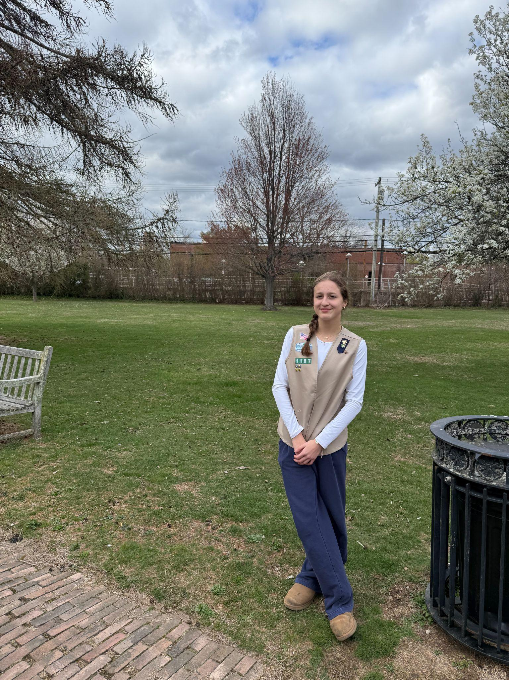
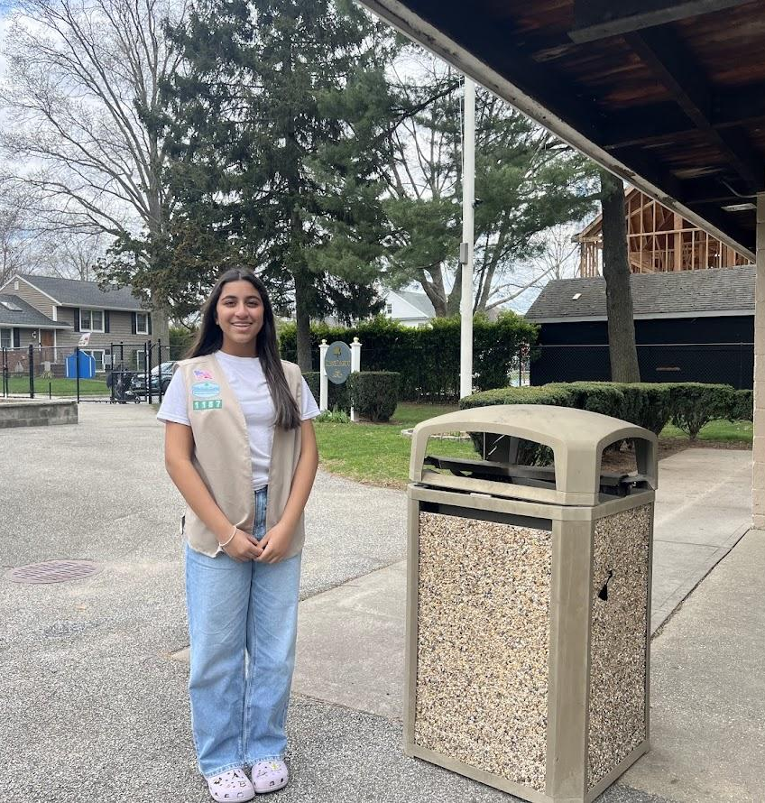
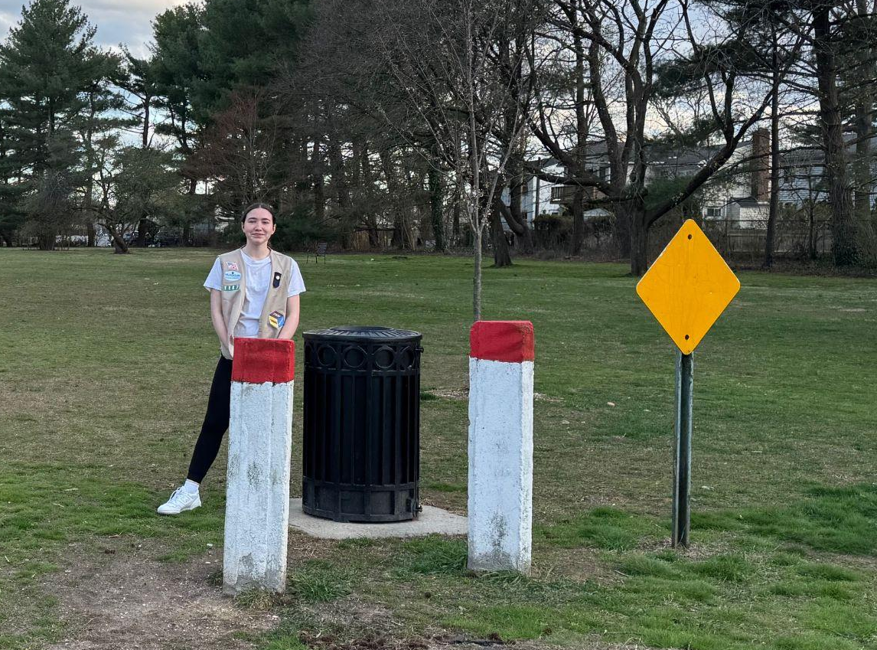
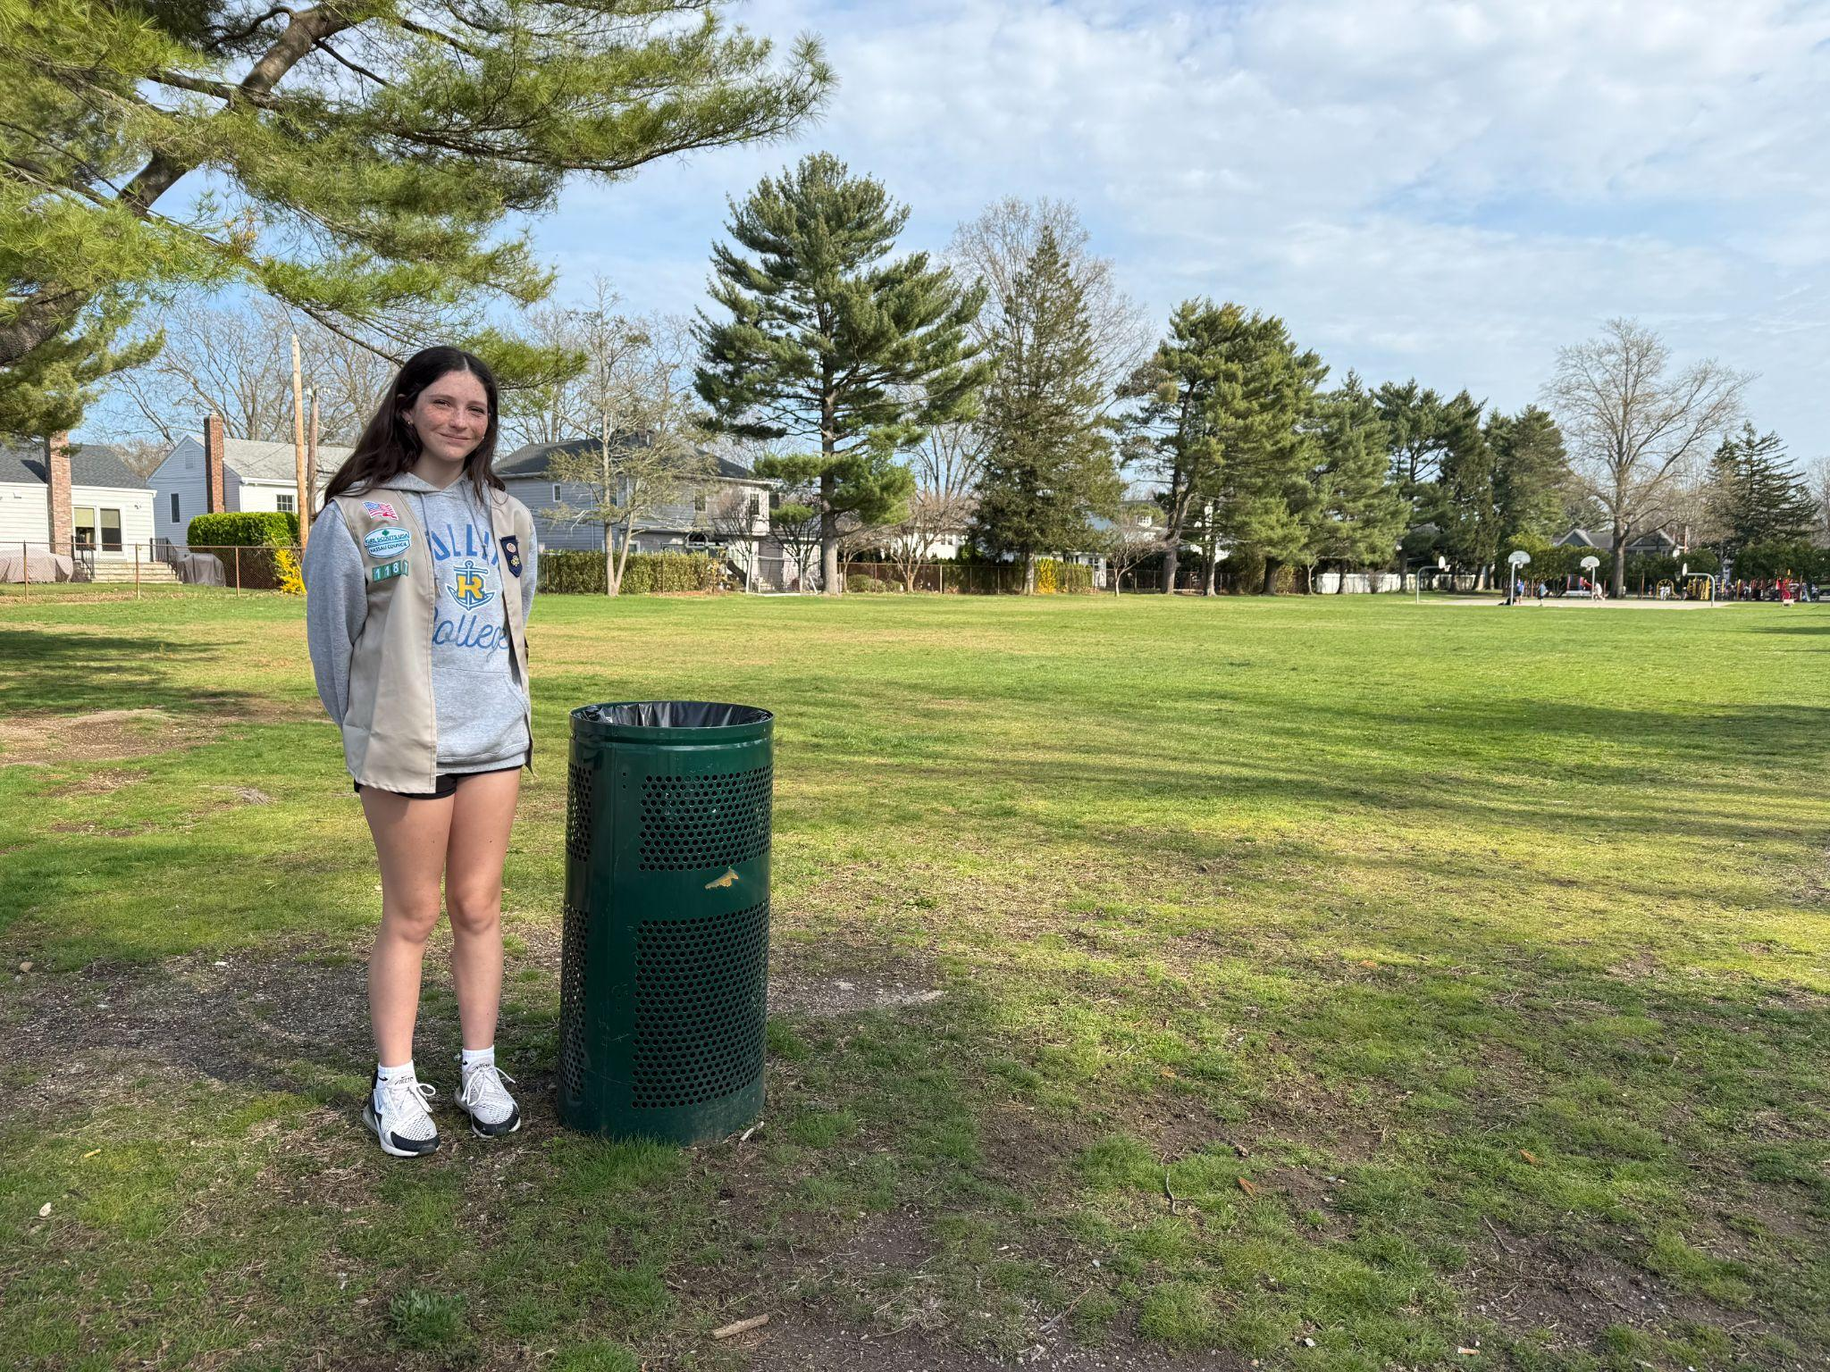
Solution: Pilot Locations
Each of us monitors the success of different park’s location
Jovana - Garden City Train Station
Manya - Tullamore Park
Juliet - Grove Park
Dana - Hemlock Park
GC Train Station
Tullamore Park
Grove Park
Hemlock Park
Notes:
Pilot Location - Juliet

Slide 17
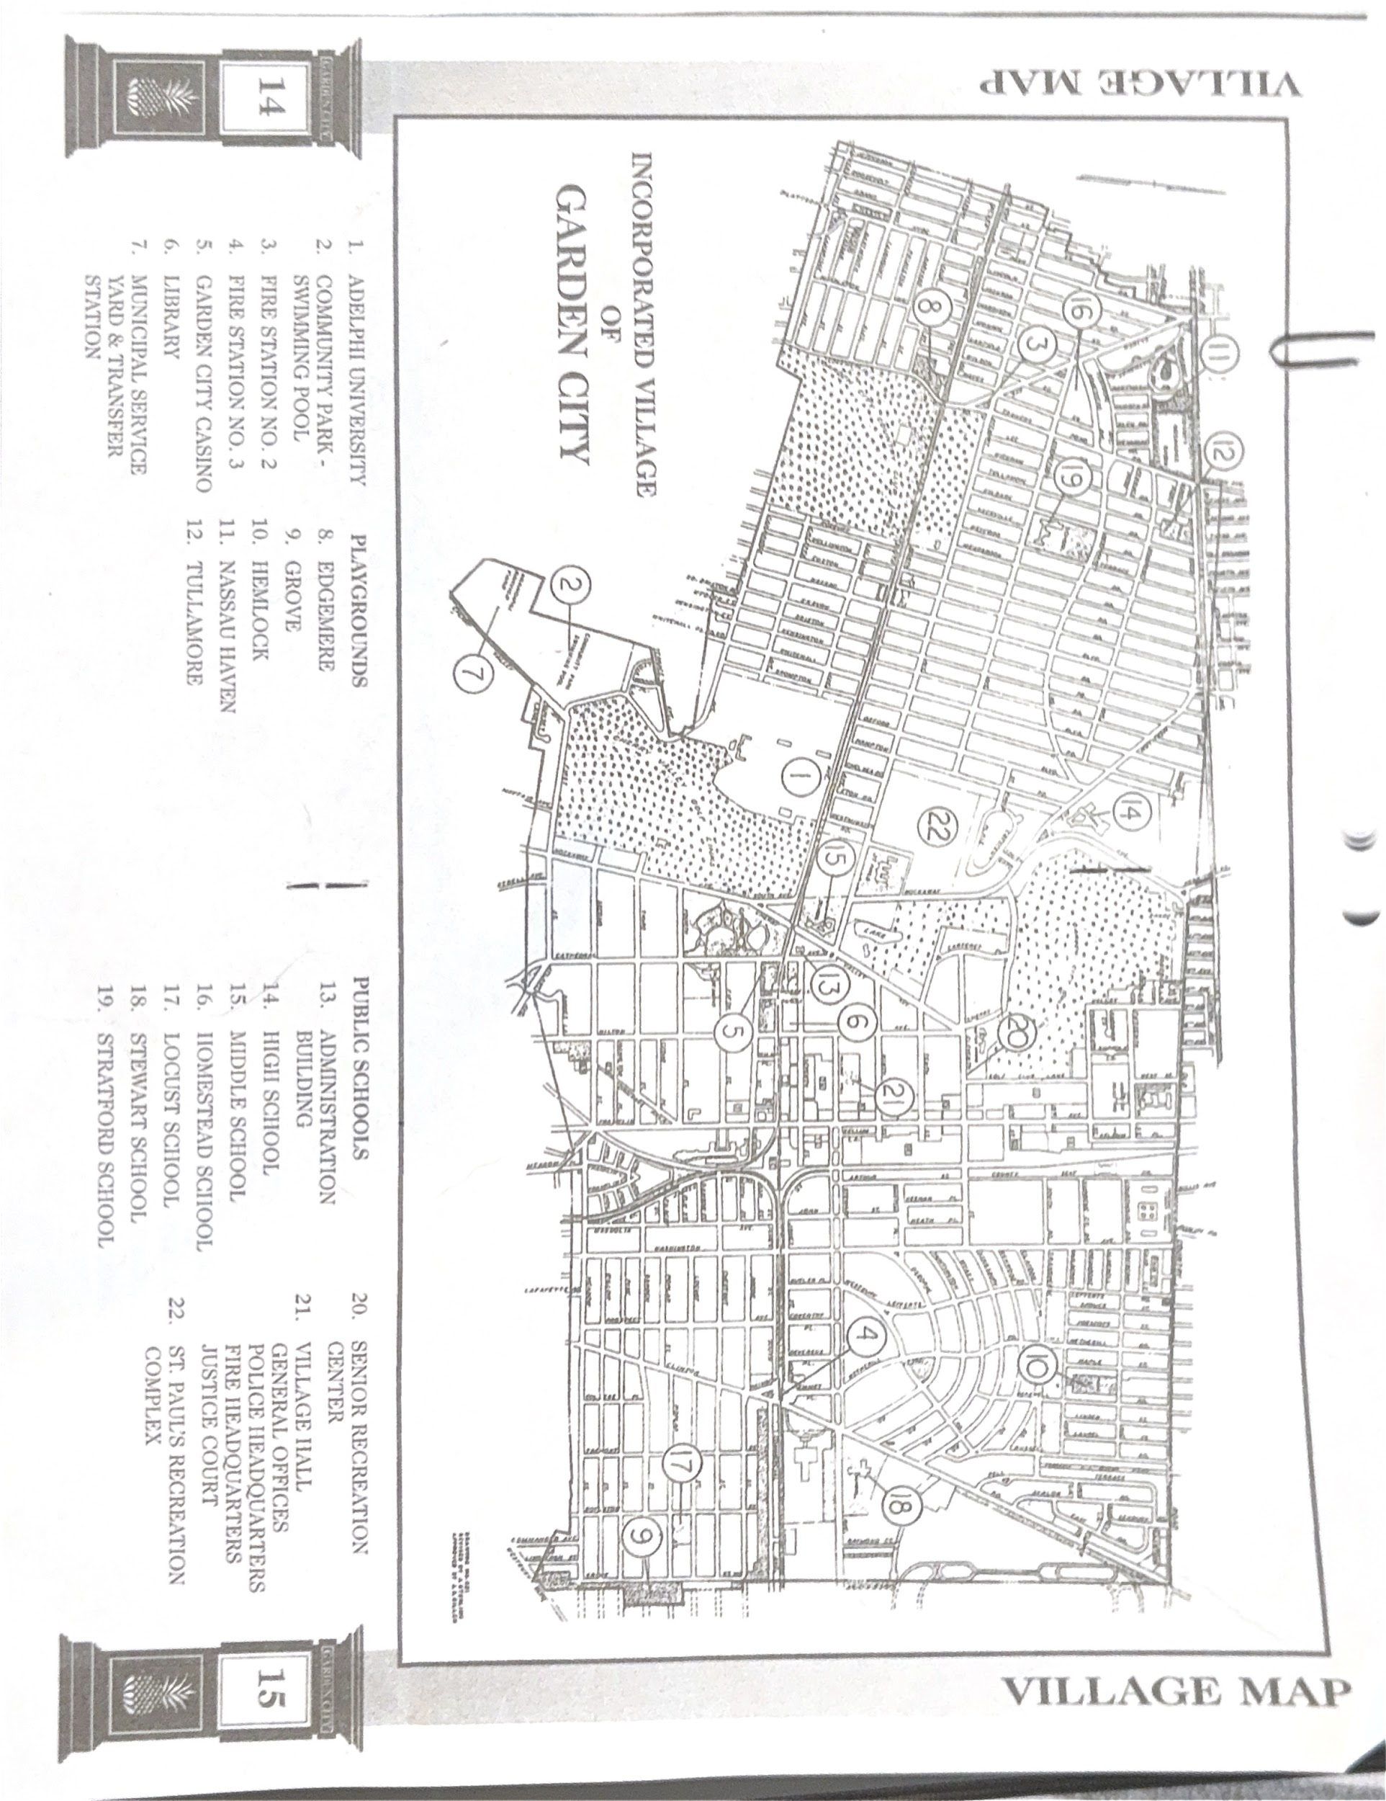
🚮
💩
💩
💩
💩
🚮
💩
🚮
💩
💩
💩
💩
🚮
🚮
🚮
🚮
Notes:
Current Layout - Juliet
-we have recognized sites where these pet waste stations are going to be more effective. The poop emojis are where we have measures the most complaints and unhappiness with lack of pet owners cleaning up after their pets (off of FaceBook), the dog emojis where ….. (instead add where dog parks are), the blue trash waste emojis are where each of us have selected to set up our pet waste station.

Slide 18


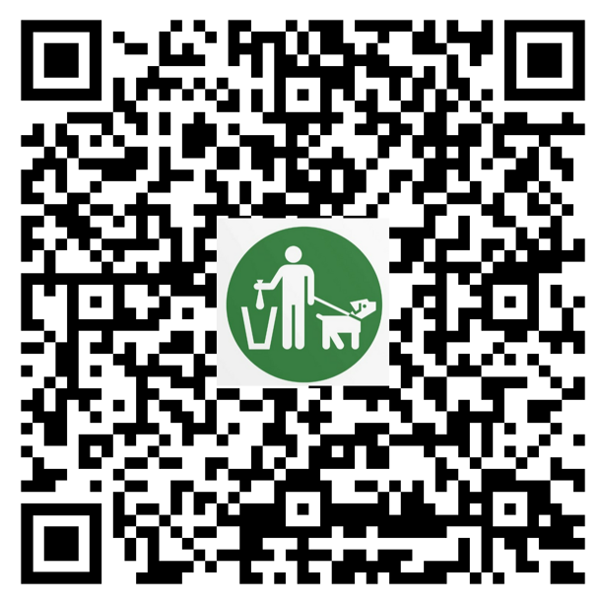



Community Impact - What Troop 1187 can do
Letter to the GC News editor
Social Media
Pop up fundraising events
GC Public Library
Dog Parks
Key Foods on 7th St
Pet Club on Franklin Ave
GC Village Pool
Feedback form
Notes:
Cost & Community Benefits - Juliet
Letter to editor - bring awareness and fundraising for pilot program
Pop up events
Cathedral campout June 7
Library
Dog Park
Contact new pet store
To start distributing these pet waste stations we require funding.
Our plan to gather funds and measure our impact:
Letter to the editor of the garden city news to offer garden city residents the option to make a donation to support our project.
-Pop up stations on seventh and the two “dog parks” with a poster and ask for donations
- Public survey of gc residents on FB and to measure the success of our project we will send out a survey.

Slide 19
Conclusion and Next Steps
Request EAB for approval for Pilot Program (June through August)
Create awareness via GC News
Hold Pop Up Fundraising events through end of summer
Get continuous feedback from the community via Google feedback form
Continue conversation on this topic with EAB
Notes:
Conclusion - Juliet
Goal - approval
As you see. We’ve highlighted this problem. Done research showing this problem exists and a lot can be done to solve problem. Signs, pooper scooper law, creating awareness. As a next step, we would like to get your approval for our pilot program and that way we can continue to educate our community about this program and the solutions we can implement
Thank you so much for listening to our Silver Award Proposal before we go to any question you may have for us I was hoping to pose some question to you all and hear your feedback or suggestions.
Do you think there are better solutions that we can add or propose? Like we have recognized a lack of trash bins around GC would this be something worth mentioning and improving on?
How can we enforce these fines? And whose jobs would it be to enforce the fines?
Do you think this will require ongoing funding for maintenance of these stations and supplies like the poop bags? If so, how could we go about collecting that?

