Slide 1
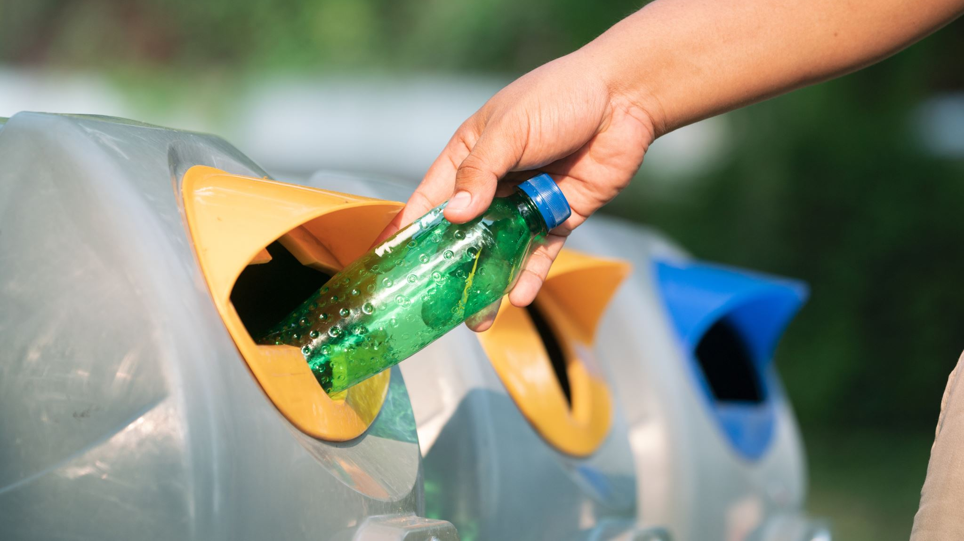

Recycling Upgrades at the DPW Yard Transfer Station

Slide 2
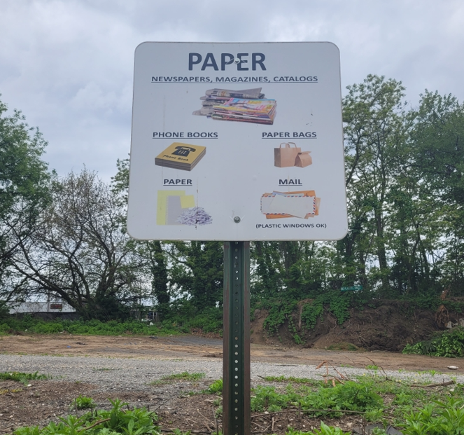
Paper Bin

Slide 3
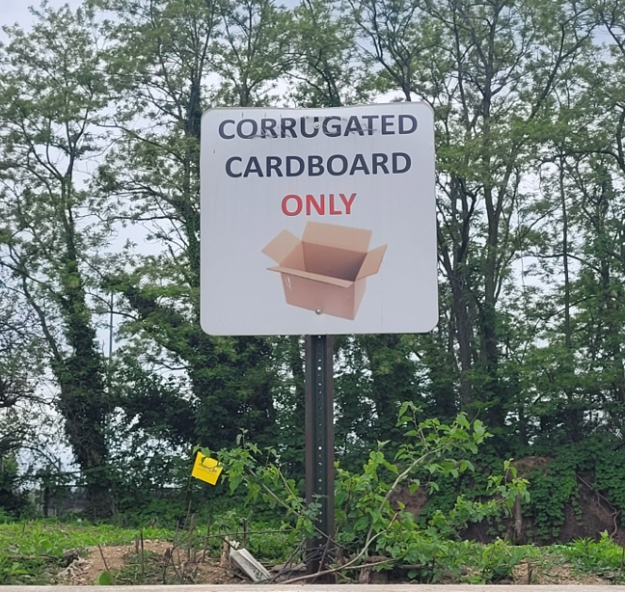
Cardboard Bin

Slide 4
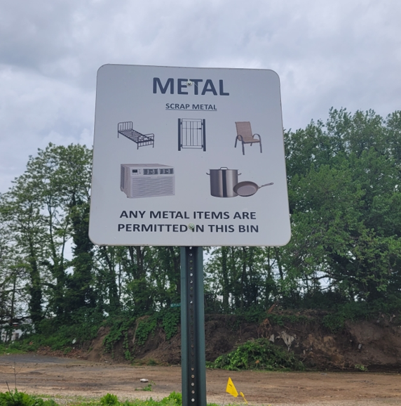
Metal Bin

Slide 5
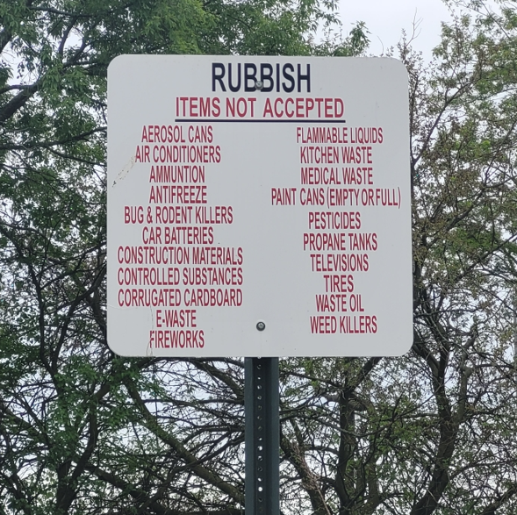
Rubbish Bin

Slide 6
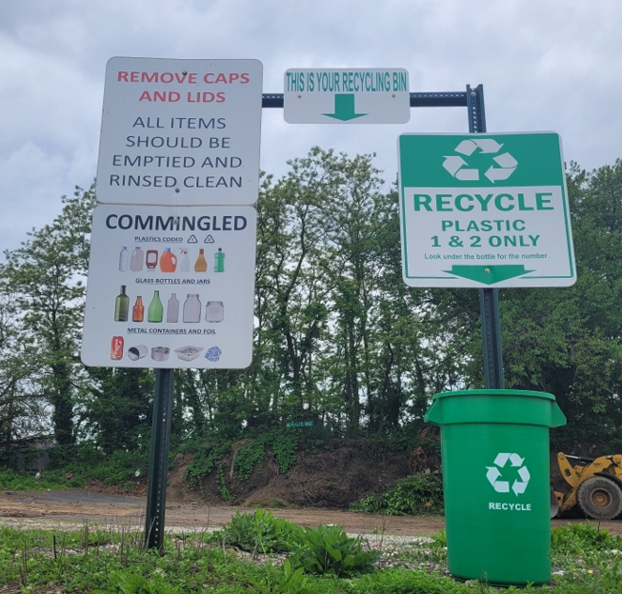
Commingled Bin

Slide 7
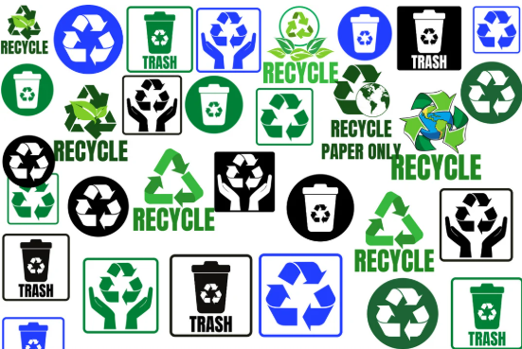
Thank You!

