Slide 1
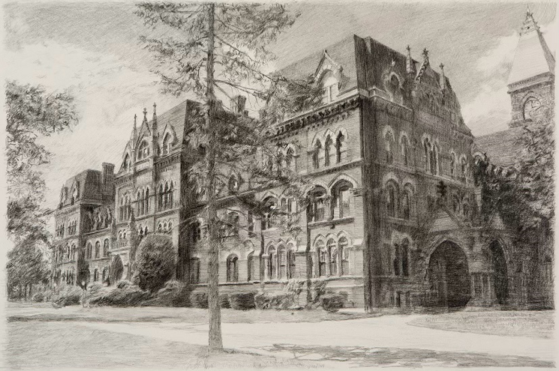
St. Paul’s
Town Hall
MARCH 8, 2025
Presented by Village Board of Trustees

Slide 2
AGENDA
  How we got here
    What’s Happened So Far
  St. Paul’s Survey
    Purpose of the Survey
    Review of Key Components
    How do you want to use the building
    Options for the building’s structure
    Financial Information, including presentation by CMA and Hawkins, Delafield and Wood
  Q&A
  Timeline and Next Steps

Slide 3
What’s Happened So Far?
Oct. ’23 Opinion Poll
BCI Work
BCI Rec Survey
St. Paul’s Survey
Village-wide poll with two options
March ’24 hired BCI
Summer ’24 Rec Survey
Village-Wide St. Paul’s Survey
Partial/all preservation
61%
Demo 39%
Full needs assessment of Rec/Parks
Create a Recreation Master Plan in conjunction with a possible St. Paul’s plan
Identified resident’s priorities for Rec programs and parks
Basis for St. Paul’s Survey and Rec Master Plan
Based on results from Opinion Poll
Apply data from Rec Survey

Slide 4
BCI OVERVIEW
  BCI hired by BOT in March 2024
    Selected to assist with creating Resident Survey on use for St. Paul’s Main Building
    Extensive experience in resident engagement through surveys, town halls, etc.
  Work To-Date
    Community Background and Needs Assessment
      Demographic Analysis
      Facilities Review
    Community Engagement
      Open House and Outreach
      Staff and Stakeholder Input
      Recreation Survey
      Draft Recreation Master Plan received
      Awaiting input on St. Paul’s plan

Slide 5
St. Paul’s Survey
What Programs do you want in the Building?
What to do with the Physical Structure?
How much are you willing to spend?
Based on Rec Survey
Top Results from Village Residents
Indoor pool questions included separately
Three Choices
Adaptive Reuse
Partial Restoration
Mothballing
“None of the Above” included in all choices
Ballpark costs for each option
Your home value
Bond costs
Calculated to estimated home tax increase

Slide 6
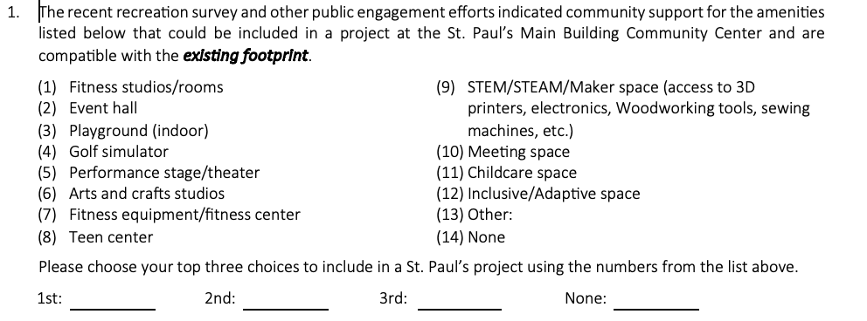
Program Choices

Slide 7
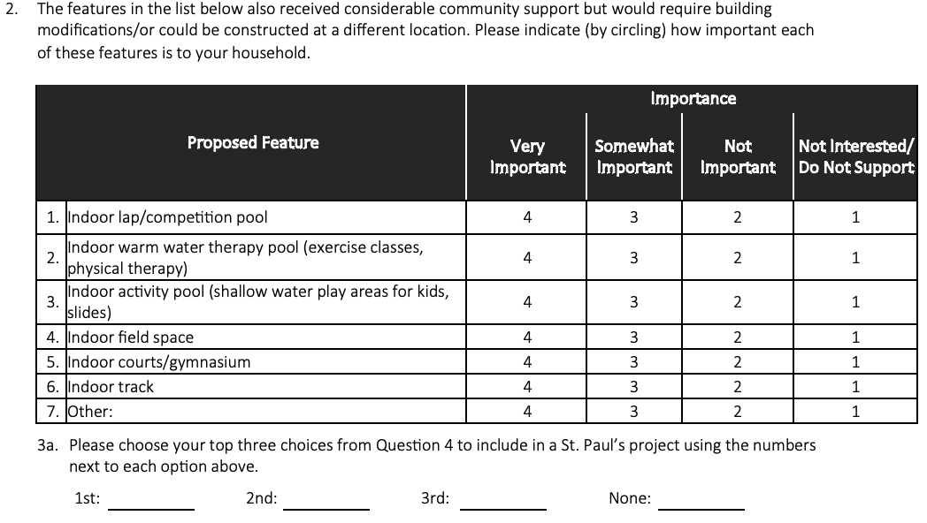
Program Choices

Slide 8
Survey Questions – Building Options
4. OPTION A (Adaptive Reuse): How likely would you be to support a project that preserves the exterior of the St. Paul's Main Building in its current form with some changes and upgrades to the interior?
____(5) Very likely
____(4) Somewhat likely
____(3) Neutral
____(2) Somewhat unlikely
____(1) Will not support
5. OPTION B (Partial Replacement): How likely would you be to support a project that involves preserving selected sections and architectural features (interior and exterior) of the St. Paul’s Main Building in their current form while replacing or expanding other parts with new construction?
____(5) Very likely
____(4) Somewhat likely
____(3) Neutral
____(2) Somewhat unlikely
____(1) Will not support
6. OPTION C (Mothballing): How likely would you be to support a project that involves preserving the entire exterior of the St. Paul's Main Building with new roof, gutters, leaders, repointing and masonry repairs, windows and doors, landscaping and irrigation and partial paving. Interior work will only include abatement and partial interior demolition (of deteriorated areas) and interior structural repairs including temporary lighting and power. The building is refurbished on the exterior and will remain unfinished on the interior.
____(5) Very likely
____(4) Somewhat likely
____(3) Neutral
____(2) Somewhat unlikely
____(1) Will not support

Slide 9
Additional Information
Based on your personal preference, rank the three options below.
1. Adaptive Reuse - Preserve the exterior of the St. Paul's Main Building in its current form with some changes and upgrades to the interior
2. Partial Replacement - Preserve selected sections and architectural features (interior and exterior) of the St. Paul's Main Building in its current form while replacing or expanding other parts with new construction
3. Mothballing - Preserve the entire exterior of the St. Paul's Main Building with new roof, gutters, leaders, repointing and masonry repairs, windows and doors, landscaping and irrigation and partial paving. Interior work will only include abatement and partial interior demolition (of deteriorated areas) and interior structural repairs including temporary lighting and power. The building is refurbished on the exterior and will remain unfinished in the interior
Please rank your three choices using the numbers next to each option above, or circle "Will not support any option."
1st: ____ 2nd: ____ 3rd: ____ Will not support any option
8. Did you select the "Will not support" answer option presented in questions 4-7?
____(1) Yes [Please answer question 8a.] ____(2) No
8a. Please indicate why you selected the "Will not support" answer option presented in questions 4-7. [Check all that apply.]
____(1) Don't care about the building
____(2) Cost of renovation/Village can't afford
____(3) The renovated building won't be useful to us
____(4) Existing footprint will not support community needs
____(5) Village already has all needed spaces
____(6) The Village could not handle this type of project
____(7) None of these options apply
____(8) Other:

Slide 10
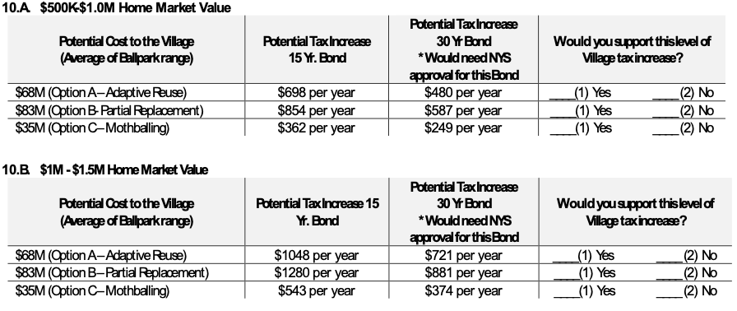
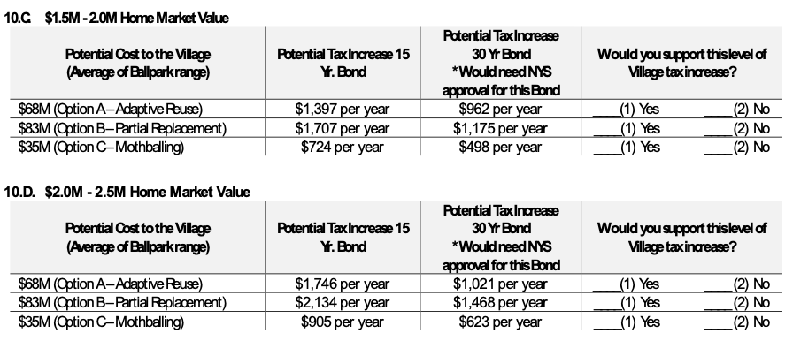
Estimated Village Tax Cost

Slide 11
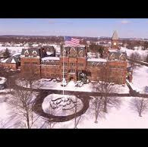
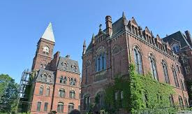
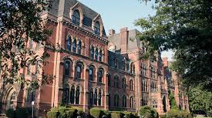
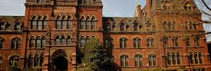
BUILDING OPTIONS
Adaptive Reuse
Partial Restoration
Mothballing
Will Not Support
Preserving selected sections and architectural features (interior and exterior) of the St. Paul’s Main Building in its current form while removing and replacing/expanding other parts with new construction
Available choice for all options. Residents can select this for any or all of the options, allowing you to disagree with these options. “Other Comments” will also allow you to add your own suggestions .
Preserving the exterior of the St. Paul’s Main Building in its current form with some changes and upgrades to the interior
Preserving the entire exterior of the Main building, along with interior structural repairs.Refurbished on the exterior and unfinished interior

Slide 12
FINANCIAL INFORMATION
Ballpark
Estimates
Home Value and Village Tax
Bond
Calculations
Based on professional guidance for every area.
“Ballpark” estimates - they will be adjusted.
Final cost will be determined after resident choices for structure are determined.
Estimated market value for your home
plus
Ballpark estimate for your prefered option
Equals
Potential Village tax increase
15 year Bond option
30 year bond needs NYS approval

Slide 13
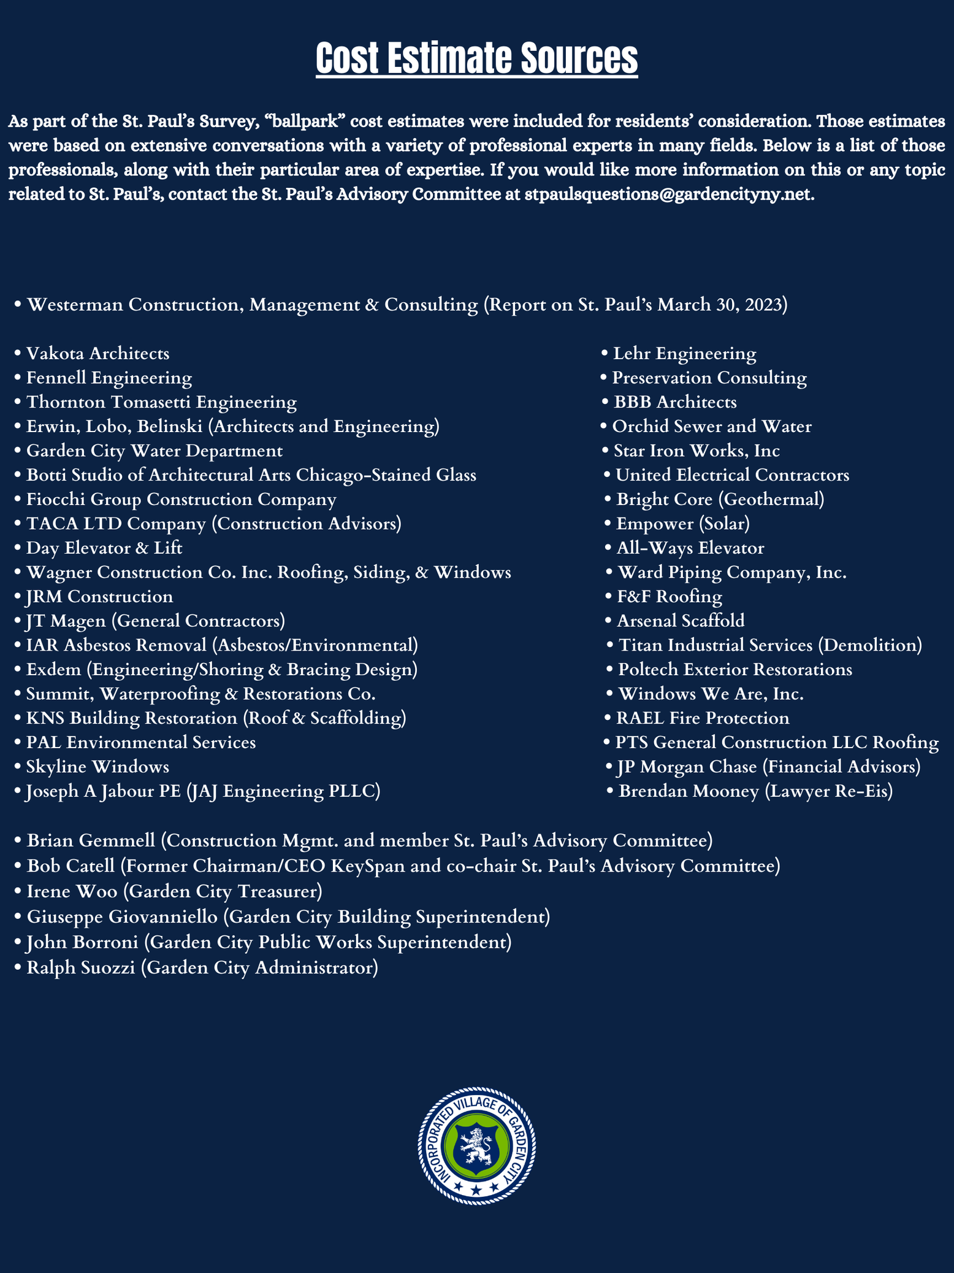
Cost Estimate Sources

Slide 14
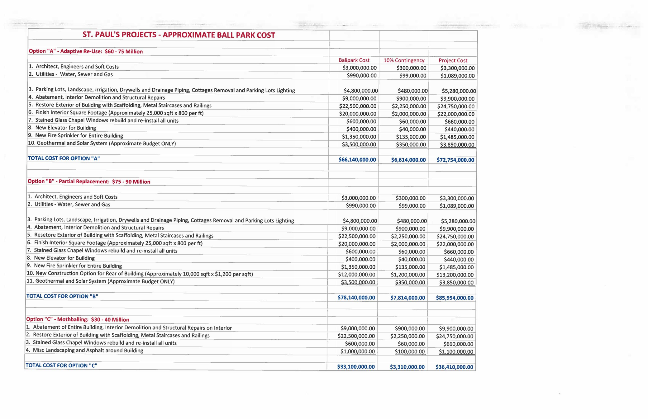
Ballpark Figures

Slide 15
Estimated Village Tax Cost

Slide 16
WHAT’S NEXT?
(TIMING IS APPROXIMATE)
3/4 weeks
Next
2-3 weeks
2-3 weeks
May/June
Formatted and tested survey received from BCI
BCI to prepare mailing to all GC Households
Survey responses collected
Responses analyzed and report created
Results shared with BOT and residents

