Slide 1
Update on Water Treatment and Conservation
Elizabeth M. Bailey
Garden City Environmental Advisory Board Meeting
Wednesday, February 16, 2022

Slide 2
Treatments of Water by Garden City
Addition of calcium hypochlorite for disinfection.
Addition of sodium hydroxide to raise pH.
Iron removal: wells 15 and 16 (Hilton Ave and Second St).
Blending for reducing nitrate concentration: wells 10 and 11 (off Clinton Rd)
Volatile Organic Compounds (VOC) removal using aeration towers: wells 8, 9, 10, 11, 12, 13, 14.
VOC removal by GAC (granulated activated carbon): wells 7, 13, 14, 15, 16.
1,4-dioxane removal by Advanced Oxidation Process (AOP) planned for all active wells. Operating at well 7; in various stages of planning or construction at other wells.
Additional GAC treatment is required at the AOP facilities for quenching.

Slide 3
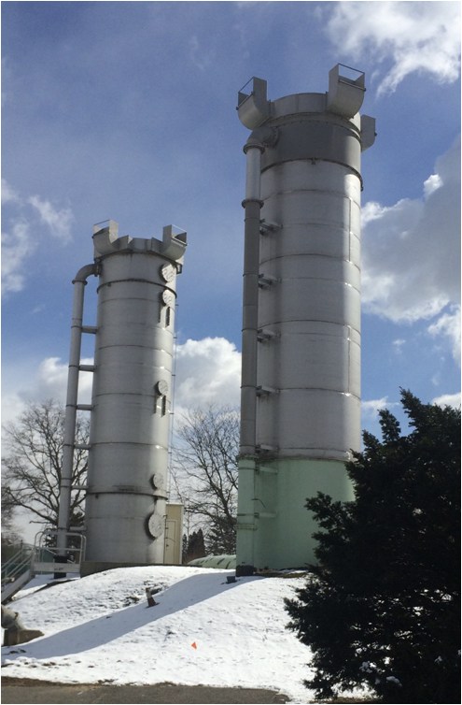
Aeration Towers at Wells 13 and 14
(Garden City Country Club, Stewart Ave)
Photo by
Elizabeth Bailey

Slide 4
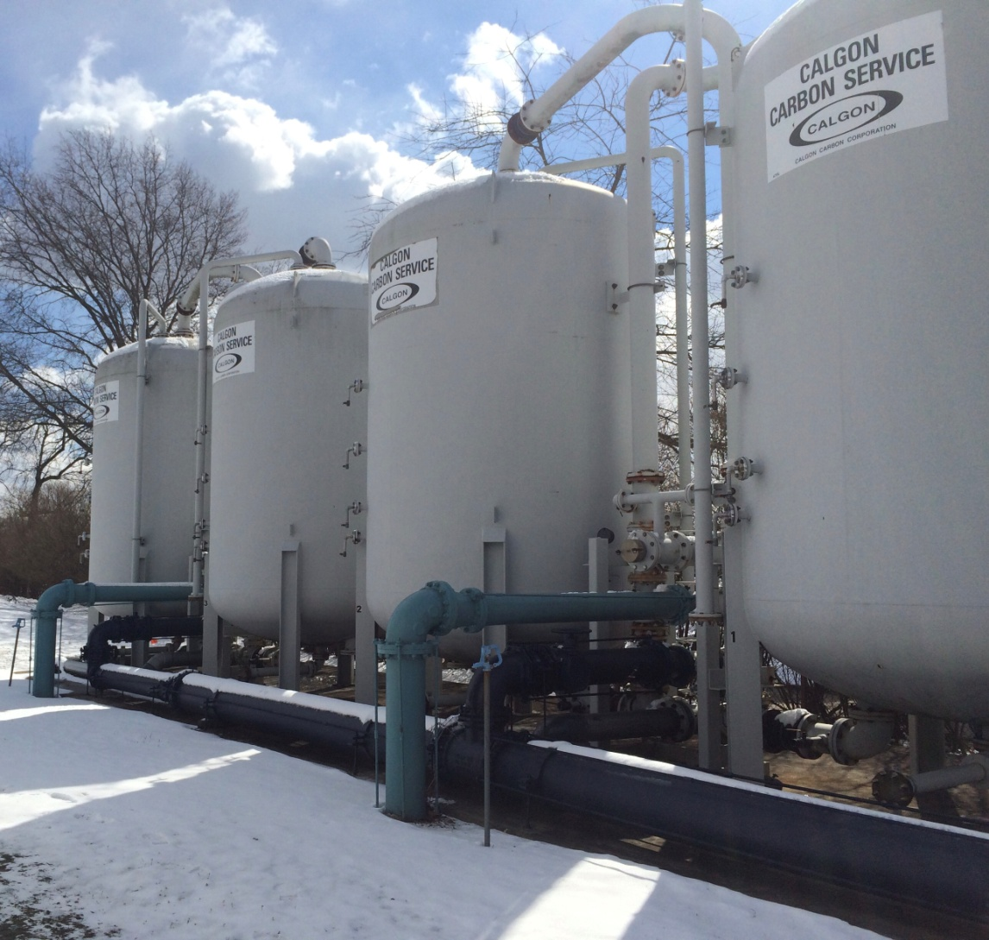
System for Treating Water with Granulated Activated Carbon (GAC) at Wells 13 and 14 (Garden City Country Club, Stewart Ave)
Photo by
Elizabeth
Bailey

Slide 5
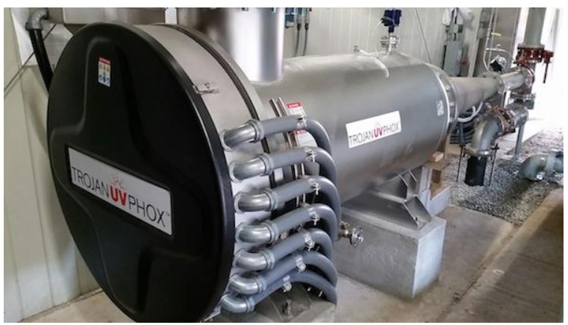
AOP System Installed by Suffolk County Water Authority (SCWA) in Central Islip
(Not a Garden City System)
This was the first AOP
System to be
installed on
Long Island.
Photo credit:
Suffolk County Water Authority

Slide 6
Estimated Per Capita Water Consumption in the United States for Customers of Public Suppliers
1995: 101* Gallons per day per person
2005: 100*
2010: 89*
New York State Residents, 2010: 79*
National Average: 100** Gallons per day per person or less
Nassau: 149**
Suffolk: 122**
Sources: *Estimated Water Use in the United States in 2010, U.S. Geological Survey, https://pubs.usgs.gov/circ/1405/pdf/circ1405.pdf.
**Sarah Meyland, J.D., Groundwater Quantity and Competing Uses, LICAP Report, 2017, https://licaponline.com/wpcontent/uploads/2020/08/Groundwater_Quantity_and_Competing_ Uses_Report.pdf

Slide 7
Nassau County Pumpage 2013 - 2021
Source: Draft LICAP report for 2021.

Slide 8
Pumpage in Garden City, 2012-2016
Source: Draft report, Village of Garden City to DEC, April 2017.

Slide 9
Garden City Per Capita
Water Consumption in 2016
Per capita average water consumption in Garden City was 204 gallons/day/person according to the draft report that the Village of Garden City submitted to DEC in April, 2017.
However, this number is based on total pumpage. If the calculation is repeated omitting non-revenue water (water used for things like flushing the system and firefighting operations), the per capita number drops to 185 gallons/day/person.
This number is still too high as it includes water billed to commercial establishments. So the actual per capita figure should be somewhat lower than 185 gallons/day/person. A somewhat lower number puts the figure in the same ballpark as the 149 gallons/day/person estimated for Nassau County residents (see slide 6).
This is still significantly higher than the estimated national average of 100 gallons/day/person or less.
Source: Draft Report, Village of Garden City to DEC, April 2017.

Slide 10
NYS DEC Water Conservation Program
In 2016, NYS DEC requested that LI water suppliers reduce their peak season pumpage by 15% over the next few years and submit annual reports on their progress.
Things water suppliers are doing to meet this goal:
Installing new meters and infrastructure.
Old meters can be inaccurate at low flow rates.
AMR (automated meter reading) – read meter remotely. (AMI is better for conservation
efforts.)
AMI (advanced metering infrastructure). Get readings in real time. Notify customer if leak
is detected (meter runs continuously for some period of time). Offer EyeOnWater App or
similar – customers can quickly track their water usage.
Leak checking their infrastructure.
Encouraging installation of smart sprinklers and water efficient toilets, showerheads and appliances.
Working with their 10 largest water consumers to reduce consumption.
Rate structure modification: Tiered rate structures: the more water consumed, the higher the cost per gallon.

Slide 11
Nassau County Actions
Water Conservation Ordinances
248-A-1987:
Restricts days and hours of irrigation to every other day, not during the
hottest hours of the day.
Prohibits hosing of sidewalks and driveways.
Requires shut-off valves on hoses.
Amended 181-2016:
Requires sensors on irrigation systems to shut them off during rain events.
Five-Year Conservation Program approved unanimously by NC Legislature last year
We are waiting for implementation of this program by the new county administration.
Smart Sprinkler Rebate Program
Nassau County rebate program for purchases of smart sprinklers. If you install one, you
may be eligible for a rebate. www.nassaucountyny.gov/1547/consumer-affairs

Slide 12
Town of Hempstead Is Offering
Free Water Conservation Kits
You can obtain one at:
Town of Hempstead Department of Water Office
1995 Prospect Ave, East Meadow
Contains: -booklet of water saving tips for your home
-two tablets for detecting leaking toilets
-drip cup calibrated in gpd, gpy, lpd & lpy
(Actually you don’t need a tablet to check for a leaking toilet. Using a few drops of food coloring will work just as well.)

Slide 13
How To Reduce Outdoor Water Consumption
Plant native vegetation, which usually requires less water.
Lawn: use a grass type that is drought tolerant. The Scotts Turf Builder website lists tall fescue first in its list of drought-tolerant grasses for the northern portions of the USA.
Need advice? Talk to your landscaper or the Cornell Cooperative Extension on Merrick Ave in East Meadow.
Irrigation system: install a smart controller (smart sprinkler) that doesn’t mindlessly water every other day whether it needs to or not. Especially during the “shoulder” months such as May, when it is not as hot, this can save significant amounts of water (and money).

Slide 14
Indoor Water Conservation #1
Water Usage for Bathroom Fixtures
 | Pre-1950 | 1950-1980 | Pre-Energy Policy Act (1992) | Post EP Act (1992) | WaterSense Requirement
Tank-type Toilet (gpf) | 7* | 5* | 3.5 to 5 | 1.6 | 1.28
Showerhead (gpm) | 3-6* |  | 3 to 5 | 2.5 | 2.0
Bathroom sink faucet (gpm) |  | 3-7** | Up to 2.5 | 2.2 | 1.5
Source: EPA Water Efficiency Management Guide, https://www.epa.gov/sites/default/files/2017-12/documents/ws-commercialbuildings-waterscore-bathroom-resource-guide.pdf, November 2017. *2016 reports to DEC that were prepared by D & B Engineers and Architects, PC. **https://www.epa.gov/sites/default/files/2017-01/documents/ws-products-support-statement-faucets.pdf
Typical residence with old fixtures: highest indoor water usage is probably due to toilets.

Slide 15
Indoor Water Conservation #2
 | Dishwashers | Washing Machines
 | Gal/Load | Gal/Load
Older models | 10 | 40
Average in 2017 | 6 | 31
Energy Star Rated | 3.5
Energy Star Compact models | 3.1
High efficiency front-loading washers |  | 13
Source: https://www.epa.gov/sites/default/files/2017-10/documents/ws-commercialbuildings-
waterscore-residential-kitchen-laundry-guide.pdf

Slide 16
Where to Look for Information on Indoor Fixtures and Appliances
EPA’s WaterSense Program: Find toilets, bathroom fixtures & showerheads that meet EPA’s specifications for water efficiency without sacrificing performance. https://www.epa.gov/watersense
EPA’s Energy Star Program: rates washing machines and dishwashers for energy efficiency (integrated modified energy factor: IMEF), as well as for water efficiency (integrated water factor: IWF – gallons of water consumed per cubic foot of capacity). It’s good to have a high IMEF and a low IWF. https://www.energystar.gov/products
Kitchen faucets are regulated under the Energy Policy Act of 1992. They should have flow rates no greater than 2.5 gallons/minute.

Slide 17
Dishwasher versus Washing Dishes by Hand –
Which Way Conserves More Water?
Example: Assume you have an Energy Star rated dishwasher and a kitchen faucet that is compliant with the Energy Policy Act of 1992.
Your dishwasher uses 3.5 gallons of water/load.
Your faucet runs at 2.5 gallons/minute.
It will take your faucet 84 seconds to use 3.5 gallons of water.
Can you wash your dishes while running the faucet for 84 or fewer seconds?
Using this combination of equipment, you probably save water by running the dishwasher, especially if it is fully loaded.
Do the math for your own dishwasher and faucet combination!

Slide 18
Conclusion
I hope this presentation has given you some ideas on how to conserve water at your residence.

