Slide 1
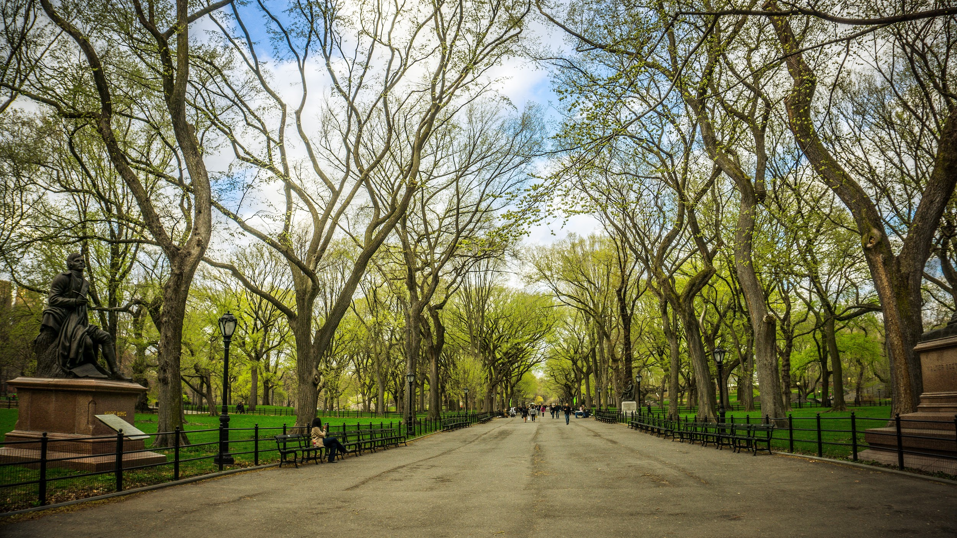

Urban Forestry Health and Garden City
Christina McLaughlin
Natural Resource Educator
cmm482@cornell.edu

Slide 2
Overview
Discuss Importance of Trees and Tree Care
Status of Forestry Health in Nassau County & Long Island
Touch upon issue of EAB and Ash Trees
Discuss other Common Tree Problems
Advocacy for Community Trees
Notes:
80% of the US population lives in urban areas and depend on benefits that trees provide
The term urban defines areas that have high amounts of people in artificial surfaces like manmade structures and buildings.

Slide 3
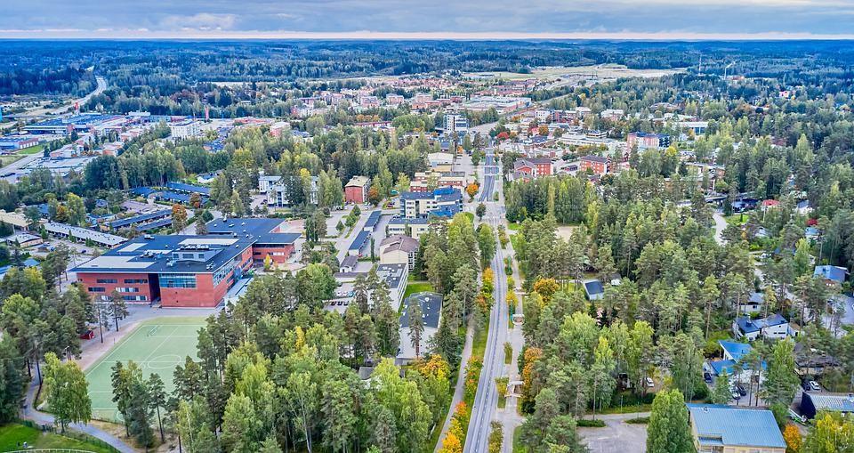
What is Urban & Community Forestry?
Urban Forest: a collection or trees that grow within a town, village or city
Community Forest: all of the trees within a town, village, or city that benefits the community in a direct impact
Ex: street, yard trees, parks, cemeteries, school grounds, cemeteries and underdeveloped green spaces.
The urban and community forest also contains wildlife, waterways, built structures and people
Urban and Community Forestry is the management of community forests to establish and maintain healthy trees for various benefits including, economic, environmental and other benefits that will enhance the quality of life for urban residents.
Management Practices may include:
Disease & invasive species prevention
Natural catastrophic events (including wildfires)
Climate change
Education and best practice techniques
Planting, pruning, advocating for planting, etc.
Notes:
80% of the US population lives in urban areas and depend on benefits that trees provide
The term urban defines areas that have high amounts of people in artificial surfaces like manmade structures and buildings.

Slide 4
Benefits of the Tree Canopy
Environmental Benefits
Improve air quality
Cools the air through transpiration
Sequesters carbon, reduces greenhouse effect
Conserves energy (heating/cooling)
Slows climate change
Moderates sun, wind and rain impacts
Reduce stormwater runoff and soil erosion
Provides and improve habitat for wildlife
Economic Benefits
Increase residential/business property values (5-20%)
Increase tax base for a community
Lower energy use cost (Heating/cooling)
Attract visitors, business and new residents
Encourage shoppers to linger and buy more
Defer maintenance on materials that are degraded by heat (Sidewalks)
Reduce worker sick days
Notes:
Trees influence energy use, and air quality by providing shade, transpiring moisture and reduction of windspeeds.

Slide 5
Human Benefits related to the Tree Canopy
Mental or Physical Health Benefits
Reduce stress and mental fatigue
Enhance mental health
Reduces obesity
Improves heart health
Enhance recuperation rates
Reduce need for medication
Reduce psychological precursors to crime
Social or Community Benefits
Enhance community pride
Increase recreational opportunities
Beautify public spaces
Bring natural elements into urban spaces
Screen unwanted views
Reduce glare or reflections

Slide 6
Tree Canopy by the Numbers
Estimated 3.8B trees with an asset value of $2.4T.
Urban Trees store 770+M tons of carbon,
valued at 14.3B.
Planting 100M mature trees around homes can save about $2B in energy costs.
In 50 years, One Tree recycles:
more than $37K worth of water
$31K worth of erosion control
$63K worth of air pollution
$37K worth of oxygen.
Urban Trees in the U.S. remove about 784K tons of air pollution annually, valued at $3.8B.
Notes:
Estimated 3.8 billion trees with an “asset value” of 2.4 Trillion.
An establishment of 100 million mature trees around homes in the U.S. can save about $2 billion annually in reduced energy costs.
Urban Trees in the U.S. remove about 784,000 tons of air pollution annually, valued at 3.8 billion.
Urban trees in the U.S. currently store 770 million tons of carbon, valued at 14.3 billion

Slide 7
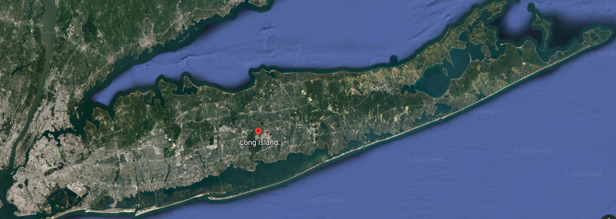
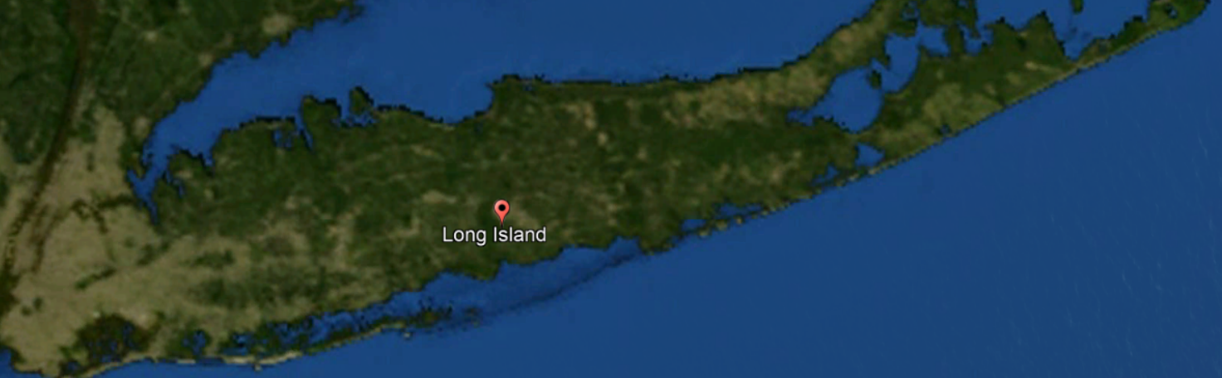
A look at Long Island’s Canopy
Notes:
Based on satellite imagery, it is assumed that tree cover or the tree canopy of the continental US is about 35.1% of the land use.
It’s estimated that Urban Forests in the US contain about 3.8 billion trees and is an asset

Slide 8
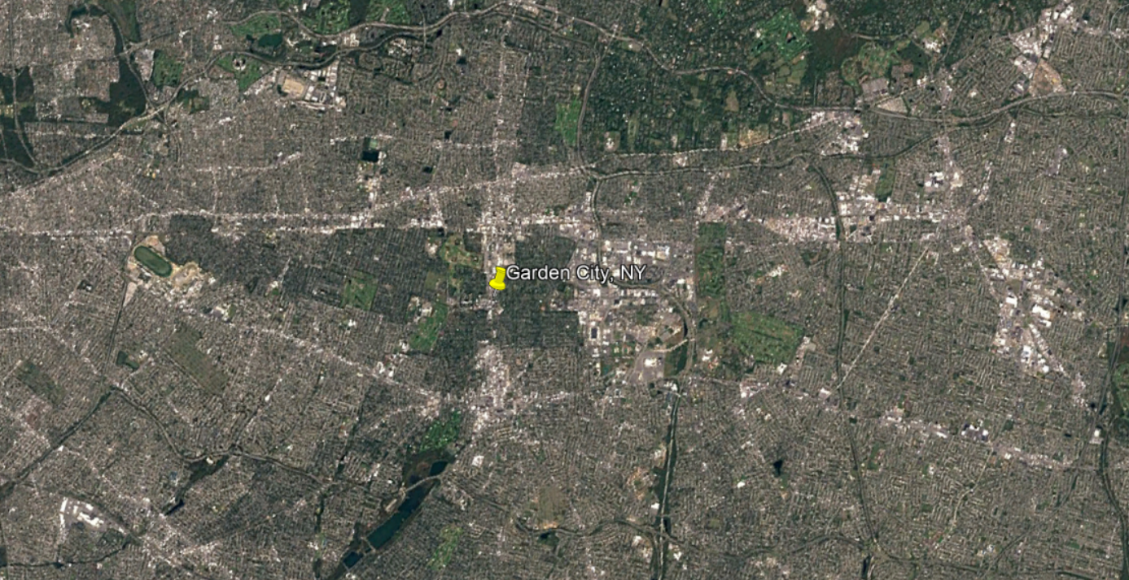
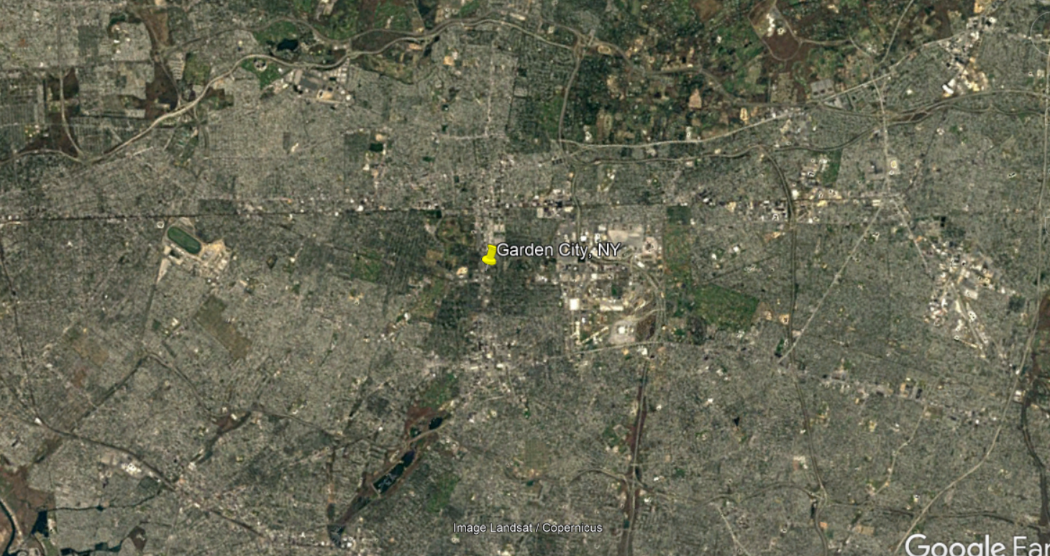
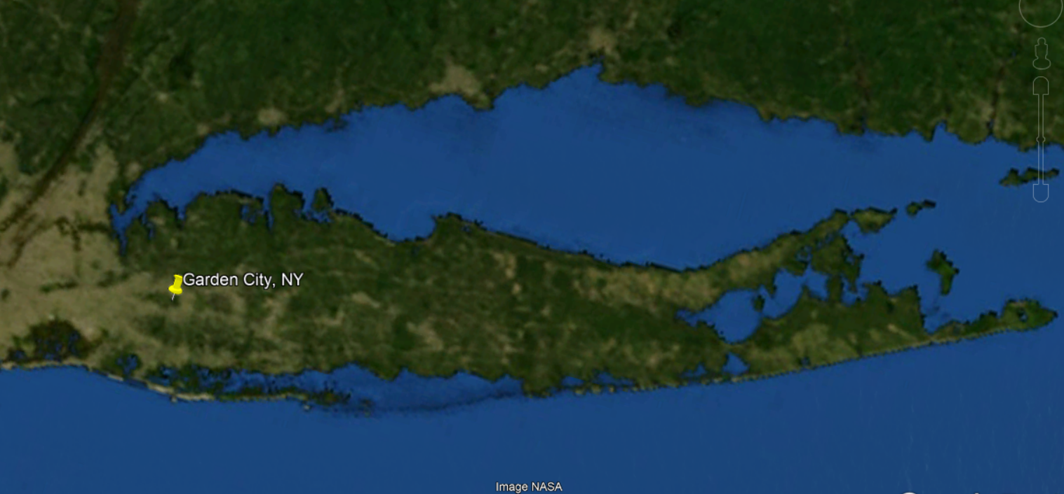
A look at Garden City’s Canopy
Notes:
Based on satellite imagery, it is assumed that tree cover or the tree canopy of the continental US is about 35.1% of the land use.
It’s estimated that Urban Forests in the US contain about 3.8 billion trees and is an asset

Slide 9
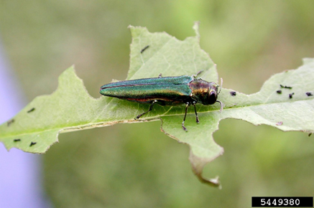
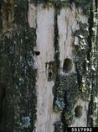
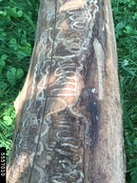
Emerald Ash Borer & Ash Trees
A wood boring beetle from Asia introduced in the US in 1990s.
EABs feed and lay eggs within native Ash trees as part of their one-year life cycle.
They chew through the outer and inner bark of a tree in s-shaped “Galleries” and leave 3-4mm D-shaped holes.
Populations of EAB can kill an ash tree in as little as 1-2 years.

Slide 10
Emerald Ash Borer & Ash Trees
Symptoms and Signs of EAB:
Unusual yellowing or thinning of foliage
Abundance of woodpecker presence and pecking holes
D-shaped exit holes
Shoots growing from the roots of a tree’s trunk with large leaves

Slide 11
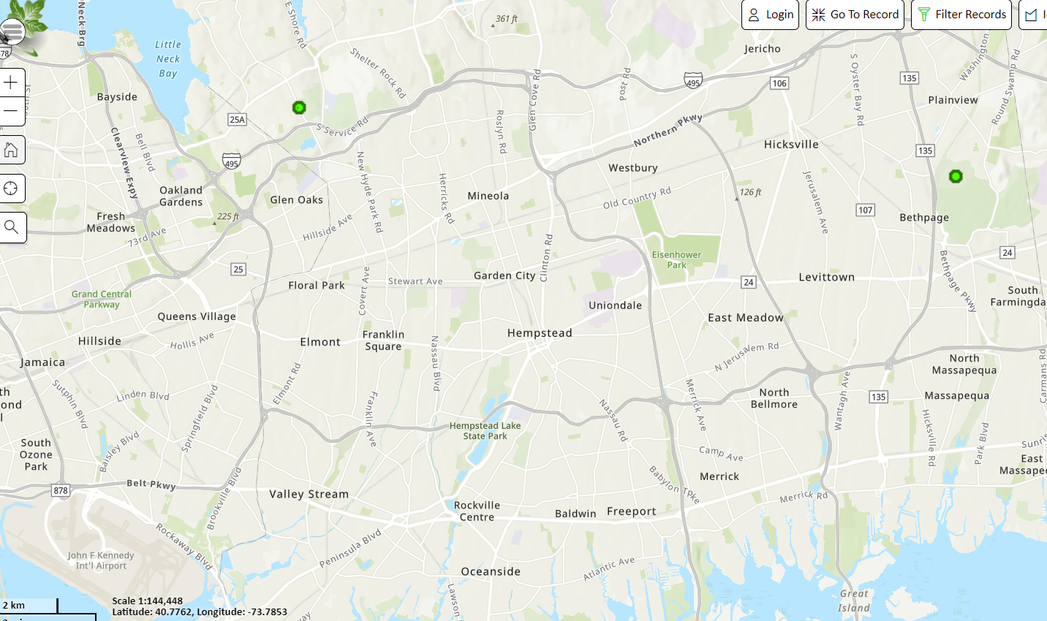
Emerald Ash Borer & Ash Trees
2 EAB sightings near Garden City but there can be more
Preventative Actions:
Be careful of firewood: Buy Local, Burn Local
Consult an Arborist on suspicious trees
Spread awareness
Be aware of quarantine areas
Plant diverse species

Slide 12
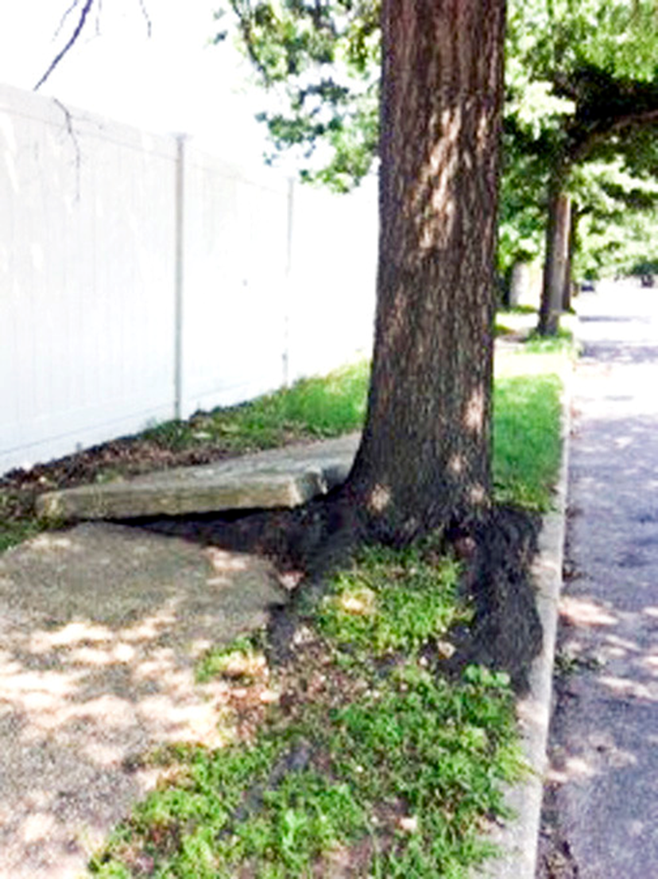
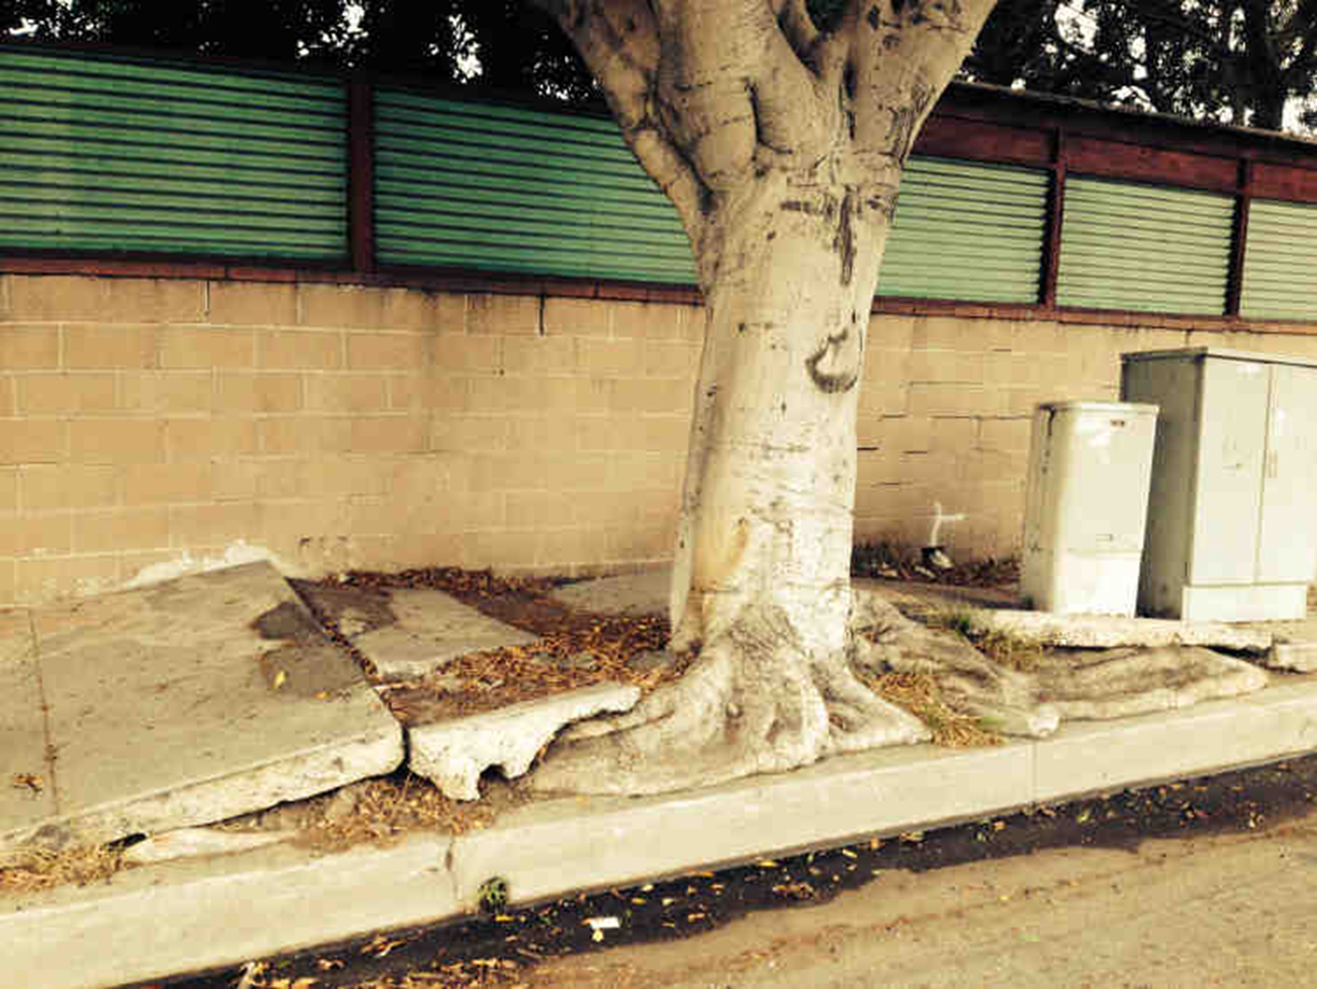
Common Tree Problems
Trees & Sidewalks (or Construction Sites):
Root System “uprooting” concrete, pavement and other man-made structures
Mainly a “Right Tree for the Right Place” issue
Large specimen trees being planted in too small or not enough adequate growth space.

Slide 13
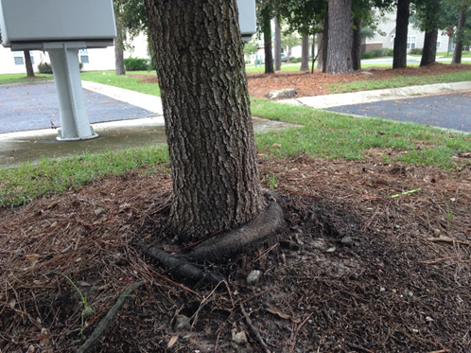
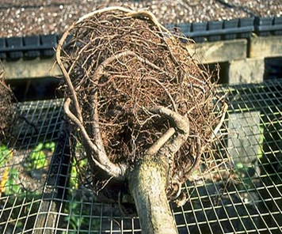
Common Tree Problems
Girdling or Root Space Restriction

Slide 14
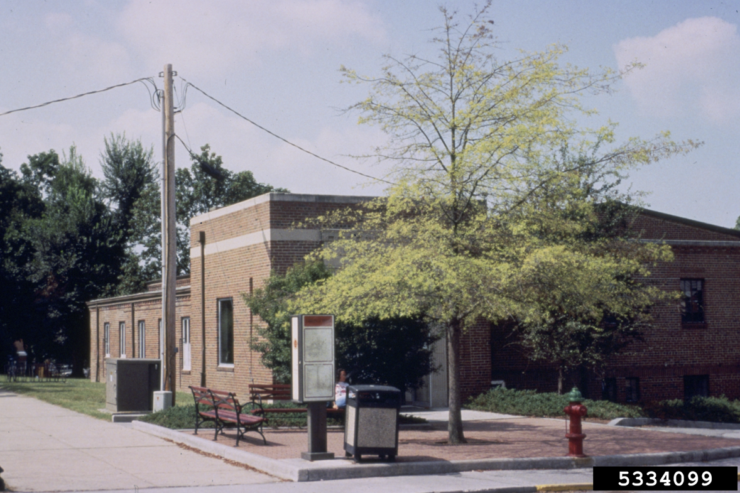
Common Tree Problems
Soil Compaction
Trees restricted in growth due to the man-made structures that can impede growth near site
Such as:
Too small planting “boxes” or plots
Planting in a heavily disturbed area with construction without cultivating the soil
Compacted soils are generally depleted of oxygen, nutrients and the “pockets” necessary for root growth and successful tree health

Slide 15
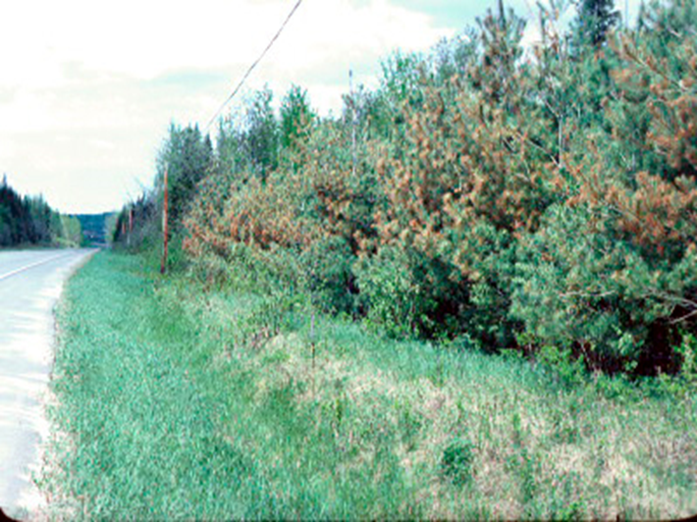
Common Tree Problems
Salt Spray:
Generally affect trees near ocean or roadways where salts interactions are common.
Can cause severe damage to trees and penetrate into the soil, weaken the tree and cause it to dieback its affected branches or kill the tree.

Slide 16
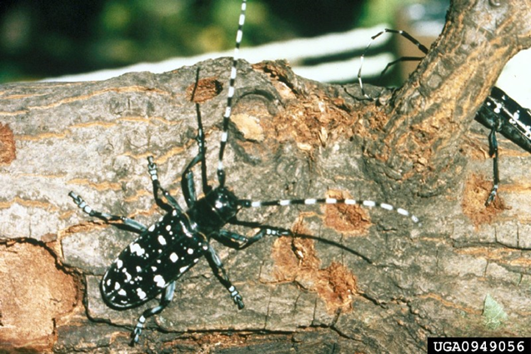
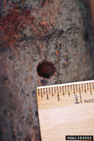
Common Pests to Look out For
Asian Longhorned Beetle
-A wood boring beetle from China found in NY in 1996.
-It feeds on 13 types of hardwood trees including Maple, Ash, Sycamore & Elms.
-ALB kills its host tree from eating it from the inside to the outer bark which can cause safety hazards due to weakened integrity of the tree.
-Trees infested with this beetle must be cut down or destroyed.

Slide 17
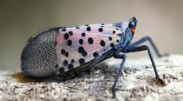
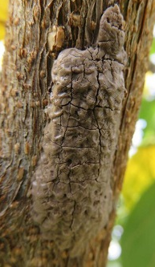
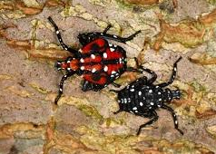
Common Pests to Look out For
Spotted Lanternfly
-an invasive plant hopper from China and Southeast Asia found in NYS in 2017.
-SLF feeds on over 70+ plants including Tree of Heaven, grapevines, hops, apple, blueberry and other species.
Threatens the agriculture, forestry and vineyard industries.
-Their style of feeding by sucking the sap from a plant weakens the infested plant and causes it to excrete honeydew during infestation.

Slide 18
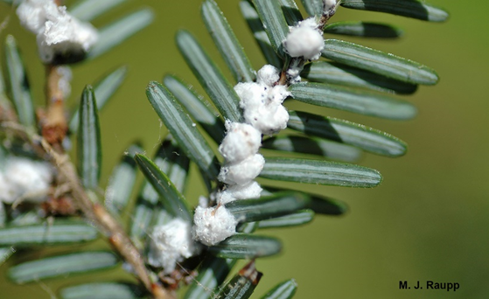
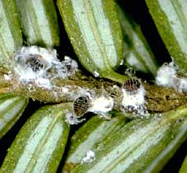
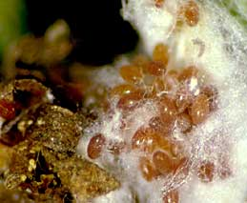
Common Pests to Look out For
Hemlock Wooly Adelgid
-an aphid-like insect first detected in NY in 1980s
-HWAs feed on hemlock trees’ plant tissues and the underside of their needles.
-They are recognized for the white “woolly” masses they produce that are found at the base of needles. These masses are produced by the females and hold the some 40K eggs they can produce in a year.
-Populations of HWA can blossom in a short time and can kill a hemlock or cause major serious die-back in as little as 4 years.

Slide 19
How to be a Tree Advocate

Slide 20
How to be a Tree Advocate
As an Individual:
Become a student of the trees
Plant a variety of tree species
Talk to your neighbors and friends
As a Community
Start an Arboretum or School Club
Host Tree-centric events
Apply to Grants and start Community projects

Slide 21
i-Tree as a Tool to quantify tree benefits
https://design.itreetools.org/

Slide 22
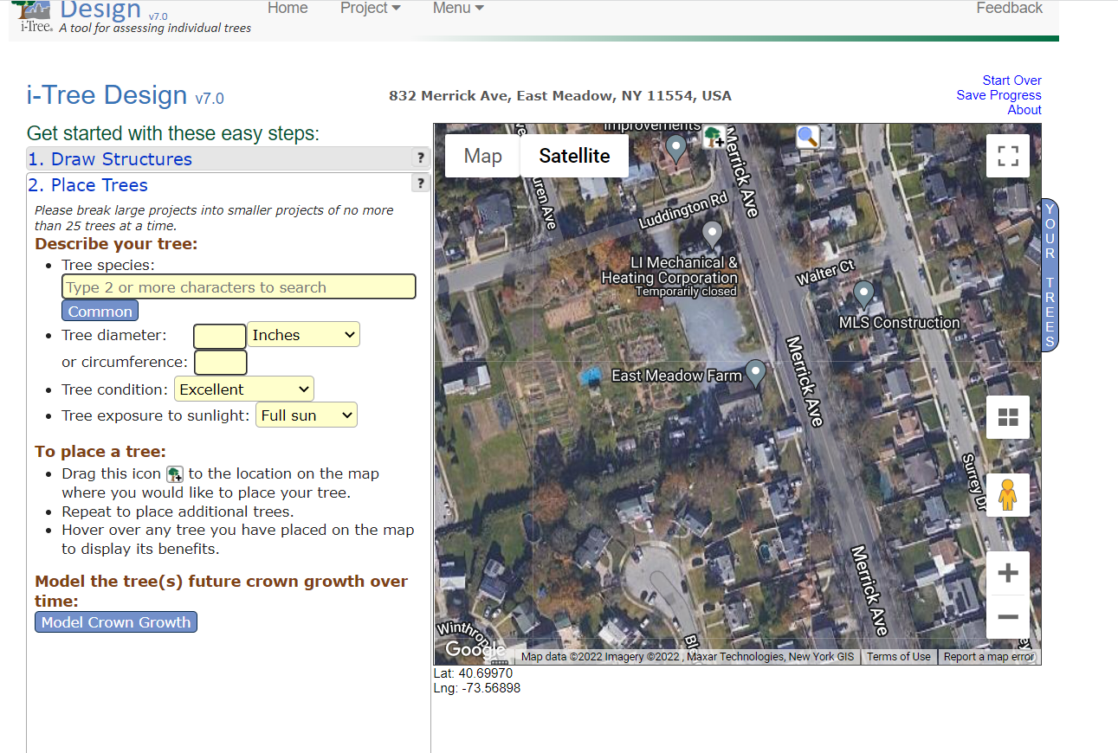
iTree Tutorial

Slide 23
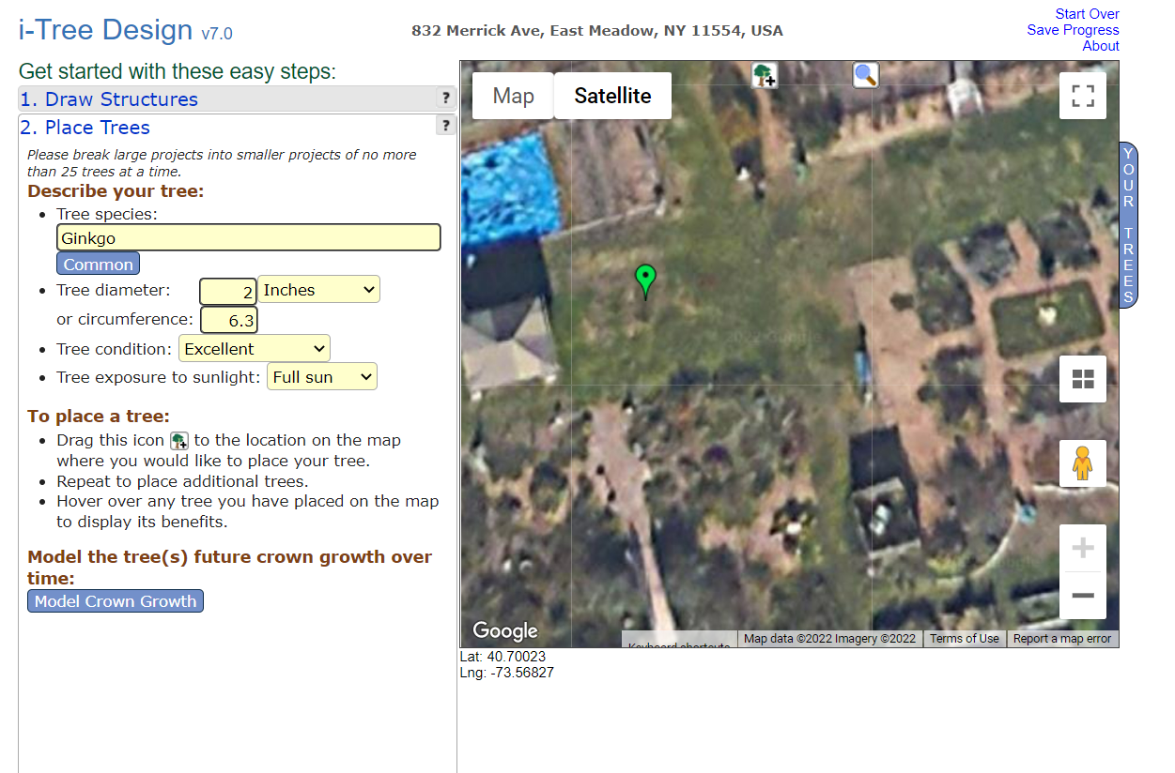
iTree Tutorial

Slide 24
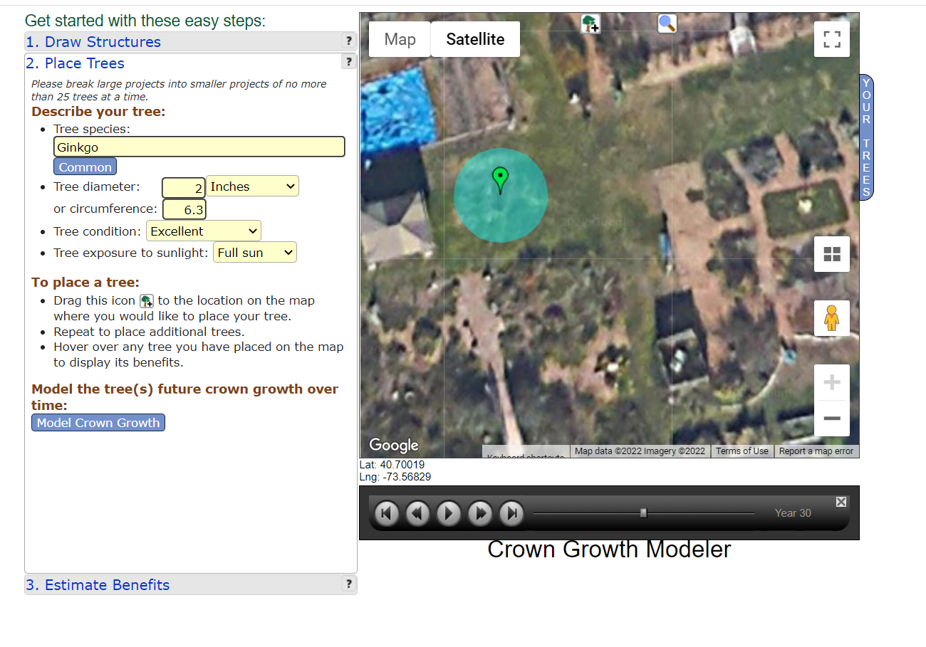
iTree Tutorial

Slide 25
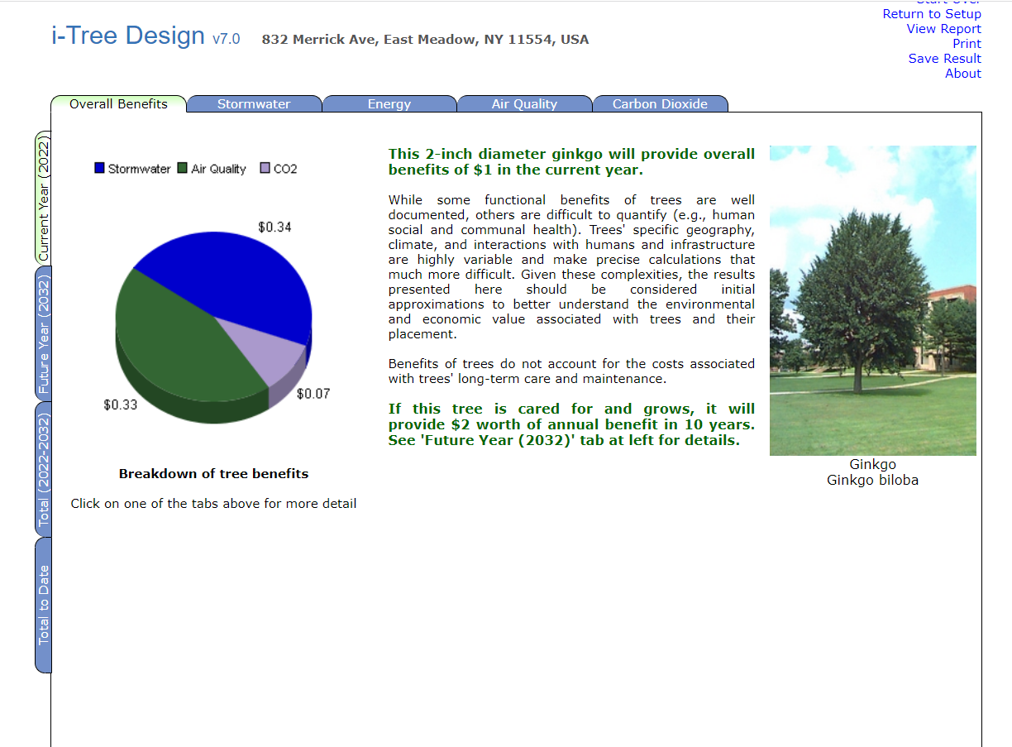
iTree Report

Slide 26
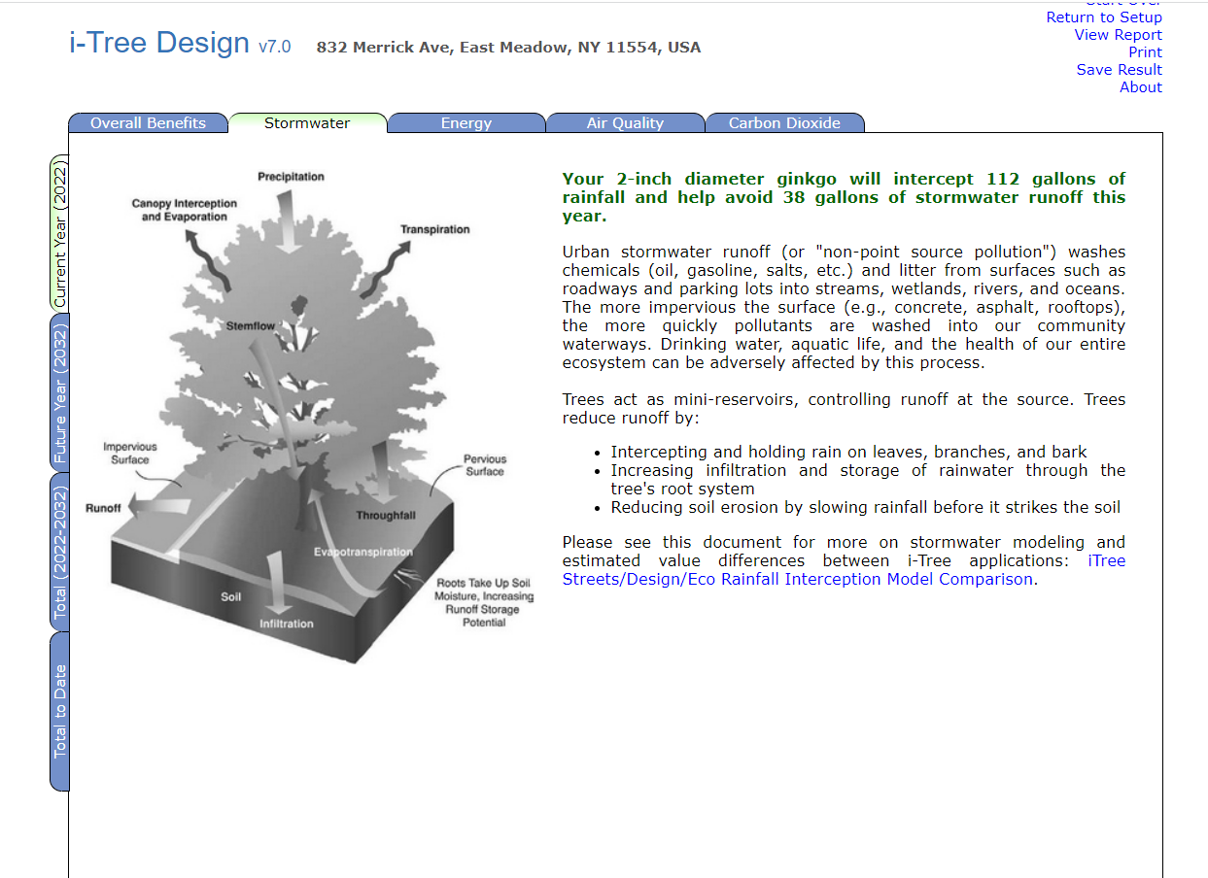
iTree Report

Slide 27
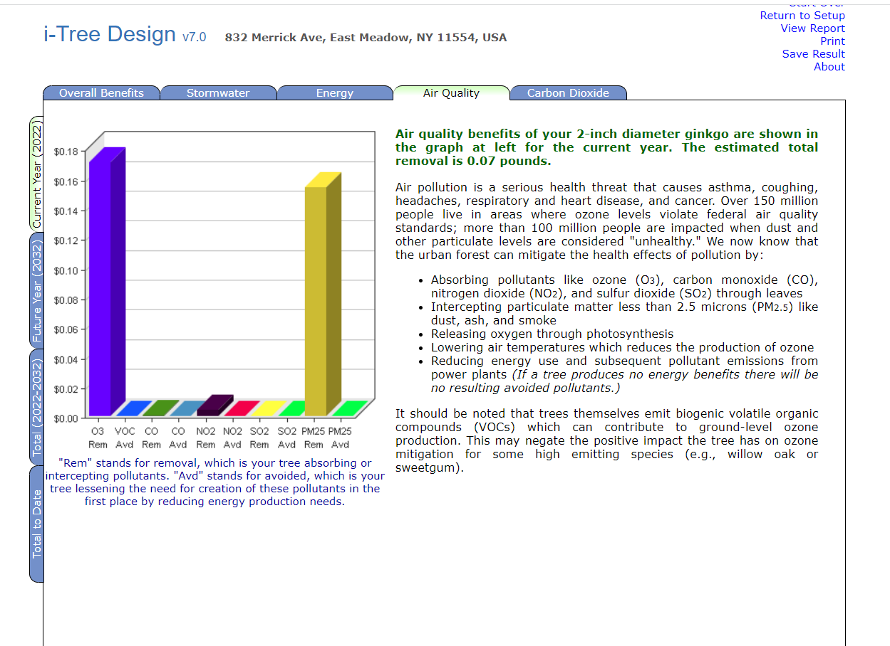
iTree Report

Slide 28
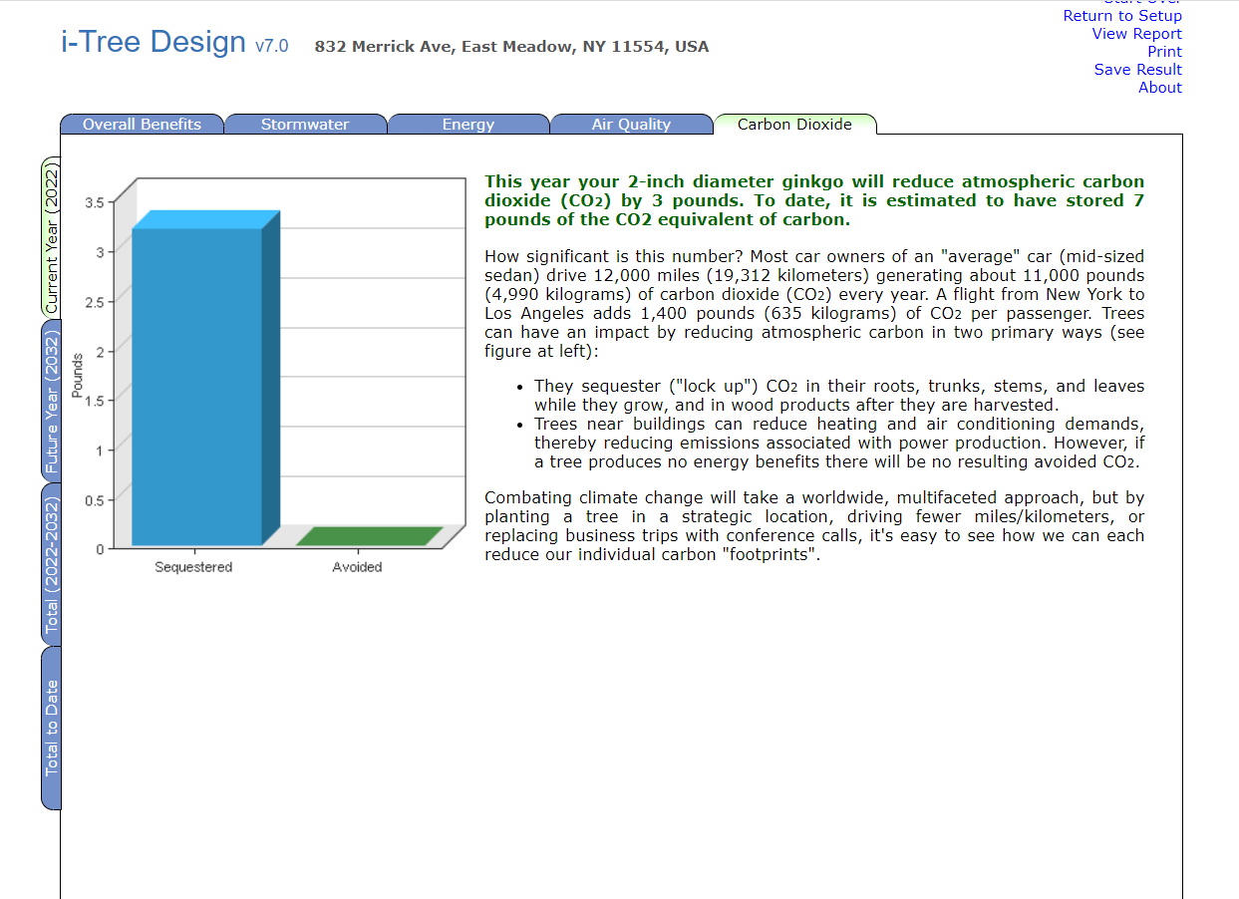
iTree Report

Slide 29
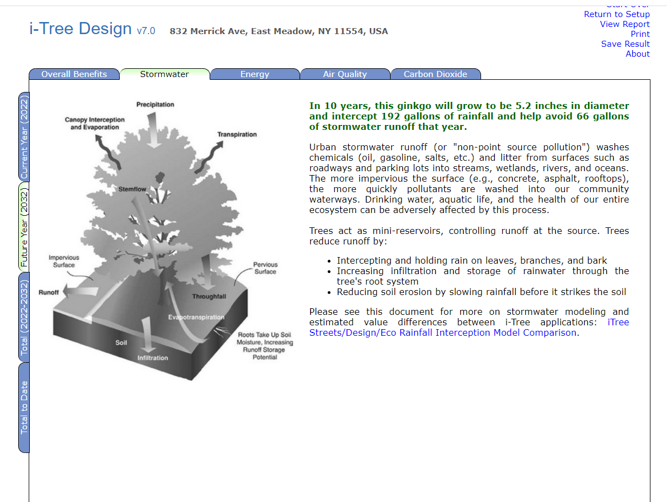
iTree Report - 10 years

Slide 30
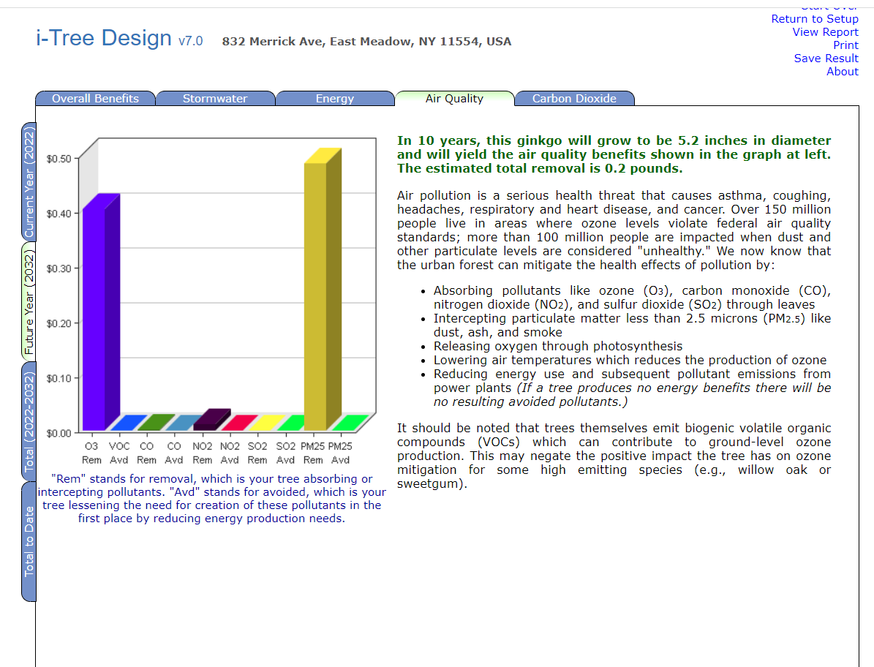
iTree Report - 10 years

Slide 31
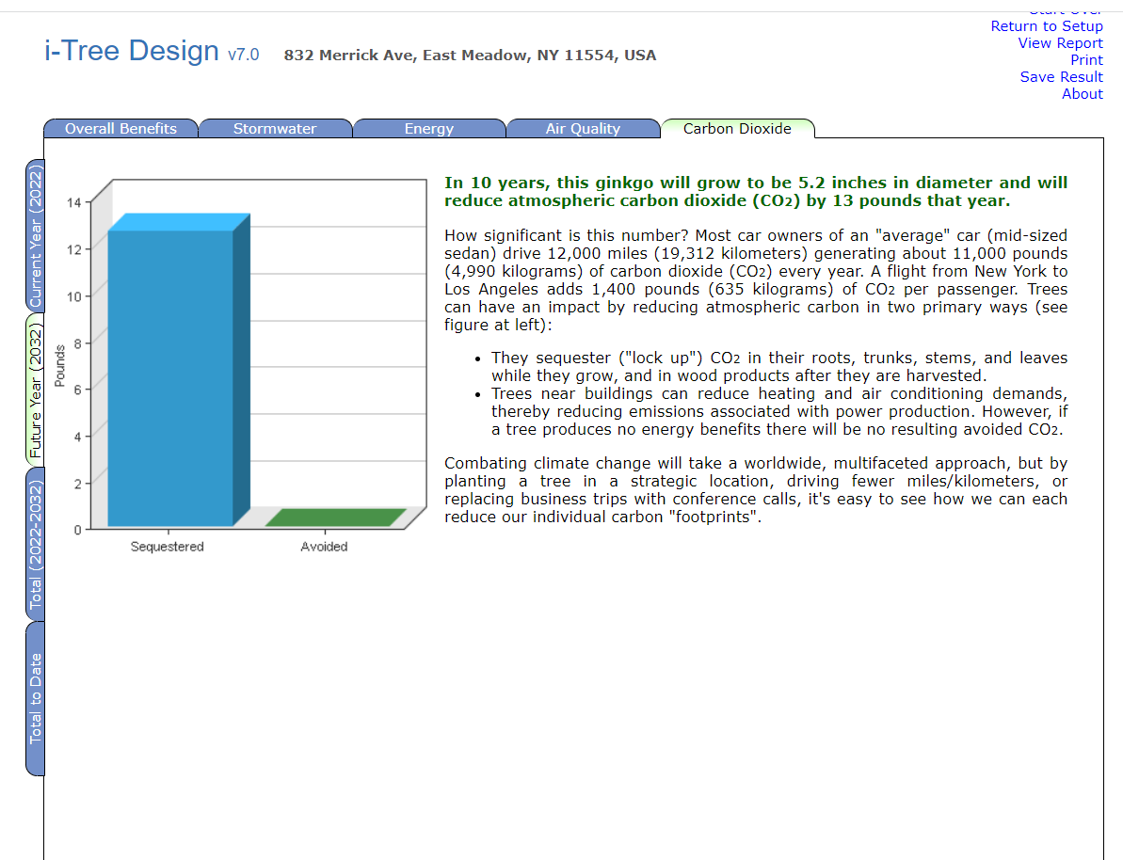
iTree Report - 10 years

Slide 32
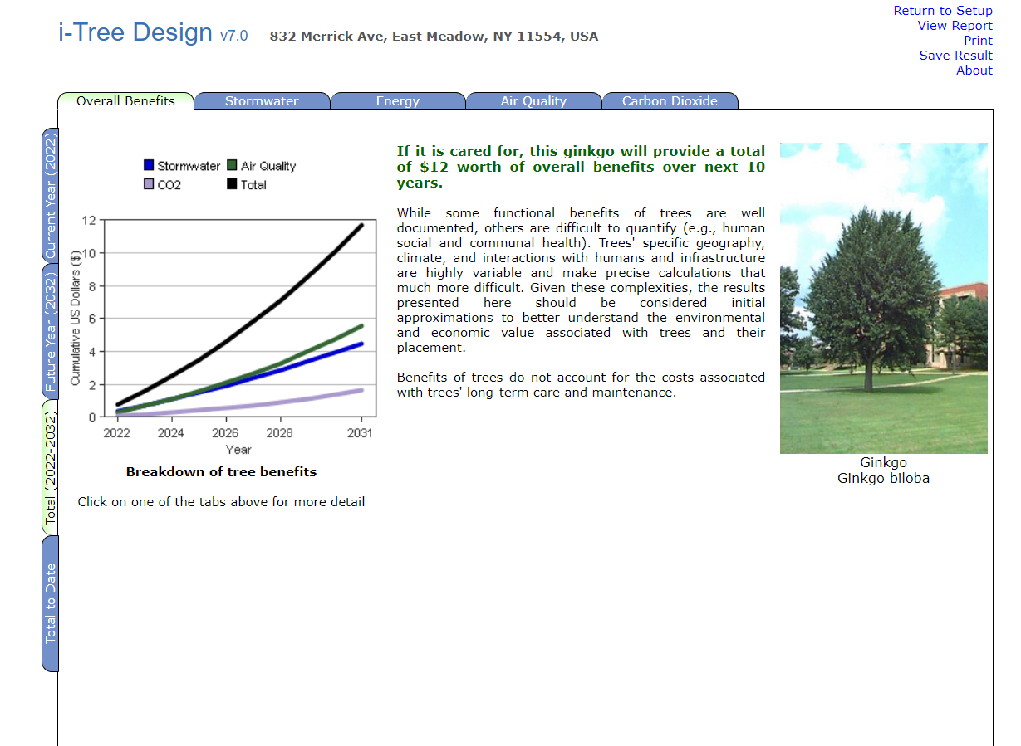
iTree Report - Now>> 10 years

Slide 33
Questions or Comments?
Christina McLaughlin
Natural Resource Educator
Cmm482@cornell.edu

