Slide 1
Rockaway Avenue Traffic Calming- Garden City
Stewart Avenue to Old Country Road/Herricks Road

Slide 2
Project Objectives
Control speed along the project limits
Improve intersection geometry at Merillon Triangle
Reduce accident potential at Merillon Triangle
Enhance pedestrian access in the vicinity of Garden City High School

Slide 3
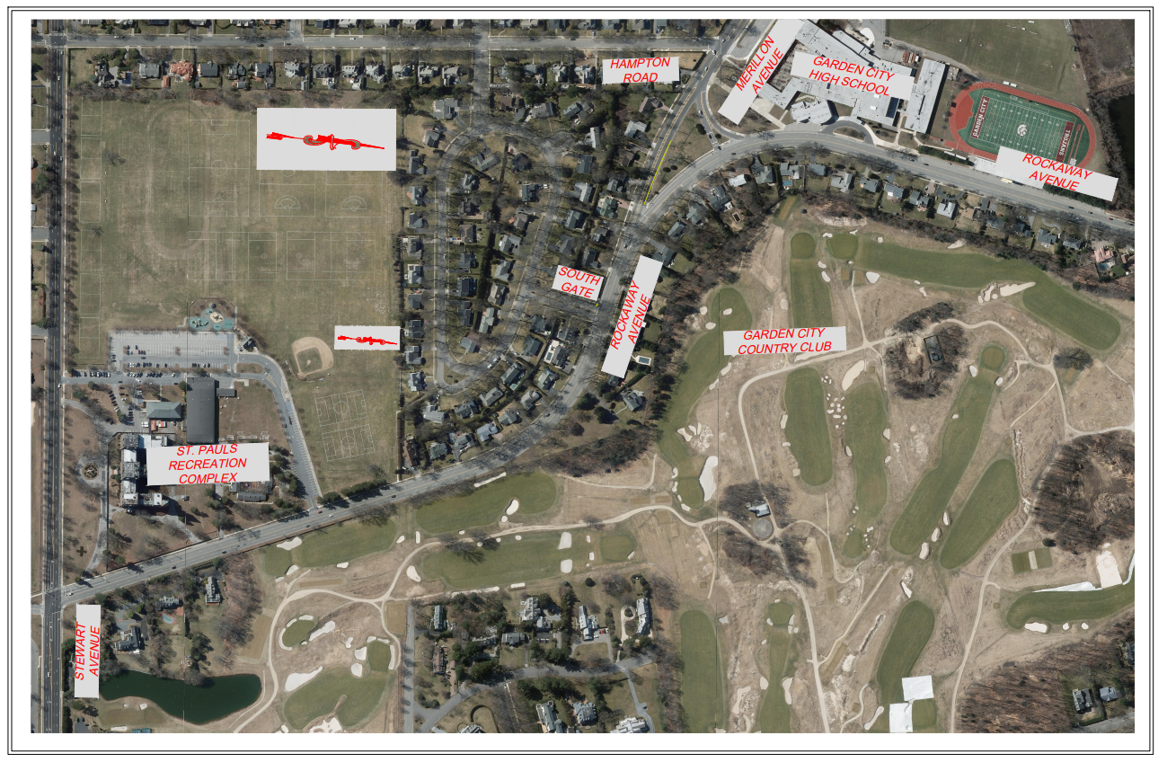
Rockaway Avenue Existing Conditions

Slide 4
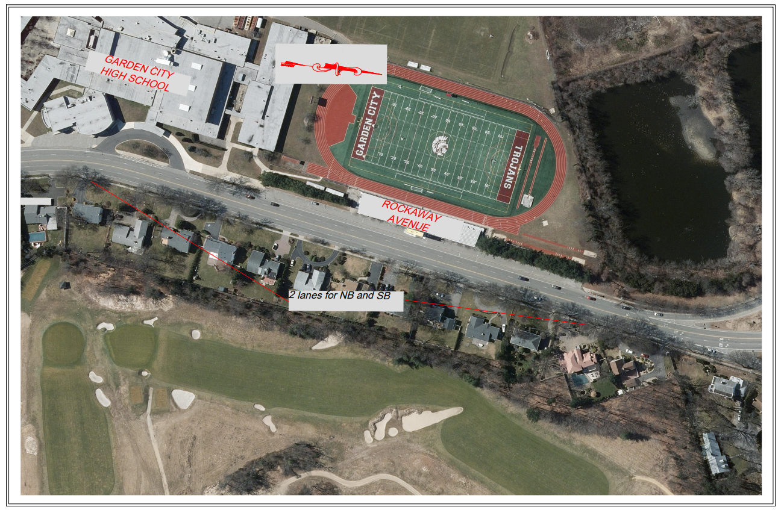
Garden City High School Existing

Slide 5
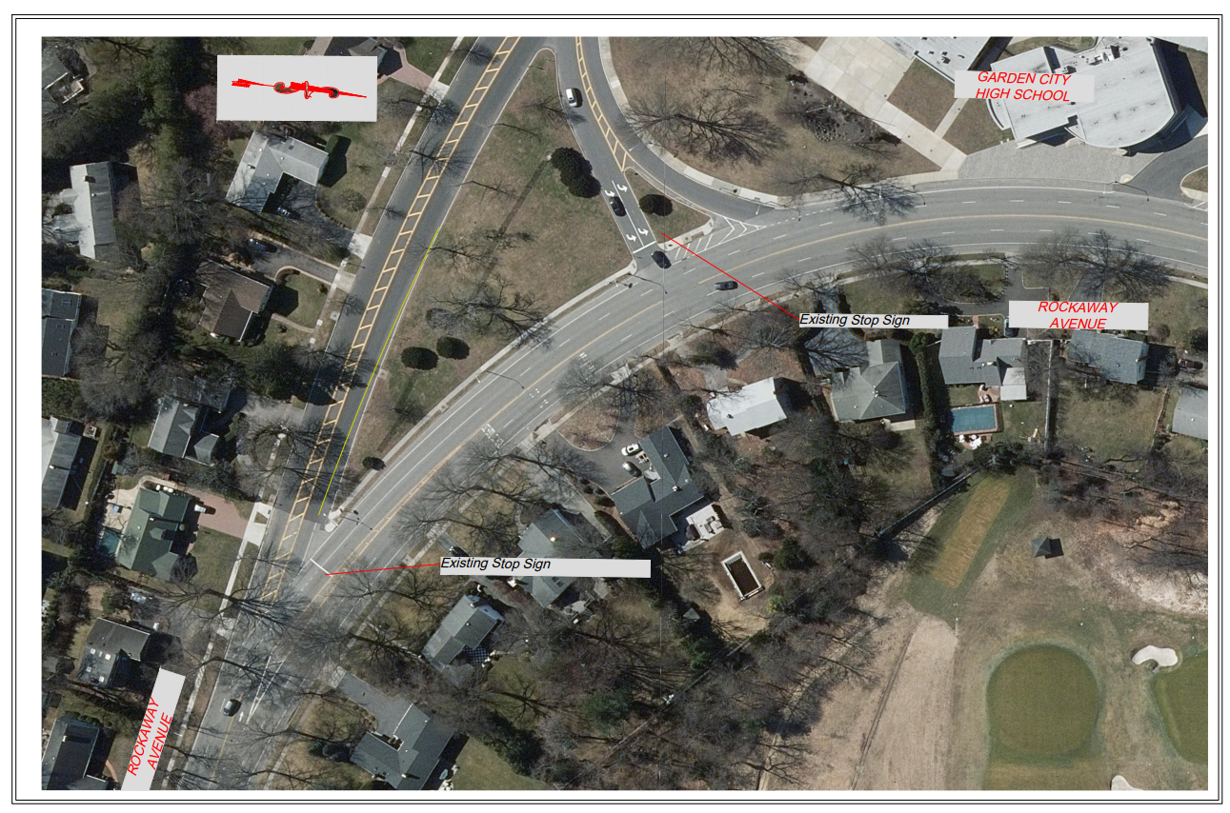
Merillon Triangle Existing

Slide 6
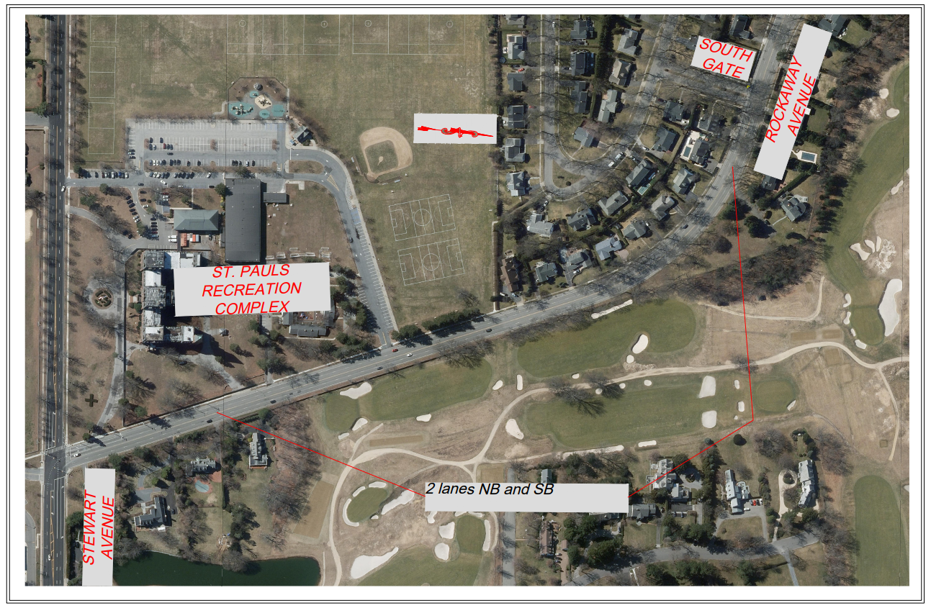
St Paul’s Section Existing

Slide 7
Study Procedure
Speed Studies
Accident Analysis
Capacity Analysis
Traffic Counts

Slide 8
Speed Study Results
Between Herricks Road/Old Country Road and Merillon Avenue
85th Percentile Operating Speed 37.6 mph NB / 49.7 mph SB
Between Merillon Avenue and Stewart Avenue
85th Percentile Operating Speed 42.5 mph NB / 57.0 mph SB

Slide 9
Accident History at Merillon Triangle
Rockaway Avenue Average Per Year
Old Country Road / Herricks Road 2.1
Segment from Old Country Road / Herricks Road
to Merillon Avenue Triangle 2.8
Merillon Avenue Triangle 8.1
South Gate 0.7
Segment from South Gate to Stewart Avenue 2.1
Stewart Avenue 1.6

Slide 10
Proposed Alternatives – Merillon Triangle
Signalization with Geometry Improvements
Roundabout- Not feasible due to R.O.W. constraints and does not provide pedestrian enhancements to access

Slide 11
Proposed Improvements
Alignment Modifications Merillon Triangle
Coordinated Traffic Signals at Merillon Triangle with Crosswalks and Pedestrian Signals
Lane diet portions of Rockaway Avenue
Resurfacing of Rockaway Avenue for the entire project limits with additional signage and new pavement markings

Slide 12
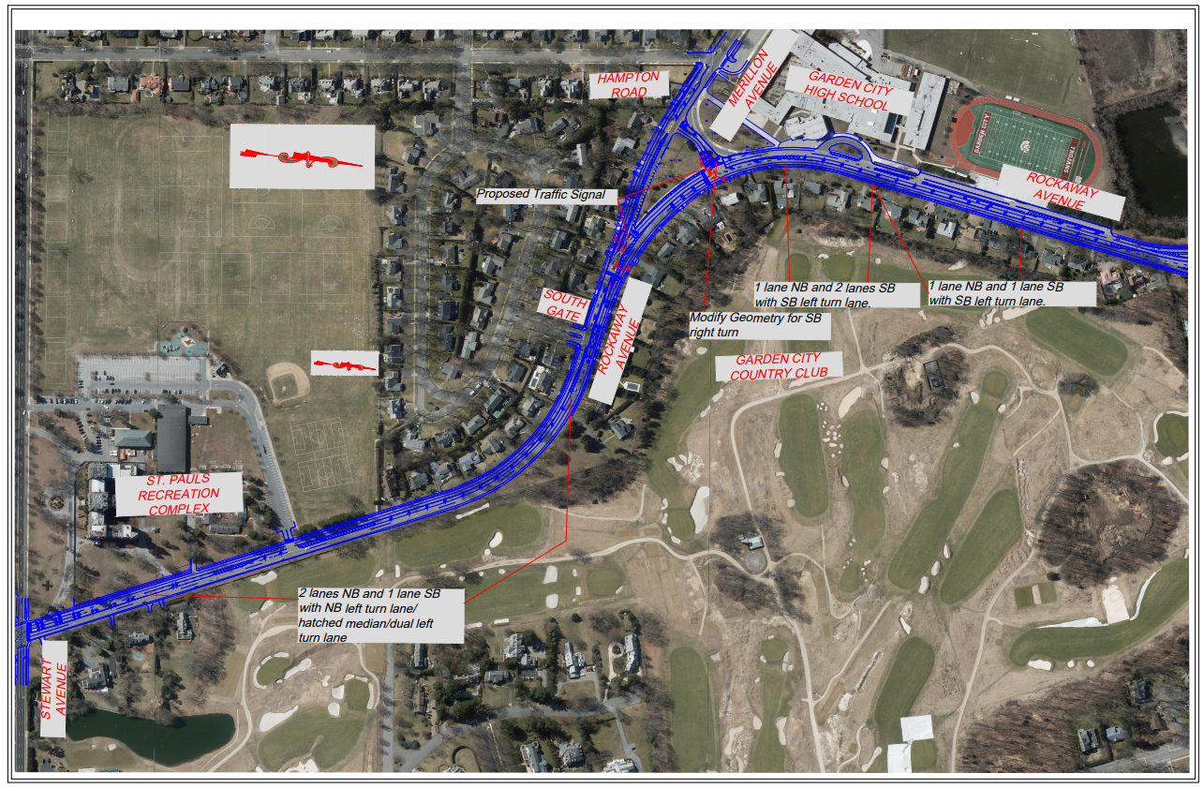
Rockaway Avenue Overall Proposed

Slide 13
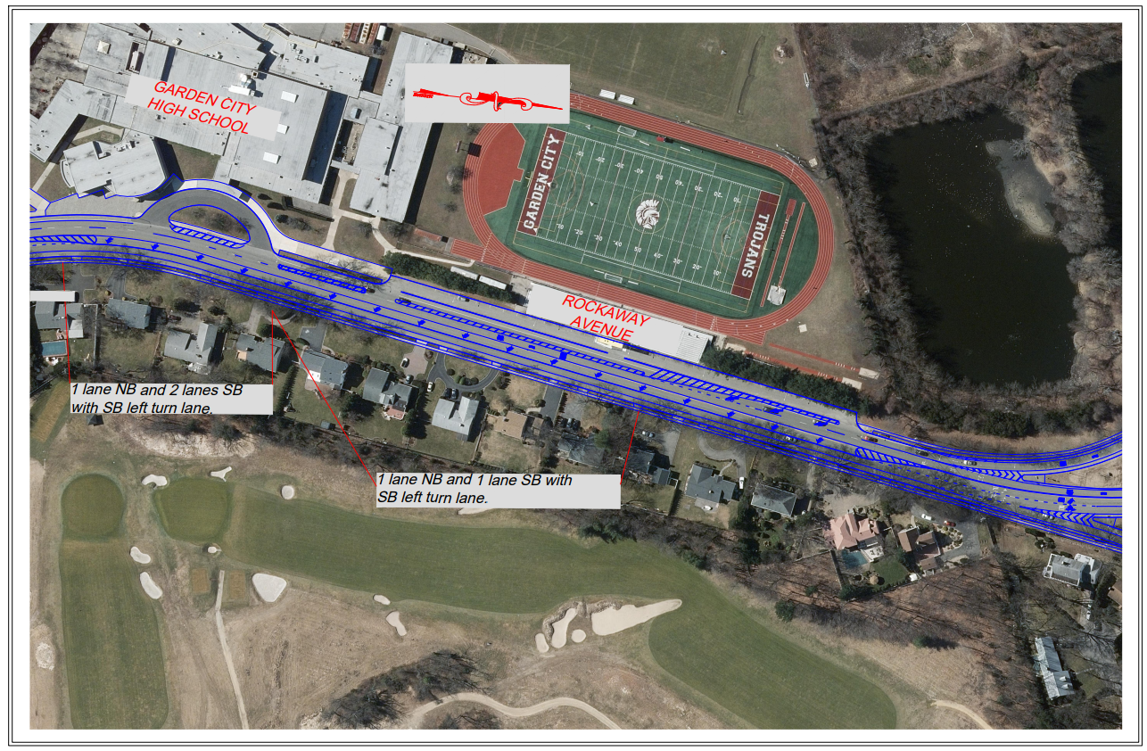
Garden City High School Proposed

Slide 14
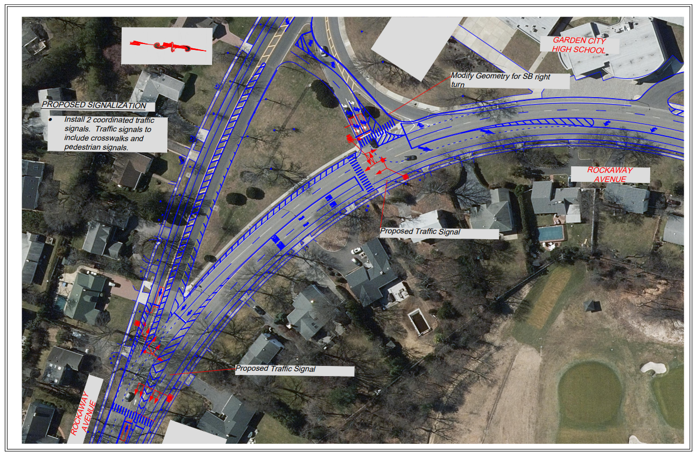
Merillon Triangle Proposed

Slide 15
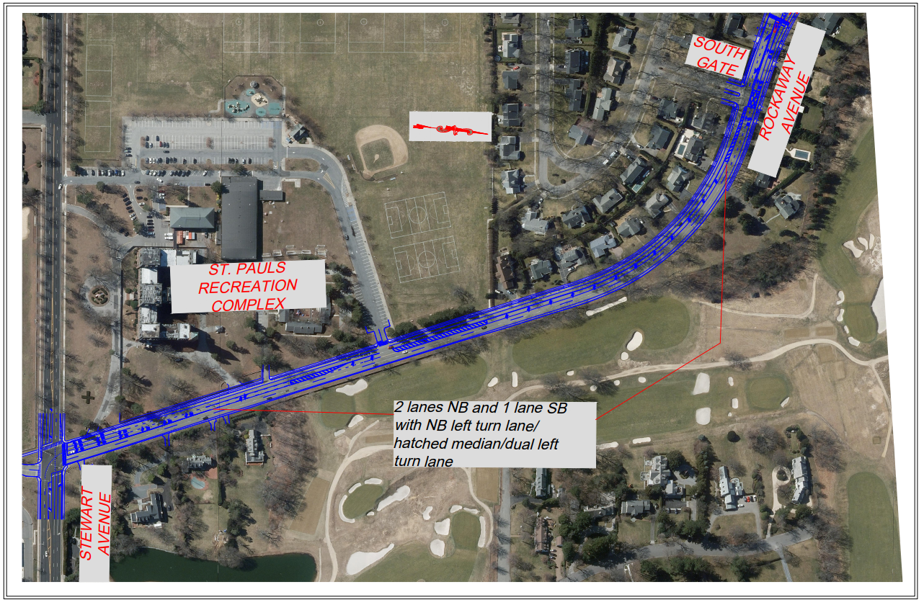
St Paul’s Section Proposed

