Slide 1
Environmental Advisory Board Meeting
March 12, 2024

Slide 2
Introducing…
My name is Joseph Umana, born and raised here on Long Island, New York.
I started my career in landscaping very early in life while attending Kellenberg Memorial High School. I was involved in numerous projects on campus up until and after I graduated in 2009.
I attended the Univ. of Delaware and graduated in May of 2013 with a B.S. in Plant Science with a concentration in Horticulture, Landscape, and Design.
On top of my degree I am also a CNLP, Certified Nursery Landscape Professional and an ISA Municipal Specialist Arborist.
I have worked for numerous companies on Long Island and around the country. I spent a large part of my career building rooftop terrace gardens, private condominium landscapes, as well as planting hundreds of NYC street trees.
After spending 10+ years in the private service sector it was time for a change…

Slide 3
What’s the Plan?
Currently Garden City is home to a system of approx. 12k trees including 9 parks and numerous shared community spaces. We also have a community tree planting program that introduces 150+ new trees every year.
We need to take a proactive approach based on risk to the public and property. We have been going throughout the village conducting visual inspections for dead/decaying trees and any hazardous trees in public spaces or along village streets.

Slide 4
Our Parks…
Garden City is home to 9+ parks that are used not only by our residents but also by numerous sporting groups/agencies.
These parks and fields remain a very large and important source of revenue for Recreation and Parks as well as the village as a whole.
Our parks also remain one of the highest traffic areas in the entire village. Upkeep, maintenance and safety pruning to remove hazardous branches and/or trees is crucial.

Slide 5
Tree Planting Program…
After much discussion with Mr. Blake I would like to start incorporating more flowering trees to our tree planting program.
We’ve specifically been discussing using Cherries, Crape Myrtles, Eastern Redbuds, Amelanchier and Vitex.
We’ve also been discussing the use of new shade tree cultivars (ie. ‘Street Keeper’ Honey Locust) that will still provide shade and canopy, but not interfere with our sidewalks or vehicular traffic.
We’re also moving away from planting entire streets in a monoculture style.

Slide 6
Reasoning…
As we move towards the future our oldest trees because our greatest assets. We need to preserve these trees as long as reasonably possible as long as they pose no risk.
We need to develop a new approach with our selection and placement.
With the increase and explosion of world trade we are rapidly seeing the introduction of new invasive pests faster than we can find methods of control.
Most recently we have seen the explosion of Emerald Ash Borer, Spotted Lantern Fly, Southern Pine Beetle and Beech Leaf Disease.
Planting in monoculture style leaves us susceptible to the next pest wreaking havoc.
We also need to adhere to the philosophy of “right plant, right place” and get away from planting large shade trees in 30” sidewalk strips.
Over time the root flares of these large shade trees are impeded by sidewalk/pavement. As their roots grow the sidewalk is lifted causing tripping hazards. When the sidewalks are then replaced, inevitably loss of structural roots will occur. With little root mass keeping a tree standing upright we risk blow over and major damage during storm events.

Slide 7
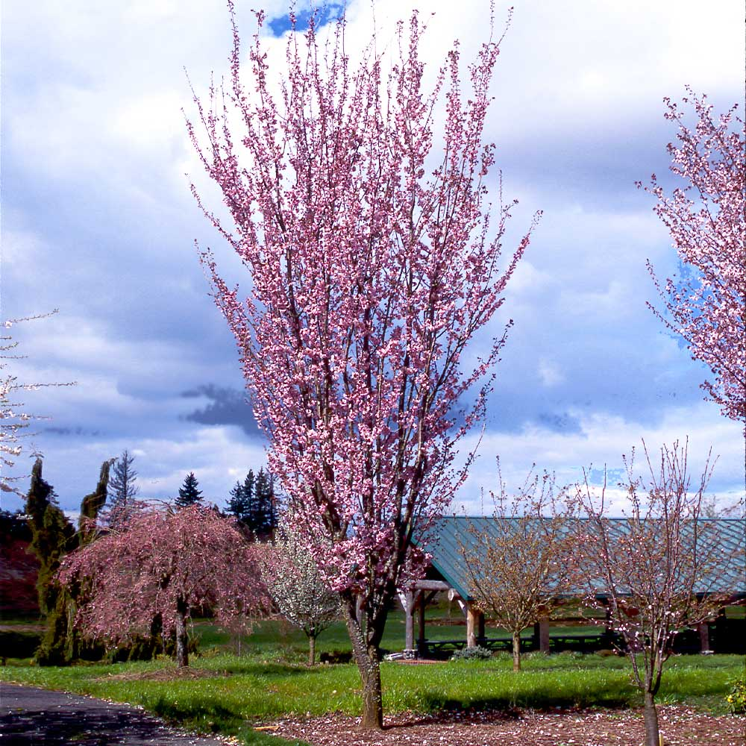
Prunus ‘Sargent’ Sargent Cherry

Slide 8
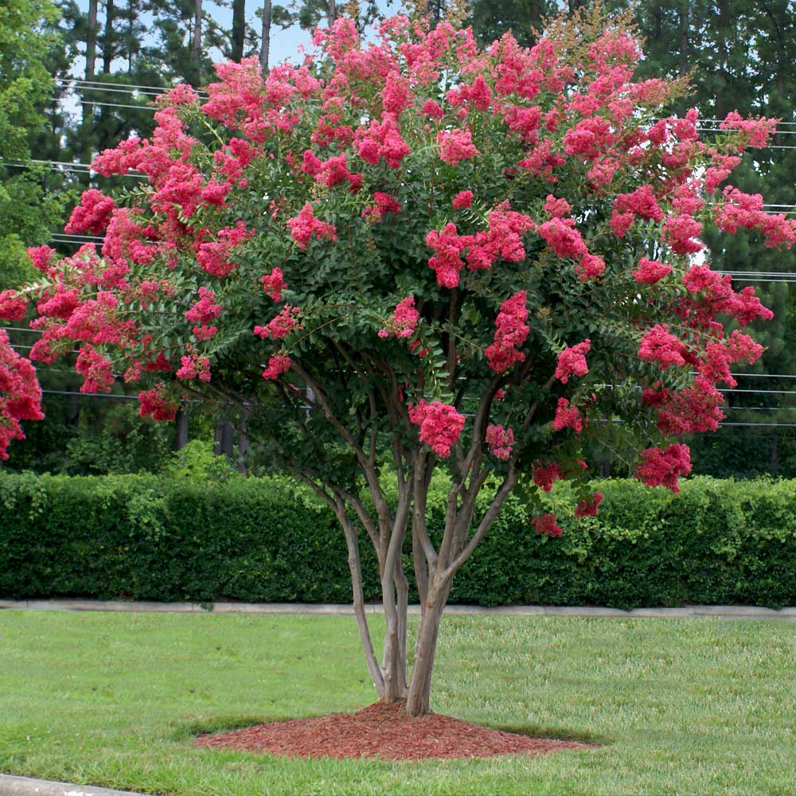
Lagerstroemia indica Crape Myrtle (many cultivars for flower colors)

Slide 9
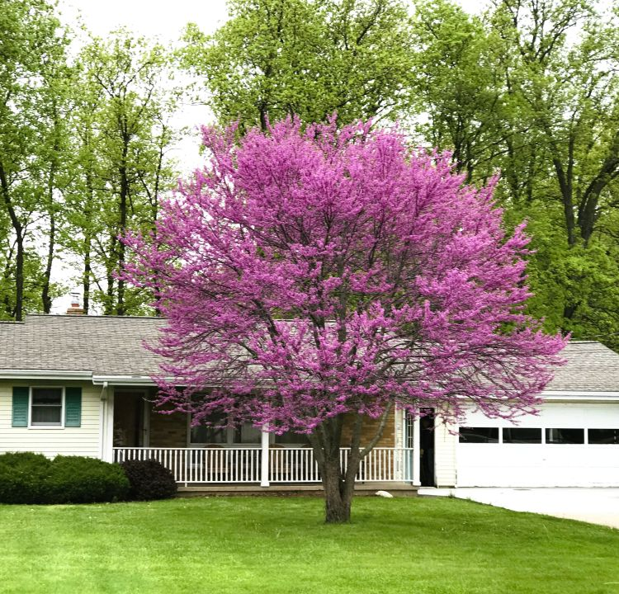
Cercis canadensis Eastern Redbud

Slide 10
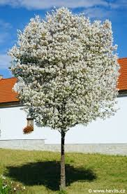
Amelanchier canadensis Shadblow aka Serviceberry

Slide 11
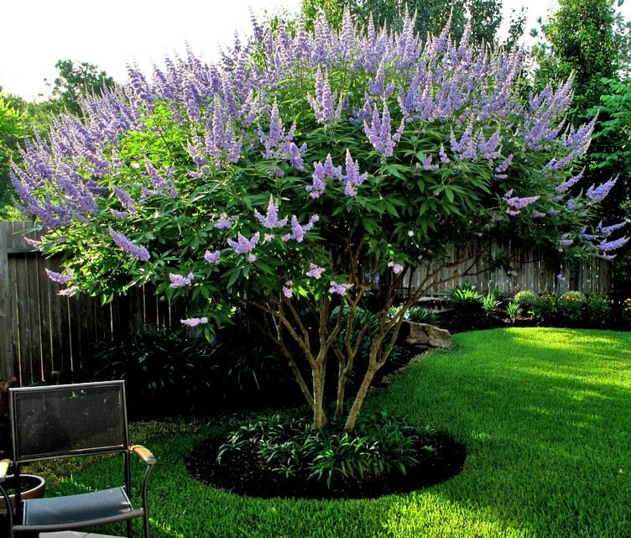
Vitex Chaste Tree

Slide 12
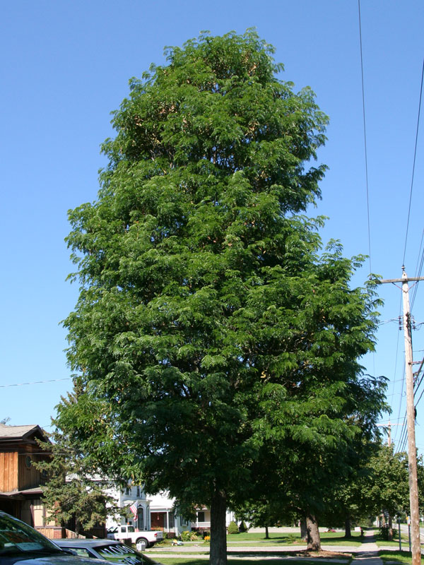
Gleditsia ‘Street Keeper’ Street Keeper Honeylocust

Slide 13
Pest Updates…
Emerald Ash Borer remains an issue and has decimated the population of Ash trees not only in the village, but throughout NY state.
Southern Pine Beetle remains an issue here on Long Island as populations remain erratic. We are seeing most of the damage take place in Suffolk County in the Pine Barrens. They will attack ALL Pine’s, but the most susceptible are Pitch Pine which are typically found near water front or beach plantings. Most of our Pine here in the village are White Pine, but we continue to assess for any damage and presence of populations.
Beech Leaf Disease is associated with a nematode, Litylenchus crenatae mccannii. This disease has only been discovered in recent years and much about it, including the full cause and how it spreads, is still unknown.

Slide 14
Spotted Lanternfly
The pest that is causing the most alarm and questions among our residents is the Spotted Lanternfly.
First discovered in PA 10 years ago, the bug was then found in NY as of 2020 and populations have exploded.
Adults and nymphs use their sucking mouthparts to feed on the sap of more than 70 plant species.
This feeding, sometimes by thousands of SLF, stresses plants, making them vulnerable to disease and attacks from other insects.
SLF also excrete large amounts of sticky "honeydew", which: promotes the growth of sooty molds that interfere with plant photosynthesis, negatively affecting the growth and fruit yield of plants.

Slide 15
Management…
DEC is working with the Department of Agriculture and Markets (AGM) and the US Department of Agriculture (USDA) to address SLF. Since it is less expensive and easier to deal with a pest before it becomes widespread, the goal is to find and treat SLF infestations early.
A plan has been developed that describes how the agencies will detect and prevent further spread of SLF in New York. Extensive trapping surveys are being conducted in high-risk areas throughout the state as well as inspections of nursery stock, stone shipments, commercial transports, etc.

