Slide 1

Legal & AAR
Fire Safety Committee

Slide 2
Key Protocols Utilized by the Fire Safety Committee to Conduct its Investigation
i. Objectives - what are we trying to achieve;
ii. Observations - what actually occurred;
iii. Suggestions - what should we implement to avoid future occurrences and need to act upon to achieve the stated objectives;
iv. Corrective Actions – following an incident occurring it is often the most difficult to recognize, investigate, accept and implement those needed changes;

Slide 3
Elements Integral to Formulating a “Needs Assessment”
a. Examining what presently exists
b. Understanding what has recently occurred
c. Sources of Information
d. Requests for Information
e. Assemblage of Information
f. Input from GCFD, Village Departments and Executive Staff
g. Distribute / Make Available Information to all the Committee members
h. Analysis of Information
i. Active listening to the GCFD and Executive Staff
j. Distillation and Verification of Information
k. Creating Actionable and Defined Objectives
l. Setting forth INITIAL Proposed Suggestions and Considerations

Slide 4






Residents & Occupants
Parents
Board of Trustees
VGC Enforcement
Board of Education
GCFD & Volunteers

Slide 5












1
2
3
4
6
5
7
8
9
10
11
12
Kitchen fires from unattended cooking, grease fires/chip pan fires
Electrical systems that are overloaded, poorly maintained or wiring in poor condition which provides a source of ignition
Combustible storage areas with insufficient protection
Combustibles near equipment that generates heat, flame, or sparks
Candles and other open flames
Smoking (cigarettes, cigars, pipes, lighters, etc.)
Equipment that generates heat and utilizes combustible materials
Flammable liquids and aerosols
Flammable solvents (and rags soaked with solvent) placed in listed contained in accordance with NYSFC 304.3.1 et seq.
Fireplace chimneys not properly or regularly cleaned that concentrate creosote
Heating appliances ‑ fireplaces, wood‑burning stoves, furnaces, boilers, portable heaters, solid fuels
Household appliances ‑ clothes dryers, curling irons, hair dryers, refrigerators, freezers, boilers

Slide 6
Methodology for Analysis
a. NFPA 1720
b. Final Report - ICMA - 2012
c. After Action Report
d. Grenfell Tower Block Fire
e. FDNY - 911 After Action Report
f. Decision Theory
f. Deductive Reasoning
h. Inductive Reasoning
i. Information processing

Slide 7
105 Hilton Avenue
Source of Ignition- Electrical;
The front of the house was fully involved when the alarm was transmitted;
Verified time of the actual events was secured and confirmed by time stamped photographs;
A “duty crew” was present in Headquarters and responded to the scene in minutes;
A PowerPoint presentation of those photographs documented this event.
148 Washington
Source of Ignition - Undetermined;
There were no working smoke detectors;
The fire was fully involved prior to being discovered;
It was first observed by a passing Village vehicle who sounded the alarm;
Initial attempts at entry were impossible because of the extensive fire.
41 Spruce Street
Source of Ignition - Electrical - Extension cord;
The fire spread substantially before being detected;
GCFD responded within minutes of the alarm and quickly extinguished.
130 Stewart Avenue
Source of Ignition - Water in Circuit Breaker Panel;
Once the alarm was transmitted the GCFD responded in minutes.
Revel Restaurant - Kellum Drive obstruction
A Fire Hazard and Risk was created by blocking a roadway;
Fortunately, no injuries or deaths occurred but the Village’s good fortune cannot be relied upon in the future;
It is imperative that compliance with the laws and good fire prevention protocols be maintained.

Slide 8
EMERGENCY ACTION AND RESPONSE PLAN

Slide 9
CATEGORIES OF FINDINGS AND RECOMMENDATIONS
DEPARTMENT ORGANIZATIONAL CHART
RESPONSE TIMES AND ATTENDANCE
RESPONSE PROCEDURES, MUTUAL AID AND DISPATCH MATRIX
TRAINING

Slide 10
DEPARTMENT ORGANIZATIONAL CHART: FINDINGS
FULLY VOLUNTEER PARA MILITARY ORGANIZATION
FOUR CHIEFS CURRENTLY 4, ONE YEAR TERMS
CHIEF OF DEPARTMENT
THREE ASSISTANTS
TWO COMPANIES ( ENGINE & TRUCK )
NOT TASK ORIENTED BUT FOR ADMINISTRATIVE PURPOSE
CAPTAIN AND TWO LIEUTENANTS EACH COMPANY ( 3, ONE YEAR TERMS )
MEMBERS DO NOT RESPOND TO GEORGRAPHICALLY CLOSEST FIREHOUSE FOR ALL ALARMS.

Slide 11
DEPARTMENT ORGANIZATIONAL CHART: RECOMMENDATIONS
ELIMINATE ADMIN COMPANIES. ALL MEMBERS ARE ASSIGNED TO EITHER CO. 2 (WEST) OR CO.3, (EAST) DEPENDANT ON GEORGRAPHIC LOCATION OF THEIR RESIDENCE
EACH COMPANY WILL RETAIN ONE CAPTAIN AND TWO LIEUTENANTS
ALL CHIEF AND OFFICER POSITIONS TO BE INCREASED TO A TWO YEAR TERM.
ASSISTS IN CONTINUITY AT THE LEADERSHIP LEVEL,
INCREASES COMPETENCE IN DECISION MAKING
ALLOWS NEW MEMBERS TO ACQUIRE NEEDED QUALIFICATIONS AND EXPERIENCE

Slide 12
NASSAU COUNTY FIRE SERVICE ACADEMY ANNUAL DEPARTMENT OPERATIONS: FINDINGS
GCFD ATTENDS EACH YEAR 4 NIGHT SESSIONS
LIVE BURN TRAINING DIFFERENT STYLE BUILDINGS
GCFD HAD MAXIMUM ALLOWABLE ATTENDANCE DUE TO COVID (25)
EVALUATIONS SHOW DEFICIENCY IN LADDER COMPANY OPERATIONS 2020 AND 2021 AS COMPARED TO OTHER SKILLS AND COMPETENCIES

Slide 13
NASSAU COUNTY FIRE SERVICE ACADEMY ANNUAL DEPARTMENT OPERATIONS: RECOMMENDATIONS
IMPLEMENT ATTENDANCE REQUIREMENT
EG. INTERIOR FFs MUST ATTEND 50% EACH YEAR OR COMPLETE FULL COURSE EVERY OTHER YEAR
EXTERIOR FFs COMPLETE COURSE EVERY 3 YEARS
ATTEND EXTRA FOUR WEEKS PER YEAR WITH MUTUAL AID DEPARTMENTS

Slide 14
TRAINING; FACILITIES FINDINGS
PROPANE FED CAR FIRE PROP AND BUILDING ( NON BURN )
FALLS UNDER NYS BUILDING CODE AND NFPA TRAINING STANDARDS REQUIRING SPECIFIC SUPERVISION FOR LIVE BURN TRAINING
REQUESTS FOR GCFD MEMBERS TRAINED TO SUPERVISE THESE EVOLUTIONS PRODUCED NO MEMBERS
BLDG USED FOR SEARCH, HOSE LINE STRETCH/ADVANCE, PORTABLE LADDERS, FIREFIGTHTER SURVIVAL AND RESCUE

Slide 15
TRAINING; FACILITIES RECOMMENDATIONS
IMMEDIATELY CEASE USE OF PROPANE CAR FIRE PROP UNTIL COMPLIANCE OF NFPA 1403, 2018ed.
SERIOUS INJURY OR DEATH AT THIS FACILITY GCFD AND VILLAGE OF GC WILL BE HELD ACCOUNTABLE FOR NOT FOLLOWING NATIONALLY PRACTICED GUIDELINES
TRAIN MEMBERS AT APPROPRIATE FIRE SERVICE ACADEMIES TO
FIRE INSTRUCTOR I
FIRE INSTUCTOR II
SAFETY OFFICER

Slide 16
TRAINING COMPANY AND CHIEF OFFICERS
THREE , ONE YEAR TERMS FOR EACH
NO CONTINUITY
NO PROFESSIONAL DEVELOPMENT
NYS HAS NO SPECIFIC QUALIFICATIONS FOR VOLUNTEER OFFICERS OR CHIEFS
CAREER OFFICERS AND CHIEFS BY LAW ATTEND 6 WEEKS TRAINING
CURRENT QUALIFICATIONS ARE SUB PAR AND DO NOT LEND TO HIGHER TRAINED MEMBERS AT HIGHER RANKS

Slide 17
TRAINING COMPANY AND CHIEF OFFICERS RECOMMENDATIONS
INCREASE TERMS FROM ONE YEAR TO TWO YEAR
IMPLEMENT STRUCTURED / TIERED TRAINING FOR OFFICERS AND CHIEFS
ADDITIONAL TRAINING FROM SECOND LIEUTENANT TO CHIEF OF DEPARTMENT SHOULD BE IMPLEMENTED IN PROGRESSION OVER TIME AS REFERENCED IN FULL REPORT

Slide 18
TRAINING: FIREFIGHTERS FINDINGS
NEW MEMBER RECEIVES 33 HOUR CLASSROOM BY GCFD MEMBERS
IN HOUSE MANUAL OUTDATED, CONTRADICTORY MATERIAL
MONTHLY DRILL SESSIONS
NO LESSON PLANS OR OUTLINES PROVIDED FOR ANY MONTHLY DRILL AS REQUESTED
REVIEW OF VIDEO AND FIRST HAND ACCOUNTS FROM RECENT INCIDENTS

Slide 19
TRAINING: FIREFIGHTERS RECOMMENDATIONS
UTILIZE NASSAU FIRE SERVICE ACADEMY MORE FREQUENTLY
UTILIZE THIRD PARTY VENDOR FOR PROBATIONARY AND OR MONTHLY TRAINING
THIRD PARTY VENDORS HAVE CERTIFIED INTSTRUCTORS, LESSON PLANS AND COMPLIANT WITH NFPA TRAINING STANDARDS
COMPREHENSIVE REVIEW OF BACK TO BASICS FOR ENGINE AND LADDER COMPANY SKILLS
PROVIDE LESSON PLANS FOR ALL DRILLS, CLASSES, DRIVER TRAINING AS PER NFPA

Slide 20
TRAINING: BUDGET FINDINGS
$15,000 PER YEAR FOR HANDS ON TRAINING. NOT EQUIPMENT
LACK OF REPETITON FOR MEMBERS DOES NOT ACHIEVE MASTERING PSYCHOMOTOR SKILL SETS
VILLAGE CURRENTLY HAS AN OFFICE OF FIRE PREVENTION BUREAU IN CHAPTERS 15 AND 107 IN THE VILLAGE CODE

Slide 21
TRAINING BUDGET RECOMMENDATIONS
INCREASE BUDGET
USE OF THIRD PARTY VENDORS WITH FIRST HAND EXPERIENCE, PROPS, CERTIFICATION
INCREASE ACCESSIBILITY TO CHIEF’S OFFICE FOR TRAINING MONIES TO PAY FOR THIRD PARTY TRAINING (PETTY CASH)
UTILIZE OFFICE OF FIRE PREVENTION BUREAU TO OVER SEE TRAINING STANDARDS AND REQUIREMENTS ARE MET

Slide 22
RESPONSE TIMES / ATTENDANCE: FINDINGS
USED NATIONAL FIRE REPORTING , APPARATUS MOBILE DATA TERMINAL, EYE WITNESS ACCOUNTS, DEPT. PROVIDED DATA
2017 CAREER FIREFIGHTER STAFFING INCLUDED 1-2 FIREFIGHTERS PER APPARATUS
PREVIOUS CAREER SYSTEM HAD HEAVY RELIANCE ON VOLUNTEER SUPPORT RESPONDING TO SCENE
REPORTING DIRECTLY TO SCENE HAS DIRECT NEGATIVE EFFECT ON MEMBER ACCOUNTABILTY AND SAFETY ISSUES

Slide 23
RESPONSE TIMES / ATTENDANCE: FINDINGS
STRUCTURAL FIRE RESPONSE TIME FOR FIRST ENGINE ON SCENE
2017 AVERGAGE: 3:47
(CAREER STAFFING WITH 1-2 FIREFIGHTERS ON APPARATUS)
2018-2021 AVERAGE: 8:37
(VOLUNTEER STAFFING WITH 4 FIREFIGHTERS AS PER S.O.P.)

Slide 24
RESPONSE TIMES / ATTENDANCE: FINDINGS
ATTENDANCE. TAKEN FROM DEPARTMENT NFIRS REPORTS.
FINGER PRINT SIGN IN*
`* NOT NECESSARILY ON THE APPARATUS RESPONDING
LOW VOLUNTEER MEMBERSHIP TURN OUT AND RETENTION IS A CRITICAL ISSUE IN FIRE DEPARTMENTS NATIONALLY.

Slide 25
RESPONSE TIMES / ATTENDANCE: FINDINGS
ATTENDANCE BROKEN INTO
YEARLY AVERAGE
2017 (CAREER) 10 VOLUNTEERS PER ALARM
2020/2021 ( VOLUNTEER ONLY ) 15.5 VOLUNTEERS PER ALARM 24/7
HOURLY AVERAGE
12AM -8AM: 9.2 VOLUNTEERS PER ALARM
8AM-4PM: 10.4 VOLUNTEERS PER ALARM
4PM-12AM: 18.3 VOLUNTEERS PER ALARM

Slide 26
RESPONSE TIMES / ATTENDANCE: FINDINGS
NFPA 1720 STANDARD FOR ORGANIZATION AND DEPLOYMENT OF FIRE SUPPRESSION OPERATIONS, EMERGENCY MEDICAL OPERATIONS, SPECIAL OPERATIONS TO THE PUBLIC BY VOLUNTEER FIRE DEPARTMENTS 2020 EDITION; CH 4 ORGANIZATION OPERATION AND DEPLOYMENT
STANDARD RESPONSE TIME AND ATTENDANCE DEFINED BELOW:
DEMAND ZONE DEMOGRAPHIC MIN. STAFF RESP TIME MEETS OBJ
URBAN > 1,000 people per sq mile 15 9 minutes 90%

Slide 27
RESPONSE TIMES / ATTENDANCE: FINDINGS
70 TOTAL ALARMS FOR STRUCTURAL FIRE RESPONSE: 2020 - 6/30/2021
NFPA 1720 CRITERIA: OBJECTIVE TO BE MET 90%
GARDEN CITY FD : OBJECTIVE MET 6.15%
-5 ALARMS DISQUALIFIED DUE TO LACK OF INFORMATION
-INCLUDES ALARMS WHERE UNITS WERE TOLD TO RESPOND
NOT IN EMERGENCY MODE
-ON SCENE TIME IS DIRECTLY RELATED TO LENGTHY TRAVEL TIME FROM HEADQUARTERS FIREHOUSE

Slide 28
This sub-committee does not recommend
returning to the type of combination fire
department with such staffing as the career
force was relegated to at its end.
Limited staffing on a single unit as previously
provided can not provide aggressive attacks
needed in the majority of our village.

Slide 29
RESPONSE TIMES / ATTENDANCE: RECOMMENDATIONS
INCREASE RECRUITMENT AND RETENTION OF VOLUNTEERS
ADDING LENGTH OF SERVICE AWARD PROGRAM (LO-SAP) FOR VOLUNTEERS
VOLUNTEER STAFFED IN HOUSE DUTY CREWS: RESPOND AND OPERATE AN ENGINE IMMEDIATELY
GCFD MEMBERS HAVE BEEN DOING THIS ON AND OFF SINCE THIS COMMITTEE HAS STARTED
DIFFICULT TO SUSTAIN DURING MOST IMPORTANT HRS. 12AM-8AM

Slide 30
RESPONSE TIMES / ATTENDANCE: RECOMMENDATIONS
UTILIZE NYS VILLAGE LAW 10-1000
OPERATE AN ENGINE 24/7 BY STAFFING IT WITH CURRENT MEMBERS OF THE GCFD WHO CAN EARN A STIPEND WHILE ON CALL AT THE FIREHOUSE DECREASING RESPONSE TIME
POSSIBLY INCREASE ROLLS AND RETENTION
THIS MODEL IS USED THROUGHOUT THE UNITED STATES

Slide 31
RESPONSE TIMES / ATTENDANCE: RECOMMENDATIONS
“SETAUKET” MODEL
4-5 CAREER FIREFIGHTERS WORKING PART TIME
SHIFTS OF 8-12 HOURS. 24/7
DECREASED RESPONSE TIME
LIMITED TRAINING COST
APPROXIMATE COST
4 FIREFIGHTERS $946,080
5 FIREFIGHTERS $1,182,600

Slide 32
RESPONSE TIMES / ATTENDANCE: RECOMMENDATIONS
EACH OF THESE RECOMMENDATIONS RELIES HEAVILY ON VOLUNTEER RESPONSE TO SUPPLEMENT OPERATIONS AT ANY STRUCTUAL FIRE

Slide 33
RECOMMENDATION FOR BEST POSSIBLE LIFE SAVING RESPONSE INVOLVING APPARATUS
MOVE ONE ENGINE AND ONE LADDER TO BOTH STATION 2 (WEST) AND STATION 3 (EAST)
IN CONJUCTION WITH 24/7 STAFFING AT HEADQUARTERS THESE CHANGES WILL INCREASE POSSIBILITY OF SURIVAL OF TRAPPED OCCUPANTS DUE TO MORE RAPID ENGINE AND LADDER RESPONSE TIMES
APPARATUS WILL BE CLOSER TO MAJORITY OF ALL MEMBERS
DECREASE OF RESPONSE TIME AT ALL AREAS OF VILLAGE. IMPROVING ON NFPA 1720 STANDARDS
THESE RECOMMENDATIONS ARE IN CONJUNCTION WITH FINDINGS AND RECOMMENDATIONS OF APPARATUS AND FACILITY SUB COMMITTEE AND THE ASSOCIATED WORK REQUIRED

Slide 34
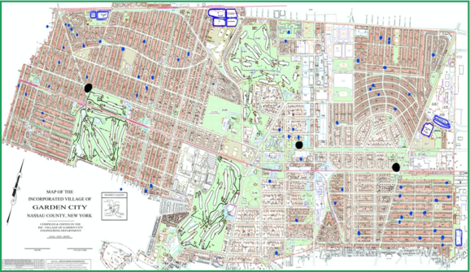
GCFD MEMBER MAP

Slide 35
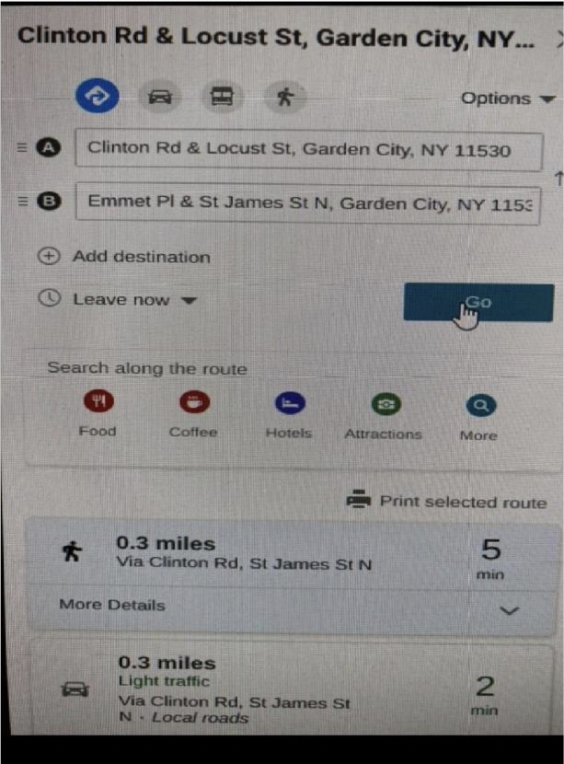
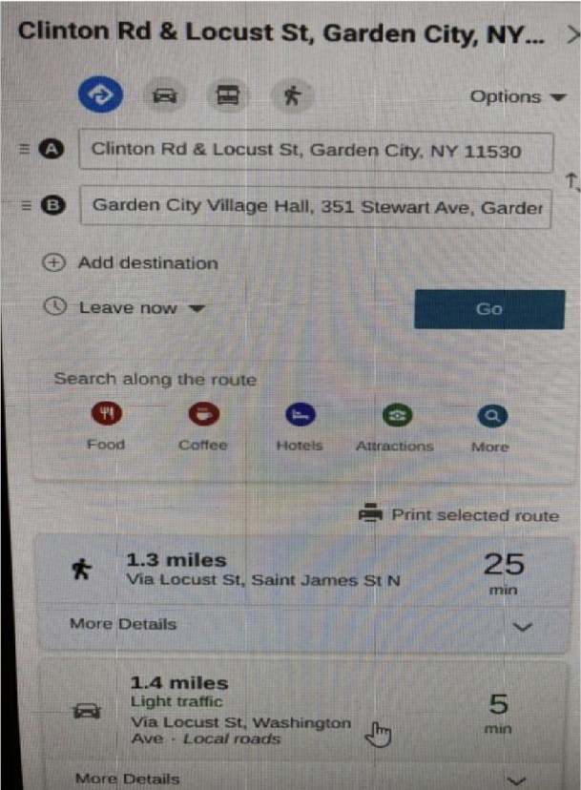
AVERAGE TIME TO HEADQUARTERS VS STATION 3
APPARATUS CAN BE ENROUTE UP TO THREE MINUTES FASTER IF MEMBERS RESPONDED TO GEOGRAPHICALLY CLOSEST FIREHOUSE FROM THEIR RESIDENCE

Slide 36
The GCFD Has a Core Group Of Members Extremely Dedicated And Active. Lack Of Total Membership Plays A Major Role In Response Times, Suppressing Working Fires Or When Necessary Action Is Needed At Other Serious Incidents.
Mutual Aide Departments Are Dispatched Automatically In An Attempt To Alleviate The Burden Left From The Lack Of Staffing At More Serious Alarms, But Most Other Fire Departments Are Having A Similar Manpower and Response Issue.

Slide 37
GCFD Is Above Average At Non Fire Emergencies
With Recommendations And Willingness To Change, Adapt And Increase Training, The Garden City Fire Department Would Be An Above Average Fire Department As Far As Response Time And Operational Discipline On Long Island
SEE FULL REPORT ON VILLAGE WEBSITE FOR RESEARCH ON TOPICS NOT COVERED DURING THIS PRESENTATION DUE TO TIME CONSTRAINTS

Slide 38
Village of Garden City Fire Committee
Facilities and Apparatus Needs Analysis Subcommittee
Notes:
Thomas Faranda Joseph Plati Michael Rendino William Sollin xxxxxxxx

Slide 39
Goals
Primary Goal
Ensure the volunteer Fire Department has the facilities and equipment necessary to adequately address first responder incidents in the Village and to protect residents, property, operations and the volunteers themselves.
Secondary Goals
Support recruitment and retention.
Reduce response times.
Anticipate future Department needs.
Incorporate flexibility.
Enhance training capabilities.
Standardize equipment, apparatus and facilities.

Slide 40
Objectives
Visit and survey existing assets.
Review existing documentation.
Evaluate…
Incorporate recommendations of the Emergency Action and Response Plan Subcommittee.
Recommendations
Protect the Village and Fire Department’s assets,
Complement the Emergency Action and Response Plan Subcommittee’s recommendations.
Quantify financial commitments.

Slide 41
Existing Apparatus
Headquarters
144, 2007 Seagrave Ladder
145, 2015 Ferrara Engine
146, 2015 Ferrara Rescue
147, 2018 Ferrara Quintuple Combination Pumper
Station 2 (West)
142, 2004 Seagrave Engine
Station 3 (East)
143, 2009 Spartan Crimson
1415, 2014 Polaris ATV

Slide 42
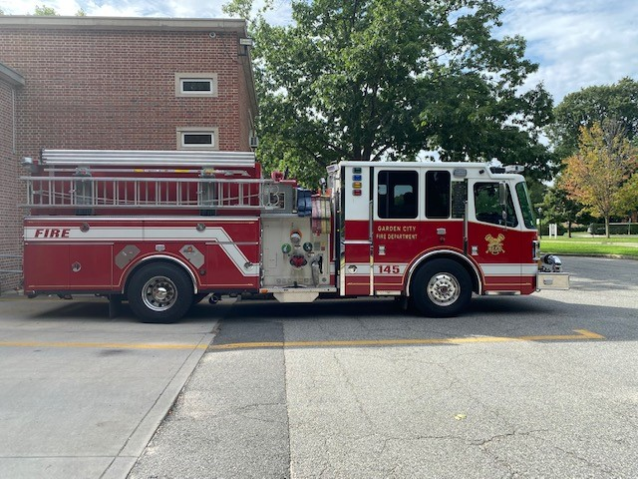
Station #1 Unit:145 2015 Ferrara Engine
Notes:
We are highlighting these vehicles and their pump panels over the next few slides as an example of what can happen without a continuity in administrative decisions over long periods time.

Slide 43
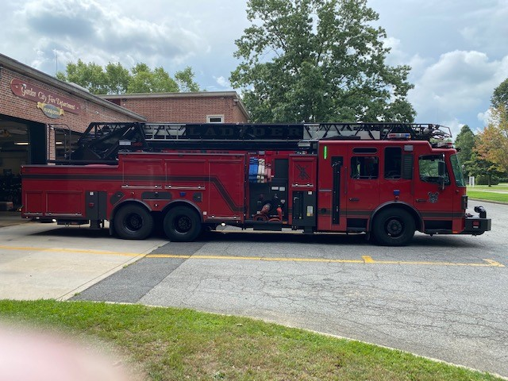
Station #1 Unit:147 2018 Ferrara Quintuple

Slide 44
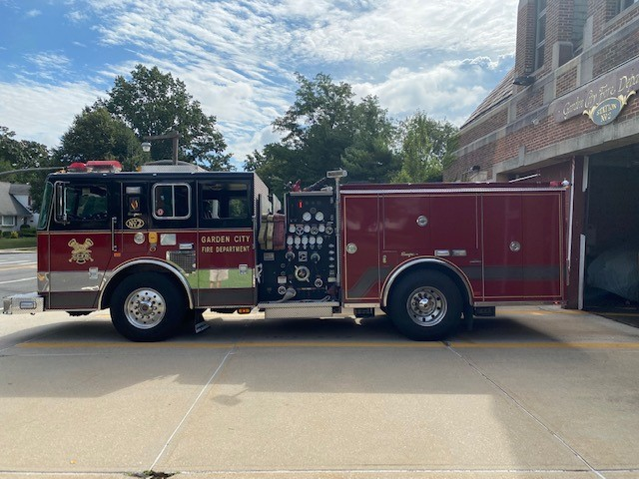
Station #2 Unit: 142 2004 Seagrave

Slide 45
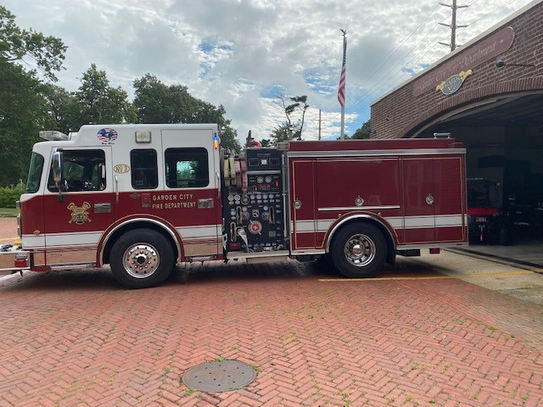
Station #3 Unit:143 2009 Spartan Crimson
Station #2 142

Slide 46
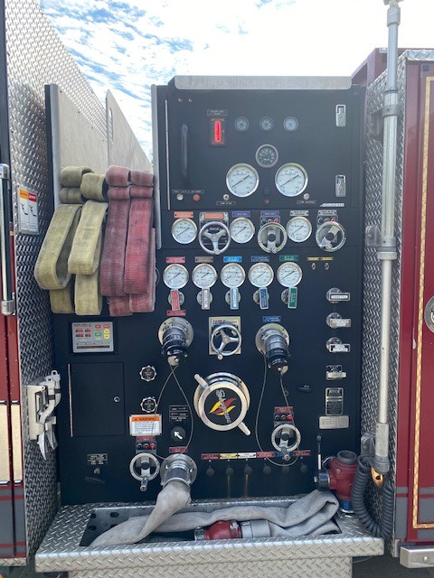
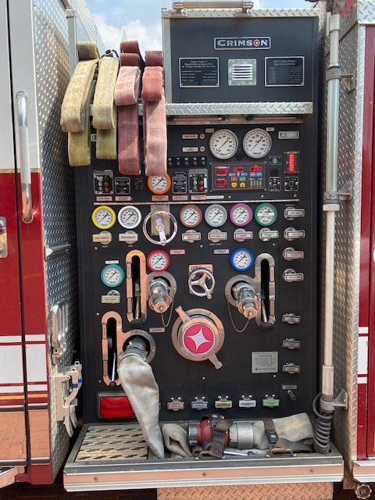
142
143

Slide 47
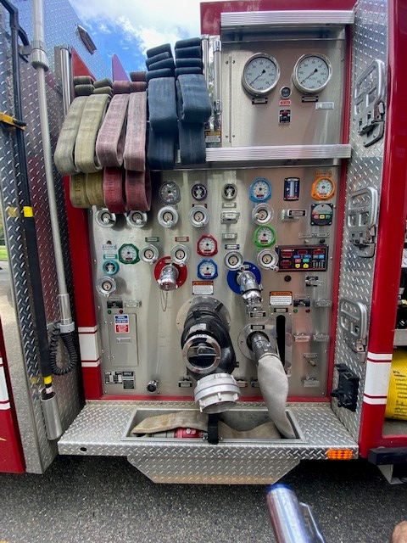
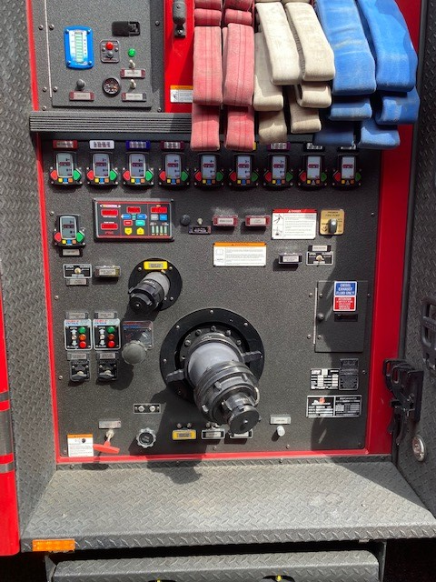
145
147
Notes:
Here is an excellent example of a common theme found during this subcommittees review. There are four different pump panels as you have been shown. Three of the 4 apparatus displayed are engine or pumper style rigs . All are from a different manufacturer.
The other, #147 is inherently different but it can be used to pump water but it also has the ability to be used for ladder/truck company operations .Thus known in the industry as a “quint”.
Shown here on this slide are 145’s(2015) and 147’s (2018) pump panels.
Both are from the Ferrara brand of fire apparatus.. These trucks were made just three years apart. These panels differ drastically in terms of technology, advancements and most of all in appearance
An operator has to be specifically trained on each of these panels. An operator may only have been trained on “just one” piece of equipment. That small but important issue multiplies successively with each pump panel. An operator having only have been trained on just one or even two of these will be impacted by the subtle or the not so subtle differences. Notice the labeling is prominent, but certain terminology may differ by manufacturer. Handles, knobs, gauges, and outlets may be laid out in a similar fashion or NOT on each apparatus. Even the colors, shapes and displays of these components vary greatly. This would confuse anyone that is not proficient on that specific rig, What happens when an operator is under stress ???.
This makes training difficult and ease of operation finite to only those trained and practicing their proficiency on each vehicle. (Say this Again!)
Since this realization of this particular administrative oversight The chiefs have embarked on training each operator on each of the pumps..
The structure of the department lends it self to the opinions of the design committee at the time and the purchase. These purchases are infrequent so each new purchases lends itself to specifications or opinions of that the committee.. There needs to be an effort to replicate equipment during purchases of this type of vehicles. The reason-So that use can easily be adapted to the current membership that provide service as “Operators” . Thus reducing the learning/training curves associated with the permissible timeframes of a volunteer department. This action is imperative.

Slide 48
Conclusions
Equipment
Detailed Equipment List Not Readily Available
Concerns related to maintenance and use of tools
Standardization is infrequent along with redundancy and under utilized pieces cause an inefficient approach
Generic Training Information
Proper Apparatus Maintenance is Performed
Apparatus Optimization
Type
Quantity
Allocation

Slide 49
Needs and Recommendations
Apparatus Life Cycles
Reduce apparatus purchase cycles to 10 to 15 years
Bulk purchasing
Facilitate standardization
Reduce maintenance costs
Optimize resale value
Reduce cost per unit

Slide 50
Needs and Recommendations
Apparatus Standardization
Equipment compartment location
Pump and aerial panel
Decrease overall training time
Increase members trained per apparatus
Increase proficiency
Decrease equipment access time
Increase reliability of proper operation

Slide 51
Needs and Recommendations
Redeploy Apparatus
Membership distribution
Greatest life hazard
Headquarters
145
New spare engine
146
Company 2 (West)
144
142
Company 3 (East)
147
143
Reduces response times
Increases probability of saving occupants
Reduce likelihood of property damage

Slide 52
Existing Facilities
Stations
Headquarters
Station 2 (West)
Station 3 (East)
Training Facilities
Village Yard
Water Works
1325 Franklin Avenue-Not Village Owned

Slide 53
Conclusions
General
Poor to near End of Life
No Master Plan
OSHA, Building, and Fire Code compliance issues
Stations
No Hot Zone design
Existing Conditions Assessments performed, only maintenance
Existing and new apparatus dimensional issues
Designed for a combination department
Training
No existing conditions assessments
Lacking training features to accommodate specific evolutions
Limited storage to protect Village investments in equipment
Insufficient or lacking infrastructure

Slide 54
Needs and Recommendations
Village Wide Programming
Evaluate existing uses, spaces, and allocation of spaces.
Propose future uses and locations based on current operations and potential future needs
Station 2 Design Competition
Issue RFQs
Geography
FD experience
Local experience
Select three design firms for competition
Retain a CM or GC for pricing
Retain one design firm

Slide 55
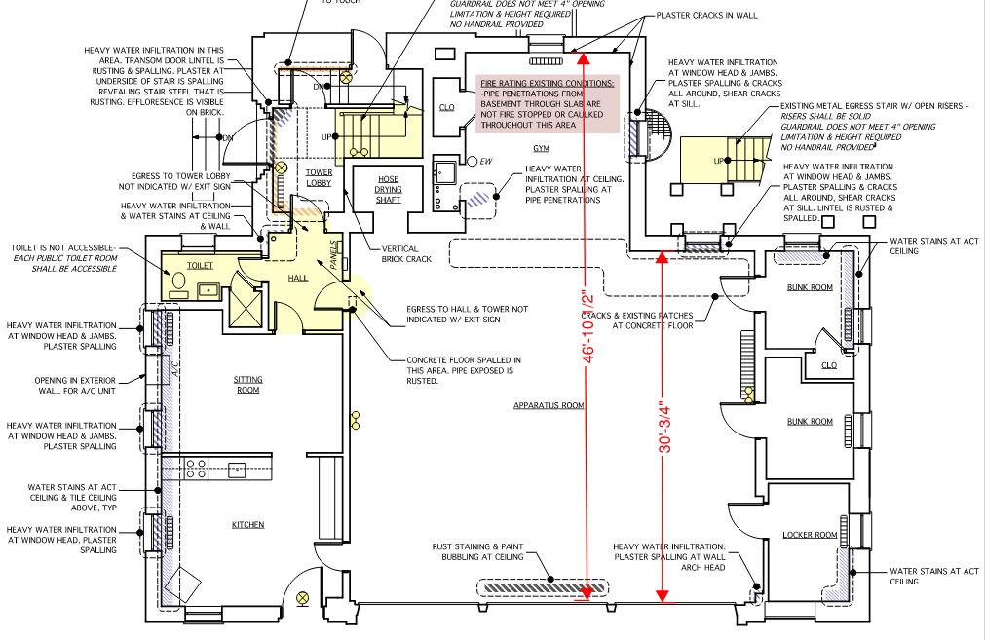
Needs and Recommendations
Apparatus Redeployment
Modify or reconstruct Station 2

Slide 56
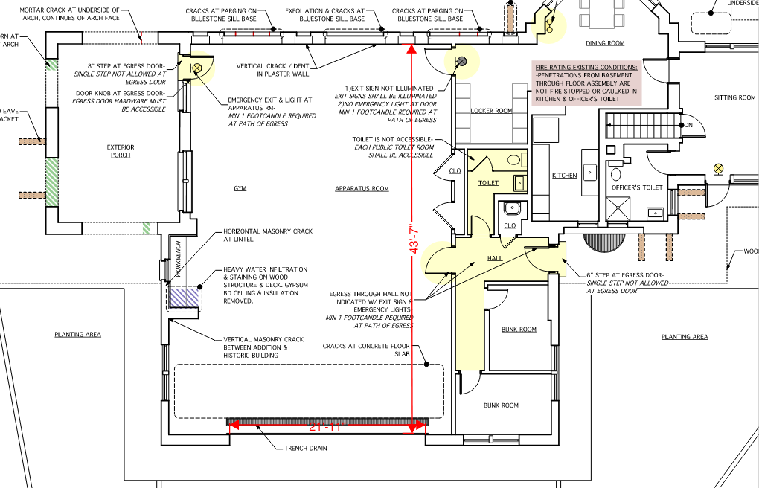
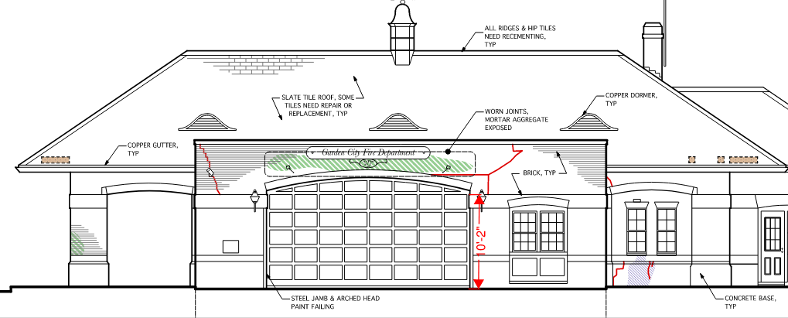
Needs and Recommendations
Apparatus Redeployment
Modify Station 3

Slide 57
Needs and Recommendations
Fire Protection Committee
Continue the operation
Fire Department Administrative Liaison
Hire a dedicated staff member for administrative tasks
Facilitate maintenance requests
Department accountability
Consistency between administrations
Prioritize fire protection and life safety

Slide 58
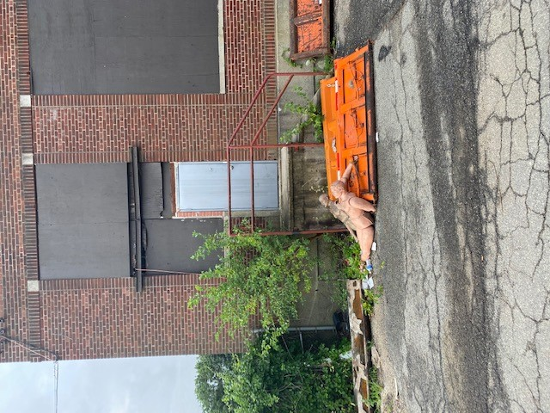
Needs and Recommendations
Village Yard
Apparatus Redeployment
Modify or reconstruct Station 2
Notes:
We chose this picture because greatly depicts the conditions throughout the site. Please look to the left of the door, Just above the tree growing out of the foundation. Above the tree over the steel bracing is the available electric for the volunteers use in this building “A weather beaten extension cord”.
Pushed through a penetration to that acts as a service feed.
Ironically the cord is draped over a steel support. We surmise this support has been placed to brace the brickwork from spalling forward any further. We know this because it is a common practice seen in aging masonry buildings.
As you see varying gates from Village trucks inhibit entry and valuable training pieces are stored or discarded on the exterior. There is only 450 sq/ft of useable training space in side the 2 floors of this structure - which approximately is just about the average size of a living room here in Garden City.
How can we expect 40 volunteers to train in this confined area once a week?

Slide 59
Needs and Recommendations
Training Facility Alteration or Construction of New
Interior firefighting operations
Mask confidence
Bail-out
Truck company operations
Rescue and removal operations
Roof operations
Interior engine operations
Yard hydrants
Electrical service
Sanitary facilities
Hydration facilities
Car fire and extraction operations
Dedicated and protected Department facilities
Accommodate necessary evolutions
Mutual aid operations
Complement EA&RP recommendations for training
Incorporate infrastructure for safe training

Slide 60
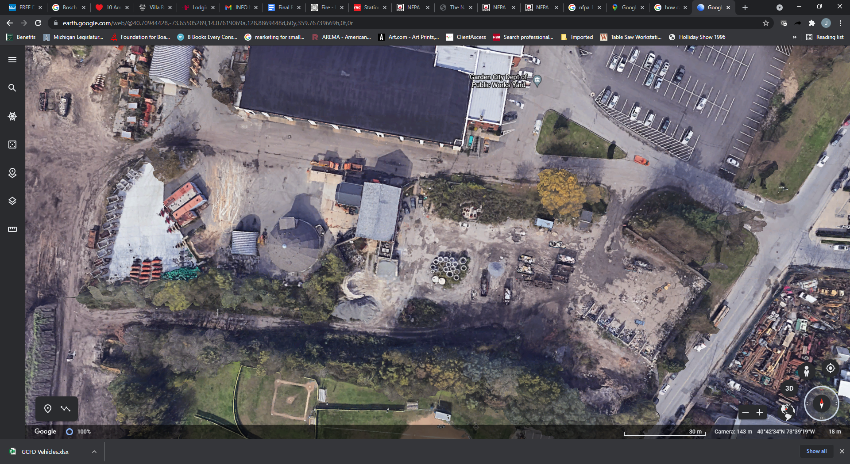
Site Layout of Village Yard

Slide 61
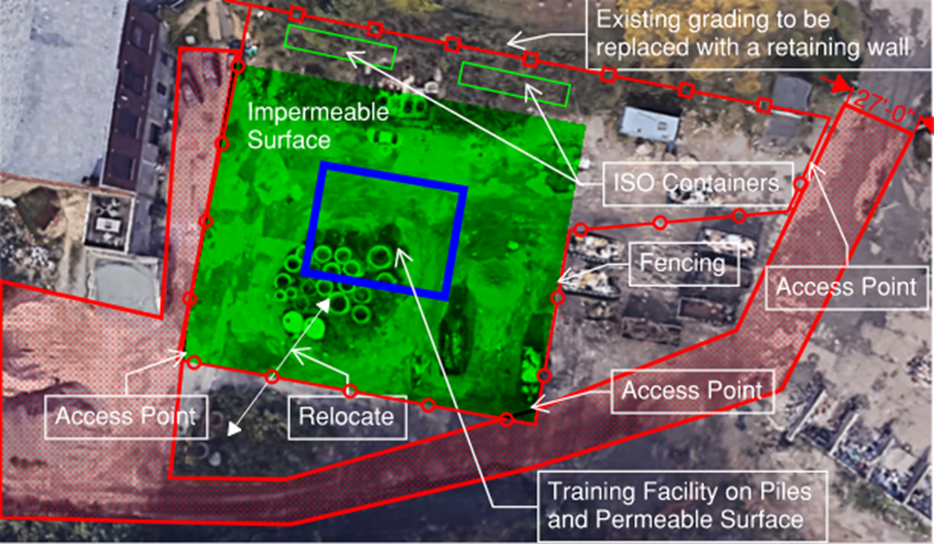
Notes:
Rudimentary layout of proposed training site

Slide 62
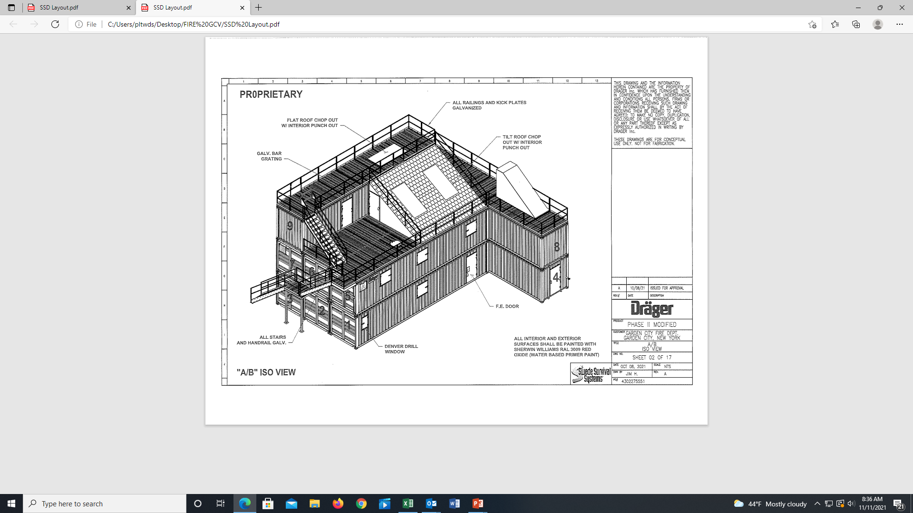
Needs and Recommendations
Apparatus Redeployment
Modify Station 3
Notes:
Example of a facility that consist of all the basic needs of training.

Slide 63
Fire Safety Committee
Master Plan and Risk Assessment Sub Committee
Executive Summary
Alarm / Fire Statistics & Improvement Suggestions

Slide 64
Objective
Provide input and guidance for assisting the Garden City Fire Department in developing a formal Master Plan and Risk Assessment.
Summarize improvement suggestions for discussion with the sub committees, fire department, and board of trustees.

Slide 65
Alarm Statistics from GCFD (% = False Alarms / Total Alarms)
Service demand over the years has been :
2013 - 978
2014 - 978
2015 – 1,043
2016 - 1,033
2017 – 1,020
2018 – 1,107
2019 – 1,137
2020 – 896
2021 (as of 8/28/2021) – 629
False Fire Alarms
2013 – 493 (50.41%)
2014 – 506 (51.74%)
2015 – 593 (56.86%)
2016 – 554 (53.68%)
2017 – 658 (64.51%)
2018 – 706 (63.78%)
2019 – 694 (61.04%)
2020 – 533 (59.49%)
2021 (as of 8/28/2021) – 398 (63.28%)

Slide 66
Fire Statistics from GCFD (% = Fires / Total Alarms)
Fire (structural, car fires, brush fires, cooking fires, outside rubbish fires, brush /
grass fires, chimney fires, fuel burner fires)
2013 – 69 (7.06%)
2014 – 59 (6.03%)
2015 – 55 (5.27%)
2016 – 67 (6.49%)
2017 – 36 (3.53%)
2018 – 43 (3.88%)
2019 – 34 (2.99%)
2020 – 39 (4.35%)
2021 (as of 8/28/2021) – 19 (3.02%)

Slide 67
Executive Summary – Improvement Suggestions
Continue to Expand Fire Prevention and Public Education Programs
Implement GCFD Master Planning, Administration, and Reporting
Invest in Recruitment and Retention Programs
Enhance Emergency Action and Response Plan
Improve Apparatus, Training, and Equipment
Update and Modernize Fire Houses in Compliance with Current Code and Safety Standards

Slide 68
1. Continue to Expand Fire Prevention and Education Programs
Increase extent and frequency of fire prevention education news and social media articles with specific focus on fire safety, smoke detectors, CO detectors, and exist drills in the home using materials readily available from NFPA.
Expand extent and frequency of training and education including scheduling classes at schools, senior center, adult education programs, and other village venues / events.
Incorporate fire safety and smoke / co detector feedback as part of alarms with check list provided to residents at completion of alarm with phone / email contact information for office of fire prevention.
Continue to emphasize compliance with village building and fire safety code and encourage more wide adoption of smoke detectors linked up with central alarm monitoring for earlier notification of alarms for residents to evacuate and fire department for response.

Slide 69
2. Implement Governance Master Planning, Administration, and Reporting
Complete Development of Comprehensive Master Plan and Risk Assessment identifying short, intermediate, and long-term improvements to be implemented in phases.
Strengthen administrative leadership and support for Fire Prevention, Training, and Administration to support fire prevention, education, training, and timely emergency response, as well as to oversee capital improvement projects. (GCFD to Consider Expanding LIFT fire prevention company contract to cover additional administrative areas)
Establish and communicate fire prevention, personnel status, training, and fire response performance measurements and reporting dashboard for periodic updates to Fire Commissioners and Board of Trustees.

Slide 70
3. Invest in Recruitment and Retention Programs
Expand budget and resources for supporting volunteer fire fighter recruitment and retention. Consider a combination of Stipend and Length of Service Award Programs (LOSAP) targeted to increase volunteer firefighter response, training, certification, apparatus operator qualifications, and membership.
Consider expanding a college program for students living in / near the village that attend college locally.
Consider changing attendance requirements moving away from a strict percentage / length of service model to factoring in time for duty crews, certifications, apparatus qualifications, and supporting training / recruitment.
Explore expanding Fire Department membership by targeted recruiting to former members, fire fighters from other towns that have moved in the village, active / retired professional fire fighters that live in the village, college graduates returning to village, and interested residents that have recently moved in the village.

Slide 71
4. Enhance Emergency Action and Response Plan
Consider Expanding Automatic Mutual Aid for General / Phone Alarms to include an engine company beyond a truck company currently included in the mutual aid plan.
Increase cross training of engine and truck company fire fighters and expand training of Motor Pump Operators (MPO’s) to increase Engine / Pumper response time to calls (GCFD has 21 firefighters in process of apparatus training / qualification).
Formalize duty crew scheduling for volunteer firefighters i.) at station and/or ii.) members who can respond from home for day & night-time to ensure coverage and identify any gaps. (GCFD already in process of implementing using Red Alert scheduling features).
Consider Implementing a Stipend Program for meals, refreshments and other expenses related to staffing firehouses with volunteer firefighter duty crews.
Establish response time goals and ensure sufficient fire fighters are available for response per NFPA 1720 through a combination of GCFD volunteer members, Village employees (GCFD or other LI FD’s) and monitor to determine if hiring of additional firefighters is need to meet goals.

Slide 72
5. Improve Apparatus, Training, and Equipment
Improve Fire Department Training Facilities & Resources by investing in a new training facility such as the Fire Training Structures (FTS) Manhattan or Sable system recommended by the Facilities / Apparatus Subcommittee to provide a more comprehensive, effective, and safe training facility.
Re-establish reserve engine to ensure all fire houses have an available engine when first line engine is out for maintenance or repair. (GCFD Planning to Restore with Next Engine Purchase)
Standardize engines and equipment to promote interoperability, increased efficiency and streamline training for operators.

Slide 73
6. Update and Modernize Fire Houses in Compliance with Current Code and Safety Standards
Remediate Fire House Safety Issues identified by Facilities and Apparatus Sub Committee to create a safer working environment for fire department personnel.
Modernize Firehouses for Company 2 & Company 3 to increase efficiency, create a safer / more productive work environment for duty crews, and expand space for equipment and training.
Expand Apparatus Bay for Company 2 and 3 to allow storage of first line and reserve engines with a deep enough bay to house the heavy rescue or ladder company for storm standbys.
Provide for a training room with proper technology for networking, computers, projectors, and white boards is available for training / classes for firefighters and fire prevention classes for residents.

Slide 74
More Comprehensive Analysis and Information follows within 1) the Draft Strategic Plan / Risk Assessment and 2) Sub Committee Reports.

